Slide 1


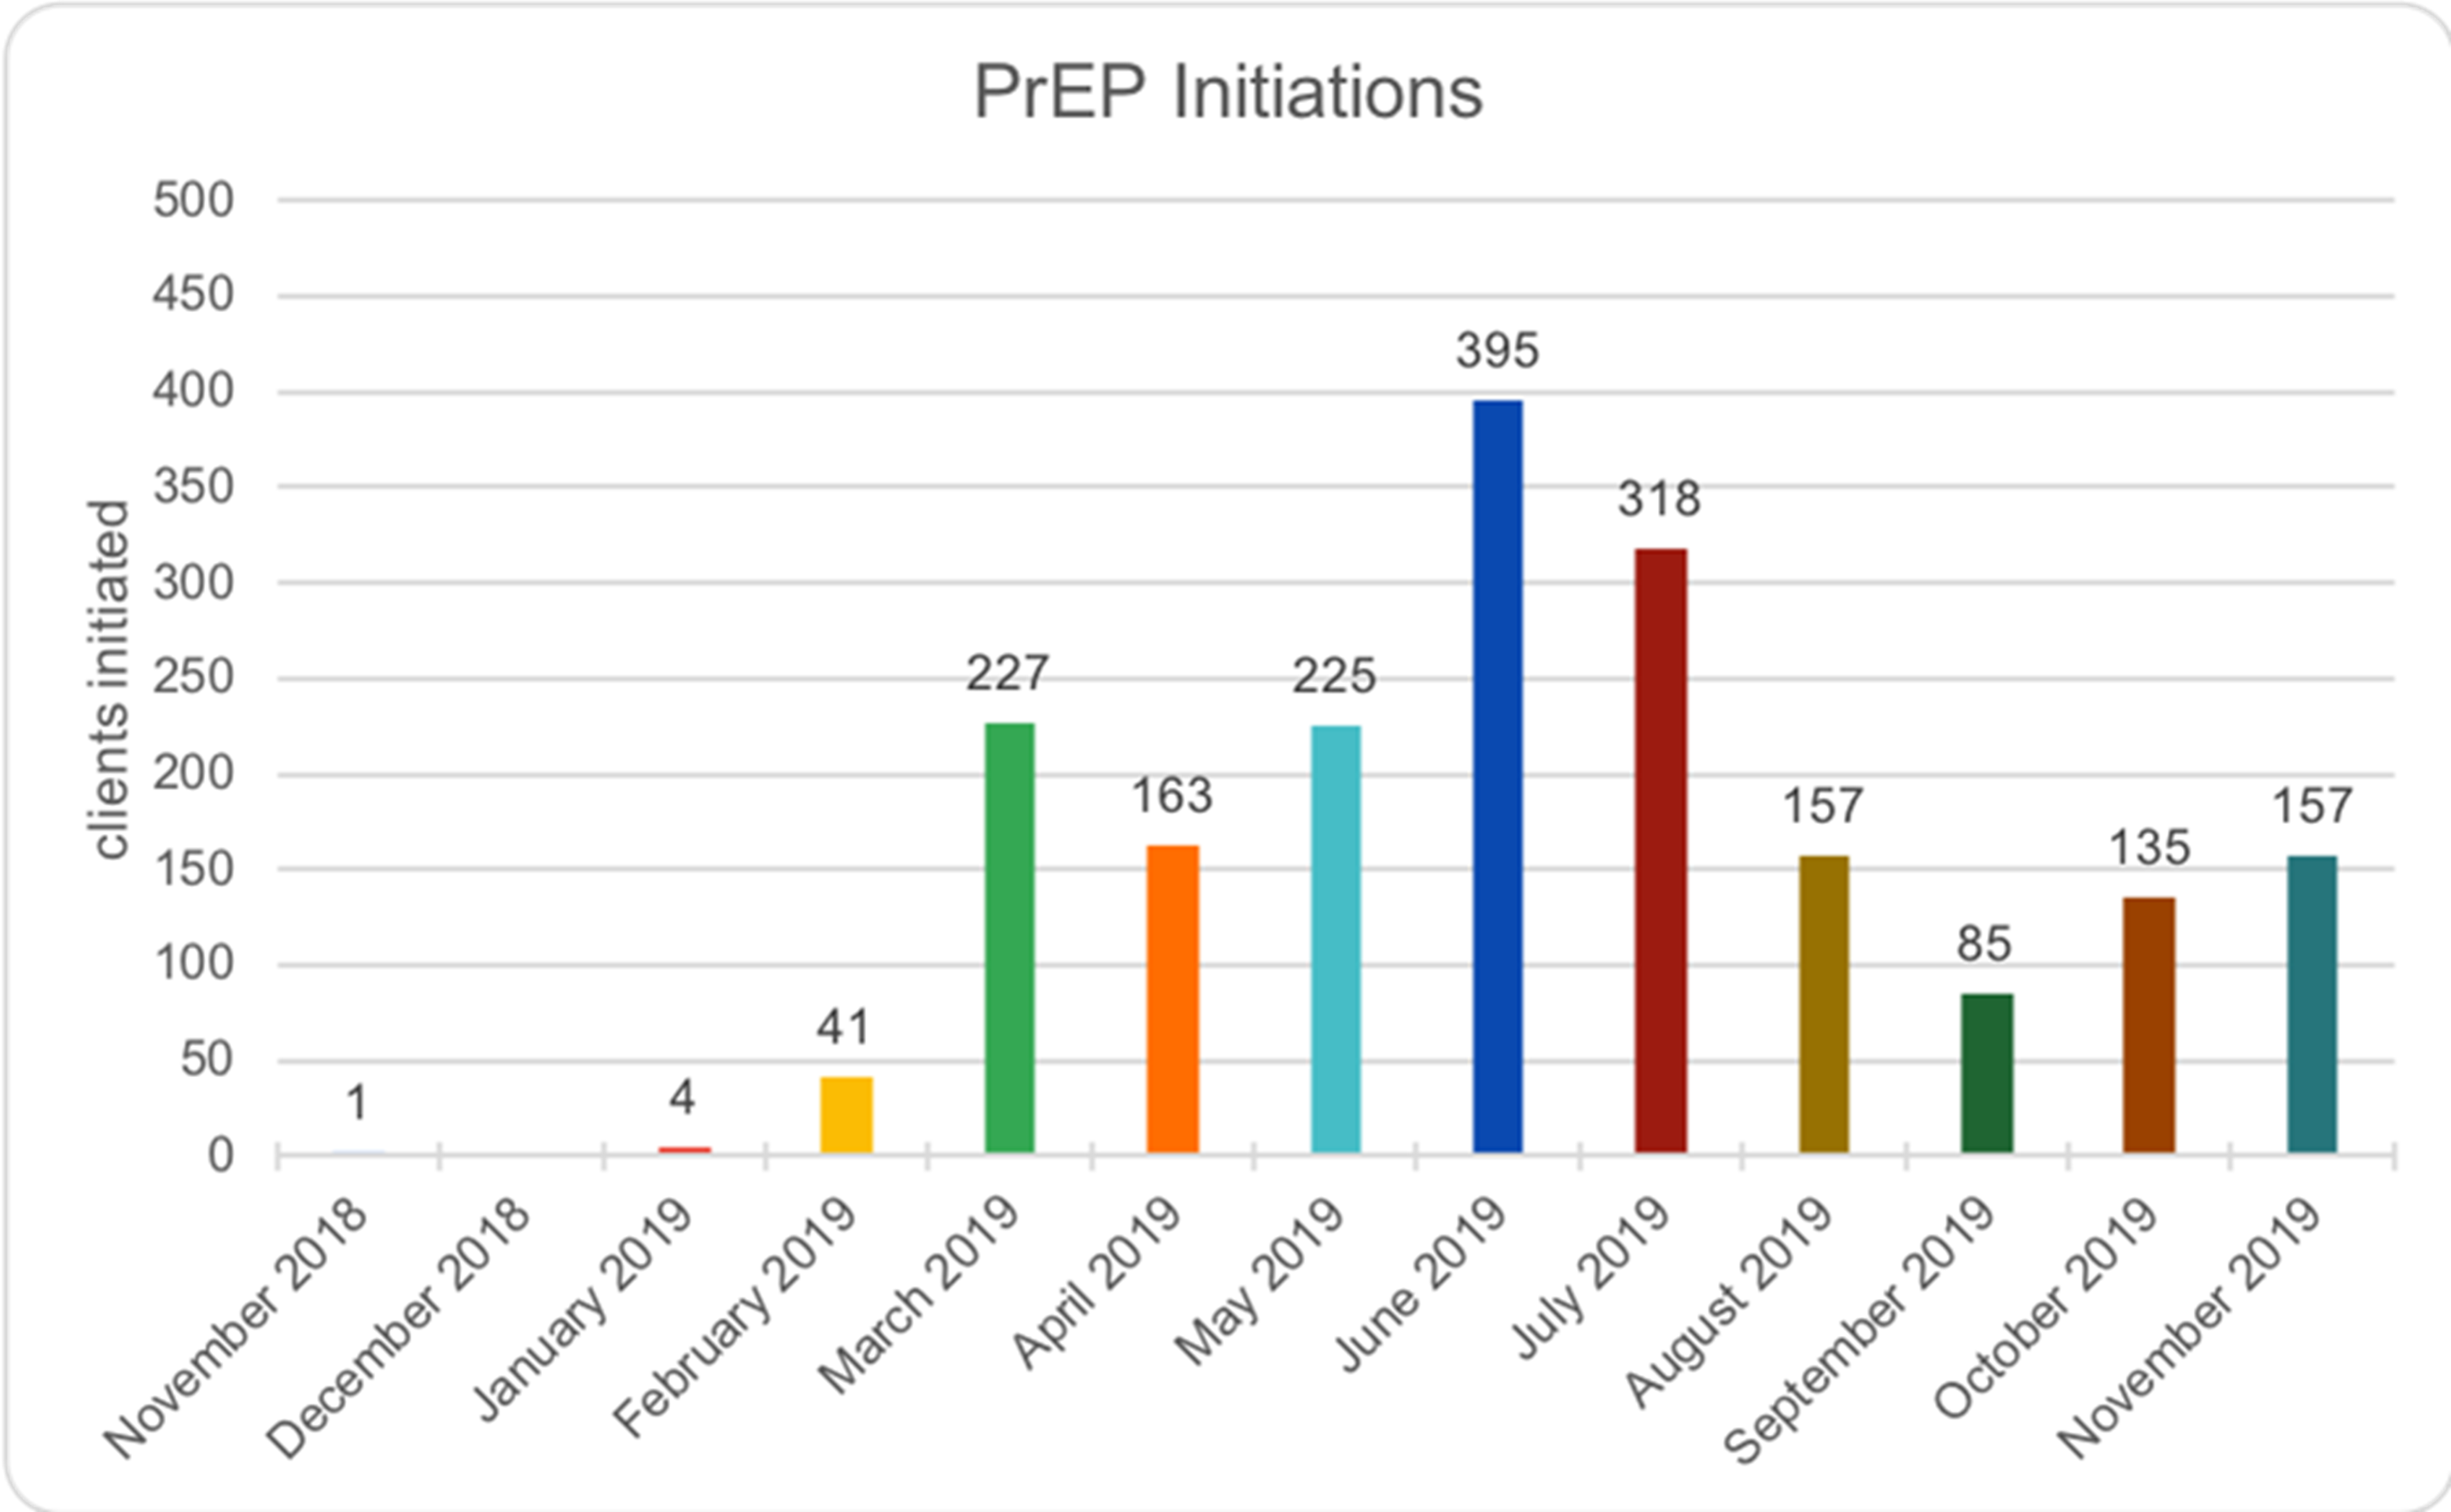

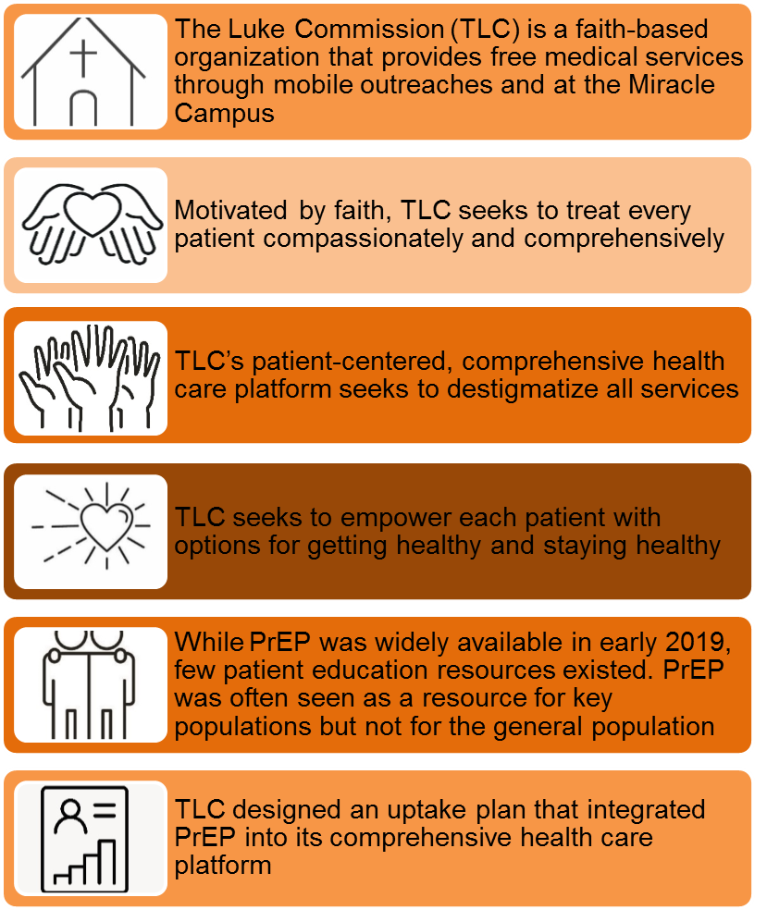
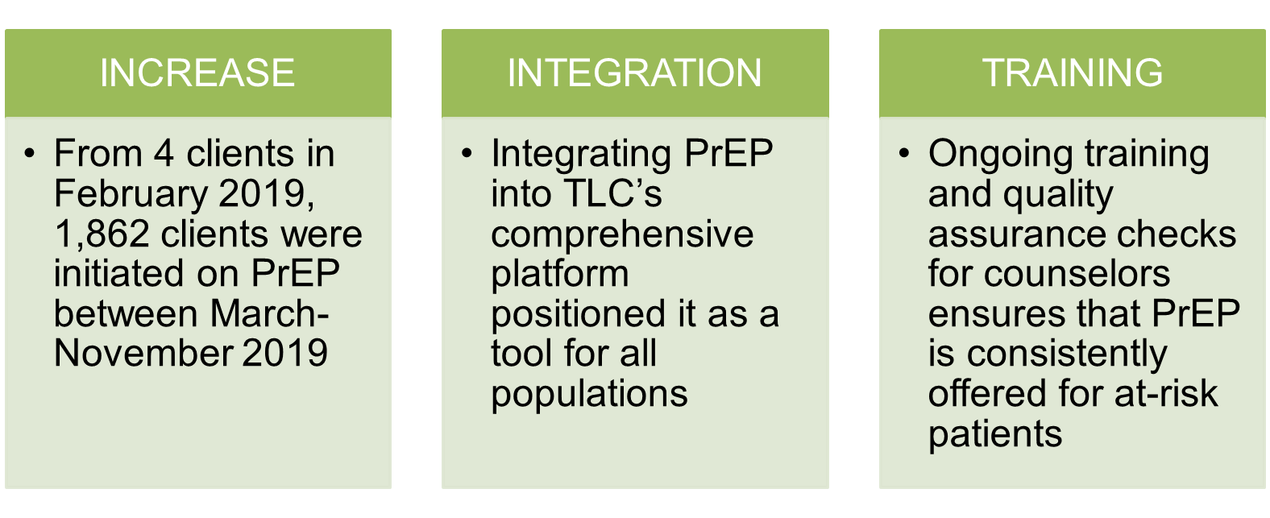
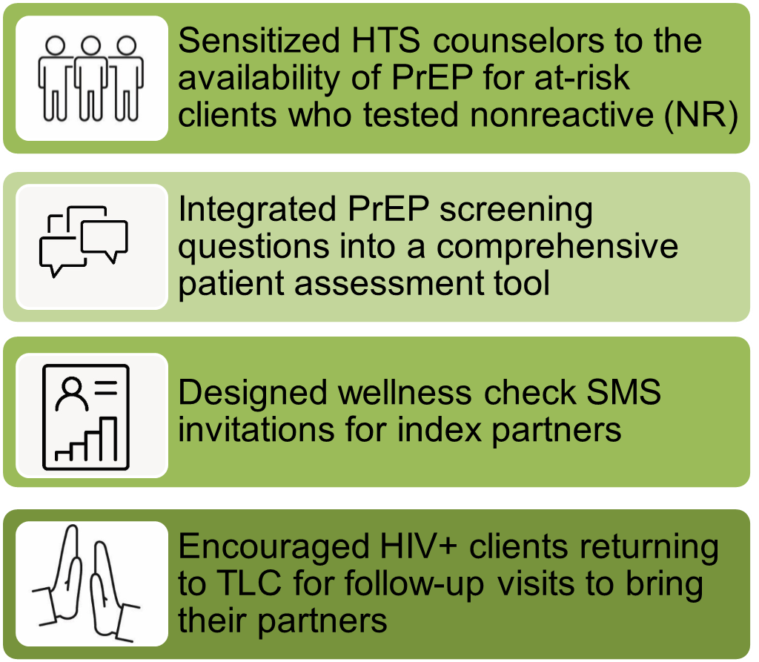
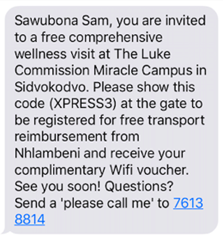

Increasing PrEP Uptake through HTS Counselor Sensitization, Integrated Screening, and Client Education
Authors: VanderWal, Echo; Benzerga, Wendy; Lukhele, Njabuliso
Background
Table 1: PrEP Initiations
Conclusions
Initial uptake of PrEP was high in the early months of the initiative; however, one-month retention was low as many clients did not return for a first refill. In response, TLC adjusted strategy to focus on more extensive education and counseling about consistent use of PrEP
By including a private code in SMS invitations, indexed HIV-negative clients were identified to counselors without stigma as potential candidates for PrEP.
Description
Lessons Learned
Sample SMS for Index Clients
Contact: Echo VanderWal, The Luke Commission, Eswatini, vanderwal@lukecommission.org

