Slide 1
“Addressing COVID-19 vaccination stigma in Faith Communities in Zambia”
Gibstar Makangila
Executive Director
Circle of Hope, Lusaka Zambia
“Addressing COVID-19 Vaccination Misinformation, a follow up”
January 19, 2022

Slide 2




About Circle of Hope
Circle of Hope (COH) is a faith-based organization that is responding to HIV and COVID-19 pandemics in communities in Zambia.
Riding on its success in HIV prevention, treatment and care at community level, COH has engaged in the COVID-19 pandemic response from both mitigation of the COVID-19 virus and promotion of the COVID-19 vaccine uptake at household and community levels.
Engagement critical success factors include:
  Community-level relationships with particular in-road within the Faith Community
  Faith-engaged community posts (CPs) dotted around various districts used as COVID-19 vaccine rallying centers
  Customer Care anchored by the RECIPE
  Robust collaboration with Ministry of Health (MOH)
  Robust collaboration with the Donor Community

Slide 3
Key Barriers to COVID-19 Vaccine access and uptake in Faith Communities
Stigma of COVID-19 and vaccines
Misinformation, myths and misconceptions
Vaccine hesitancy – driven by the legitimacy of vaccinating adults instead of infants & children
Erroneous application of Religious Doctrines – eschatology & new world order teachings
Half-truths promoted through Social Media – origin, efficacy, side effects and purpose
Access issues – location, time and flexibility
Use of two-tier vaccines (particularly in rural settings)
Prioritizing prayer, holy water & holy oils over vaccines and medicines

Slide 4
Key Drivers of Stigma in Faith Communities
Misinformation, myths and misconceptions
Absence of testimony from publicly-influential role models taking the COVID-19 vaccine
Limited Pulpit sensitization from Faith Champions/Clergy
Minimal Pulpit sensitization from known health workers who are also congregants and members of Churches/Mosques/Temples
Absence of vaccination centers in Faith Community Settings and Houses of Worship
Concealment of cause of death during funeral sermons in cases of COVID-19 fatalities
The fear to be isolated, quarantined and swift & poorly attended funerals

Slide 5
Strategic Engagement of the Faith Community
Building of capacity among community influencers to disseminate accurate information on the COVID-19 vaccine that promotes vaccine uptake
Publicly addressing myths, misconceptions and misinformation in congregational settings
Capacitation of faith leaders to be messengers of hope and spread positive COVID-19 messages promoting COVID-19 vaccine uptake within the faith community
Provision of support to Faith Community networks and structures including volunteer allowances, psychosocial counselling, depression, suicide, household poverty, etc. where feasible
Provision of support to the elderly in accessing the COVID-19 services in congregational settings
Provision of access to vaccine centers through the COH CPs embedded in communities
Provision of mobile vaccine centers and help desks in churches, mosques after worship services
Promotion of love, care and responsibility underpinned by the RECIPE message in Faith settings
Invitation of MOH staff to give 10 min pep talks to congregations before main sermons

Slide 6
Quote from a Faith Champion (Clergy)
Several key community leaders have been reached who initially had reservations on COVID-19 vaccine uptake.
Bishop Sakala of BIGOCA Church, Lusaka, had this to say:
“To be protected from COVID-19, I saw to it that faith alone is not enough and as a Pastor it is
important to be a living example to the community. To me this is the message of hope to my
fellow men and women of God. I saw to it that it is a good combination of practice of faith
and hope even to the church I am pastoring. To the unvaccinated, it is very vital to be
vaccinated to prevent oneself from this pandemic attack before its too late. I urge all those
who are not yet vaccinated to do so and stop hearing from unfounded statements.”

Slide 7
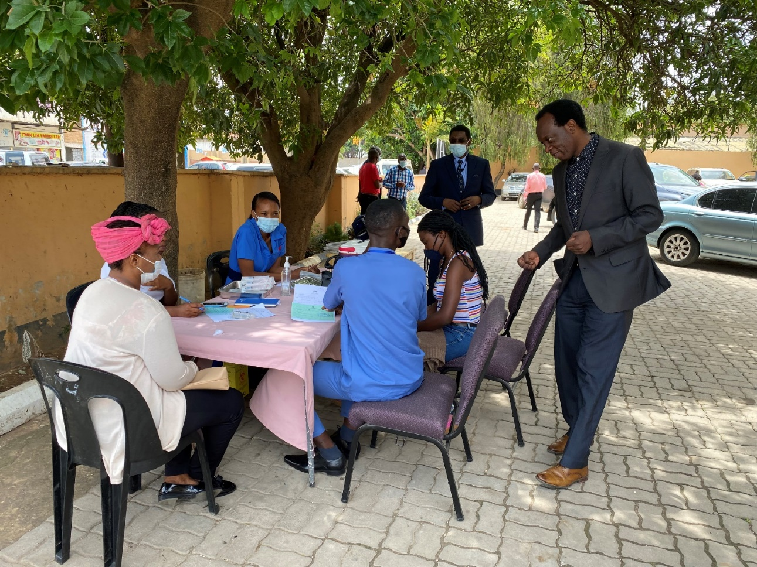
A Clergy observing the vaccination within church grounds

Slide 8
Quote from a Community Health Worker
A trained and oriented COH Community Health Worker, Mr. Simbuwa Mutanuka, aged 56 from Lusaka, Zambia had this to say:
"I came to the decision after I received information about the benefits of being vaccinated,
especially at my age. Further, after witnessing first hand many COVID-19 illnesses and deaths
in my neighborhood and community at large I resolved to protect myself and my family."
My message to those who are unvaccinated is that they need to get vaccinated because the
vaccine protects them individually, as families and the community at large. I will tell them
that the vaccine is good for them because it will boost their immune system in case of
infection with the COVID-19 virus."

Slide 9
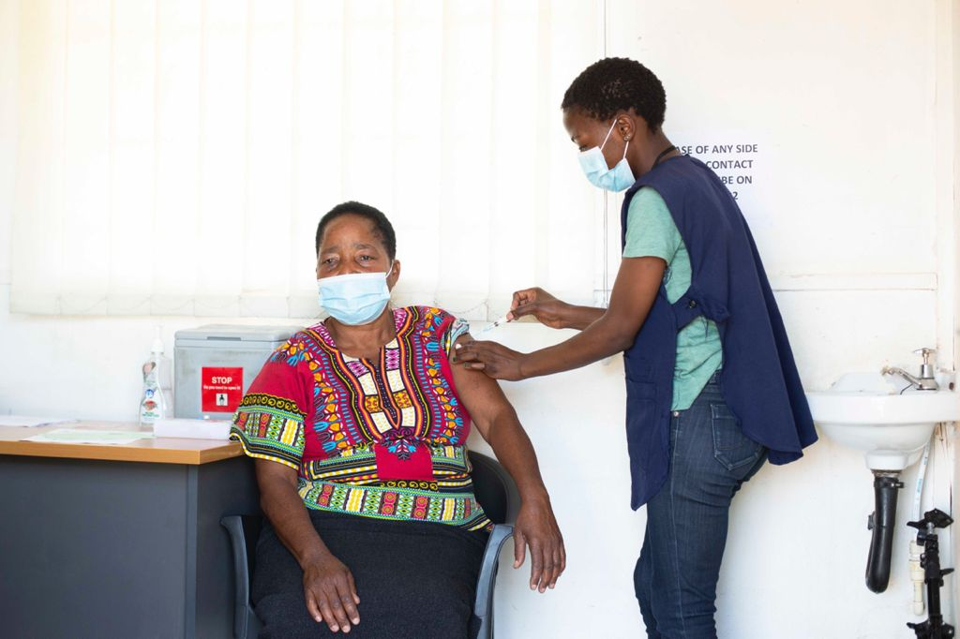
Vaccination at a faith engaged COH CP

Slide 10
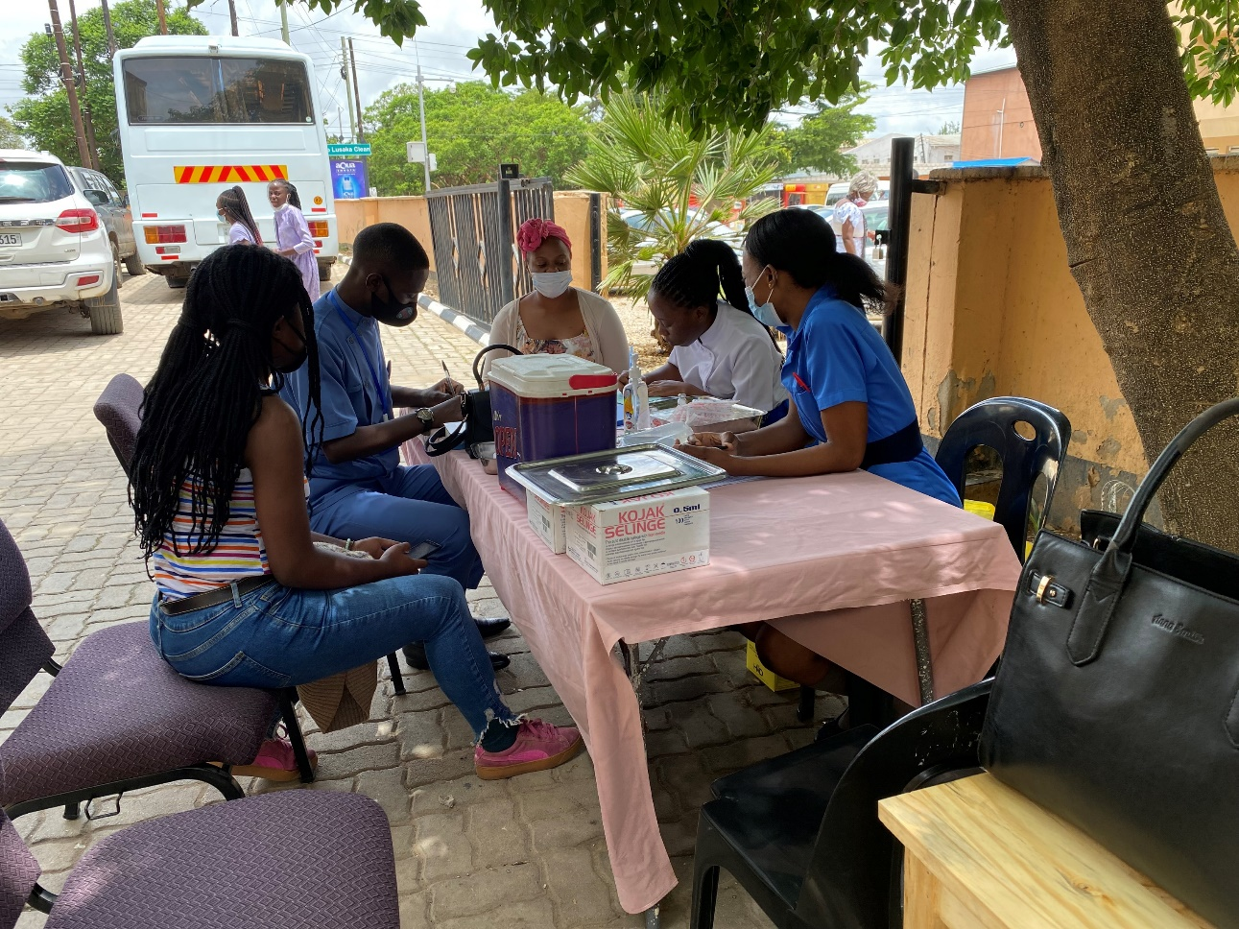
Mobile vaccination centers established in faith communities at days of worship

Slide 11
The Faith Community begun to use their pulpits to disseminate COVID-19 prevention and vaccine uptake promotion messages e.g. Northmead Assembly of God Church, Lusaka, Zambia https://drive.google.com/file/d/1vsrgLrzAu-2kPUYH3yG7gsXBrhjoS-8_/view?usp=drivesdk
Bishop Joshua HK Banda on COVID-19 Vaccines Myths & Misinformation
https://youtu.be/LfVDQ536Ru8
Sister Astrida Banda, Catholic Church https://youtu.be/vI7xa7HLpq4
The inherent capacity of the Faith community to sustain the fight to promote COVID-19 vaccine uptake https://youtu.be/QX36L1_MCNg

Slide 12
Faith-engaged COH Vaccination Centers’ Performance Comparison of other Non-Ministry of Health Facilities engaged in vaccinations in Lusaka District Oct’ – Dec’ 2021.
Period | Oct-21 | Nov-21 | Dec-21 | Total | Percentage contribution
Organization Name
Care for Business Hospital | 52 | 38 | 85 | 175 | 1%
Chreso Ministries Health Centre | 284 | 192 | 443 | 919 | 5%
Circle of Hope Health Centre (CPs) | 1663 | 5139 | 8209 | 15011 | 75%
Coptic Hospital | 18 | 1 |  | 19 | .1%
Fairview Hospital | 324 | 202 | 109 | 635 | 3%
Kabelenga Family Hospital | 41 | 93 | 67 | 201 | 1%
Medland Hospital | 268 | 79 | 273 | 620 | 3%
Mutti-Kabelenga Health Services Ltd | 42 | 127 | 124 | 293 | 1.5%
Unicohs University Hospital | 54 | 74 | 91 | 219 | 1%
St John Paul ii orthopeadic Mission Hospital | 160 | 225 | 311 | 696 | 3.5%
The Hill Wellness Centre – Family Legacy Missions Zambia |  |  |  |  | 0%
Victoria Hospital | 27 | 14 | 42 | 83 | 0.5%
Mum's Care Hospital | 135 | 345 | 317 | 797 | 4%
Forest Park specialized Hospital | 110 | 39 | 146 | 295 | 1.5%
Total | 3 178 | 6 568 | 10 217 | 19,963

Slide 13
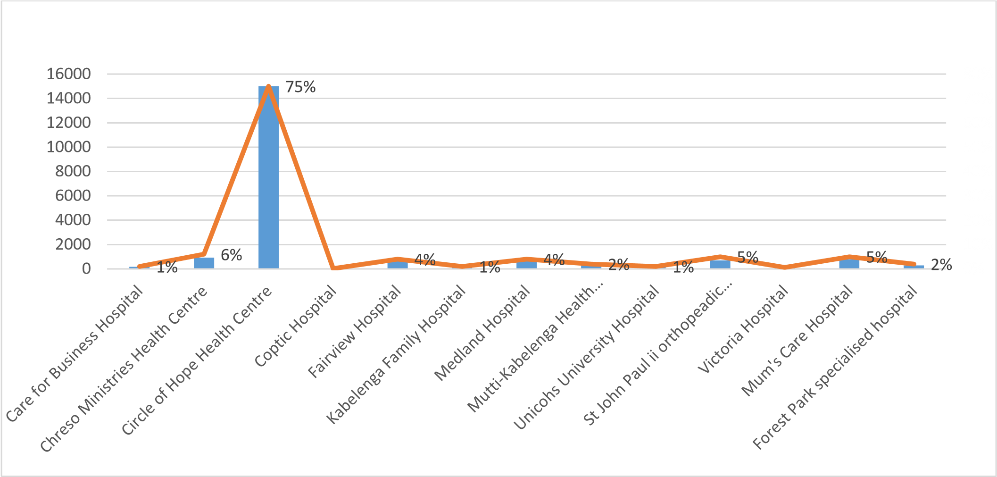
Graphical depiction of Engaged COH Vs Non MOH vaccinations in Lusaka District Oct’ – Dec ‘21.

Slide 14
Vaccinations by Month,
July – December 2021

Slide 15
Performance Update July - December 2021
COH PERFORMANCE
Number of people sensitized through one to one | 151,838
Number of sensitization / education meetings or advocacy products held or disseminated (community meetings held by CHWs. Dissemination during sermons by Faith leaders) | 94,926
Number of congregants/groups above 45yrs that received COVID-19 Vaccine Messages during sermons or messages | 311,634
Number of congregants reached via media/social media dissemination of COVID-19 Vaccine Messages of Hope (WhatsApp, Facebook, you tube) | 124,004
Number of COVID-19 vaccine IEC material printed / distributed | 14,000/14,000
Number of people who were referred for COVID-19 vaccine services | 323, 168
STAFFING
Ministry of Health staff | 51
Circle of Hope staff | 224

Slide 16
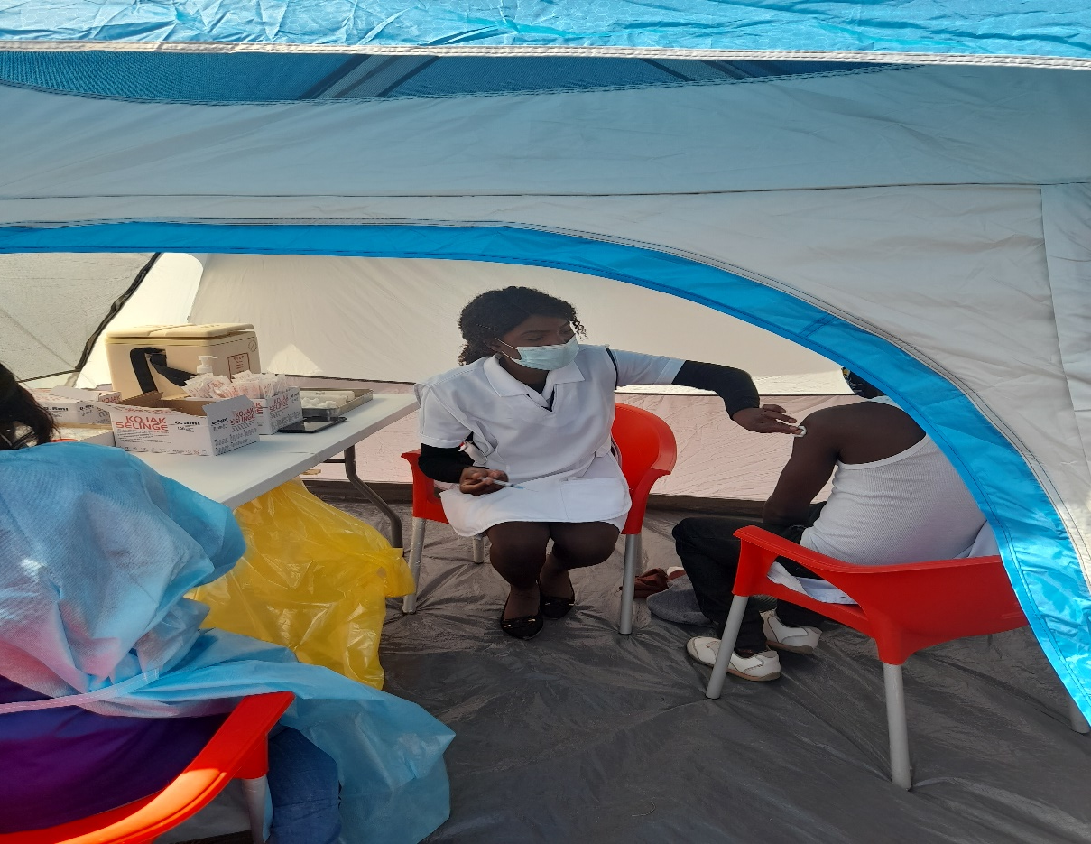
THANK YOU

