Slide 1
SUSTAINABILITY OF FAITH BASED PROGRAMS; EDARP’S APPROACH
John Motoku 16th February, 2022

Slide 2
Outline
Introduction
Technical Program areas
Key sustainability Initiatives
Challenges & Solutions
Acknowledgments

Slide 3
Eastern Deanery AIDS Relief Program (EDARP)
Founded
1993
Lab support / TA by CDC
1996 NTLP (TB LAB)
PEPFAR Funding
CDC Implementing Partner
FBO – Roman Catholic
Support from German Catholic community
2001 CDC
2016 – Pepfar 3
2004 – Pepfar 1
2010 – Pepfar 2

Slide 4
V
I
M
I
S
S
I
O
N
VISION
To offer Sustainable quality healthcare for all.
i
O
MISSION
We shall provide affordable quality patient centered health care services in a Christ like manner with competence and excellence.
N

Slide 5
Direct implementer - stand-alone integrated services
Community model of HIV/TB care
Contributes towards achieving Universal 95-95-95 Strategy in Nairobi County
Aligned to PEPFAR’s three guiding pillars of accountability, transparency and impact

Slide 6
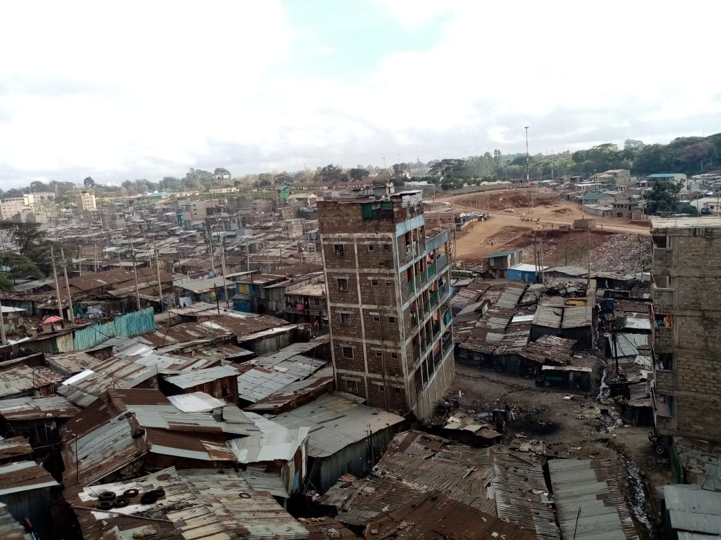

Slide 8
Key Sustainability Initiatives
Collaboration with MOH and NMS
Commodity supply
Pharmaceuticals (ARV & non-ARV)
Lab (CD4, VL & EID)
HRH- staff secondment (Vaccine roll out)
Lab support to National program (VL for Machakos County)
Participation in County and National TWGs
Partnerships with faith Institutions & other FBOs
VMMC program – Cost sharing
SVAC- Faith leaders as resource persons
FCI Steering committee
Partnership with other FBO Partners e.g. OVC
Strengthening existing community resources
CHWs- Trained volunteers
ART decentralization – community screening & delivery (ART/TB/TPT)
Private institutions- Training of HCW

Slide 9
Challenges and Solutions
Challenges
Donor/ PEPFAR dependent funding
Health budget nationally is sub-optimal
Inconsistent commodity supply pharmaceuticals
HRH Labor disputes
Scanty evidence of community participation / budget making process at the County level
Solutions
Leverage on national (NHIF & UHC) and private insurance
Buffer stock, engagement with CDC & national supply chain
Planning and restructuring
Community participation in budget making process

Slide 10
Acknowledgements
PEPFAR
CDC
MARYKNOLL FATHERS
EASTERN DEANERY FATHERS
GOK/NASCOP
EDARP CLIENTS
EDARP STAFF/CHWs

