Slide 1
Under the Radar: Global Minimum Estimates for
Pandemic-Associated Orphanhood and Death of Caregivers
Susan Hillis, PhD, MS
COVID-19 International Task Force
Centers for Disease Control and Prevention
July 15, 2021
On behalf of Dr Juliette Unwin, Prof. Lorraine Sherr, Yu Chen, Lucie Cluver, Philip Goldman, Seth Flaxman, Oliver Ratmann, Christl A. Donnelly, Samir Bhatt, Gretchen Bachman, Laura Rawlings, Phil Green and Charles A. Nelson.
www.cdc.gov/coronavirus/2019-ncov/global-covid-19/index.html
Notes:
Thank you for joining us today as we share what we are learning
from faith leaders around the world,
about leading by example with hope
during COVID-19.

Slide 2

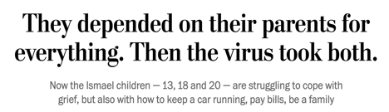
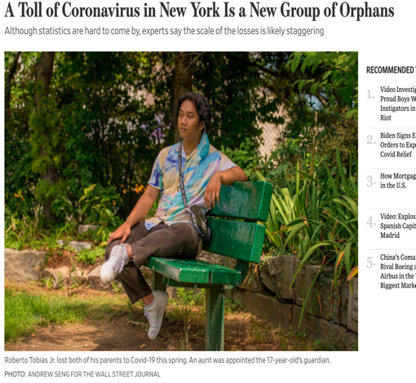

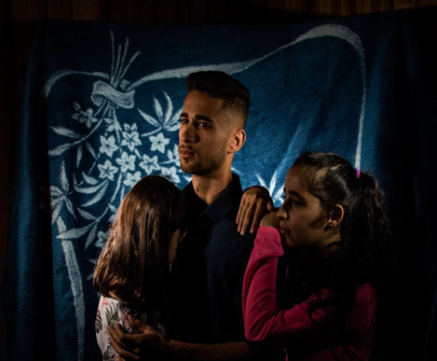
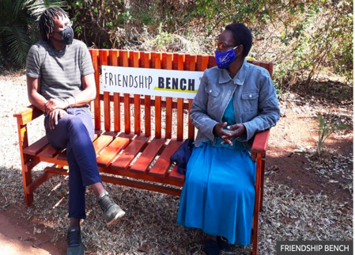

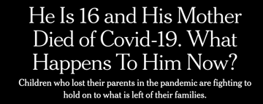
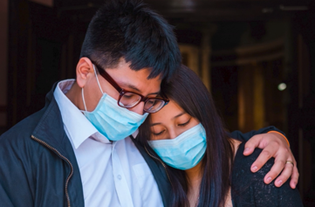
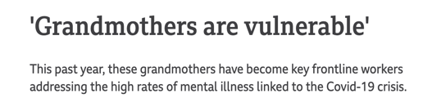
Global Impact of COVID-19-Associated Deaths on Orphans and Caregivers

Slide 3
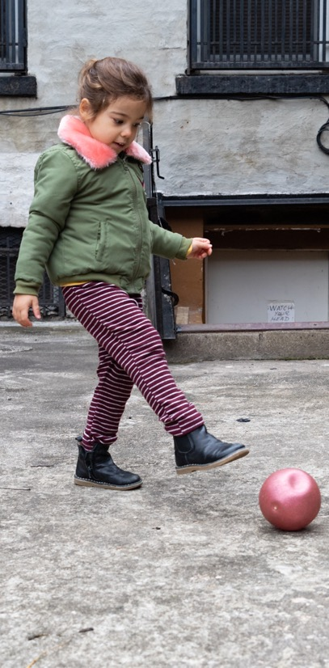
Background
COVID-19 responses focused on identification, mitigation, response, and treatment of SARS-CoV-2
  > 100 million cases and > 2.5 M deaths (Mar 2021)
Most deaths among adults
  Many are parents of children left without caregivers
  (Similar to AIDS, Ebola, 1918 Influenza pandemic)
Loss parents & caregivers → serious consequences
for children
  Increased risks of mental health problems, suicide, violence, economic hardships, infectious diseases, adolescent pregnancy, chronic diseases, premature mortality
© UNICEF/UNI316269/Bajornas

Slide 4

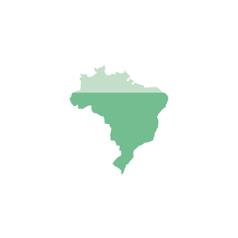
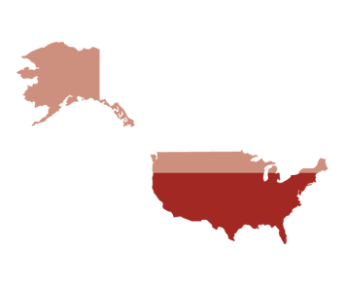
Background
Early evidence of challenges with parental or caregiver losses
  Adoption and foster care services strained by COVID-19
  Role of grandparents (more vulnerable to COVID-19) taking care of children:
Brazil
USA
UK
    Globally
    20%
    70%
    40%
    40%
    of children receive some support from grandparents
    of grandparents living with children serve as primary caregivers
    of grandparents provide regular care for children
of population (often in multigenerational households)
Goal: To provide a global minimum estimate of pandemic-associated orphanhood and caregiver deaths using data from 18 countries, representing 77% of global COVID deaths in 2020

Slide 5
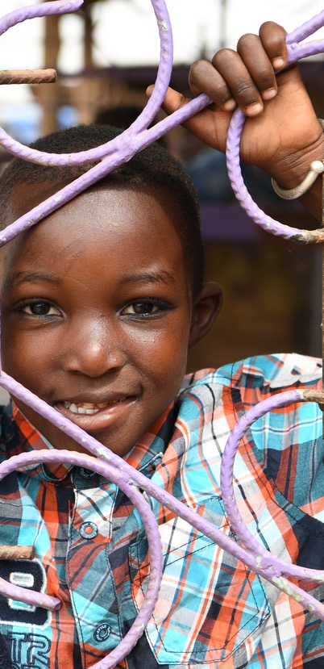
Methods
Estimated orphanhood/caregiver loss using excess mortality, COVID-19 mortality, and calculating male and female fertility rates
Orphans: Using mortality rates by age/sex, estimated average number of children age <18 by summing the average # of children born (to a man or woman over each of past 17 years, for age they were that year. (Adjusted for double orphans)
© UNICEF/UNI318699// Frank Dejongh

Slide 6
Methods
Loss of co-resident grandparents/caregivers:
  Prevalence of skip generation grandparents > age 60, living with grandchildren, in absence of parents
  Prevalence of grandparents or other potential caregivers > age 60, living with a household member of 0-19 years-old
Extrapolated global estimates of numbers of children orphaned or losing grandparents/caregivers, via logistic model using Institute for Health Metrics and Evaluation fertility rates to predict ratios of orphans or caregiver loss to deaths, for every country in the world
© UNICEF/UNI318699// Frank Dejongh

Slide 7
Minimum Estimates of Children Experiencing COVID-19 Associated Death of Parents and/or Caregivers*
Values > 100,000
13,404
56,514
2,794
8,617
5,542
5,782
136,692
5,979
54,180
203,549
4,487
186,972
10,402
50,083
4,869
136,572
189,899
2,532
2,987
19,504
119,242
Range
Total: 1,041,383
*March 1, 2020 – April 30, 2021
2,794
203,549
Notes:
Numbers of children who have lost primary or secondary caregivers from countries associated with 77% of COVID-19 deaths up to 30 December, 2020.

Slide 8
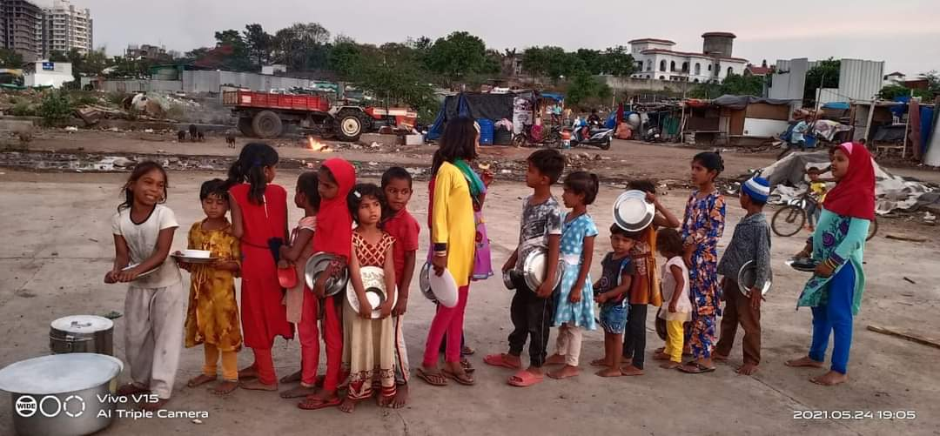

Slide 9
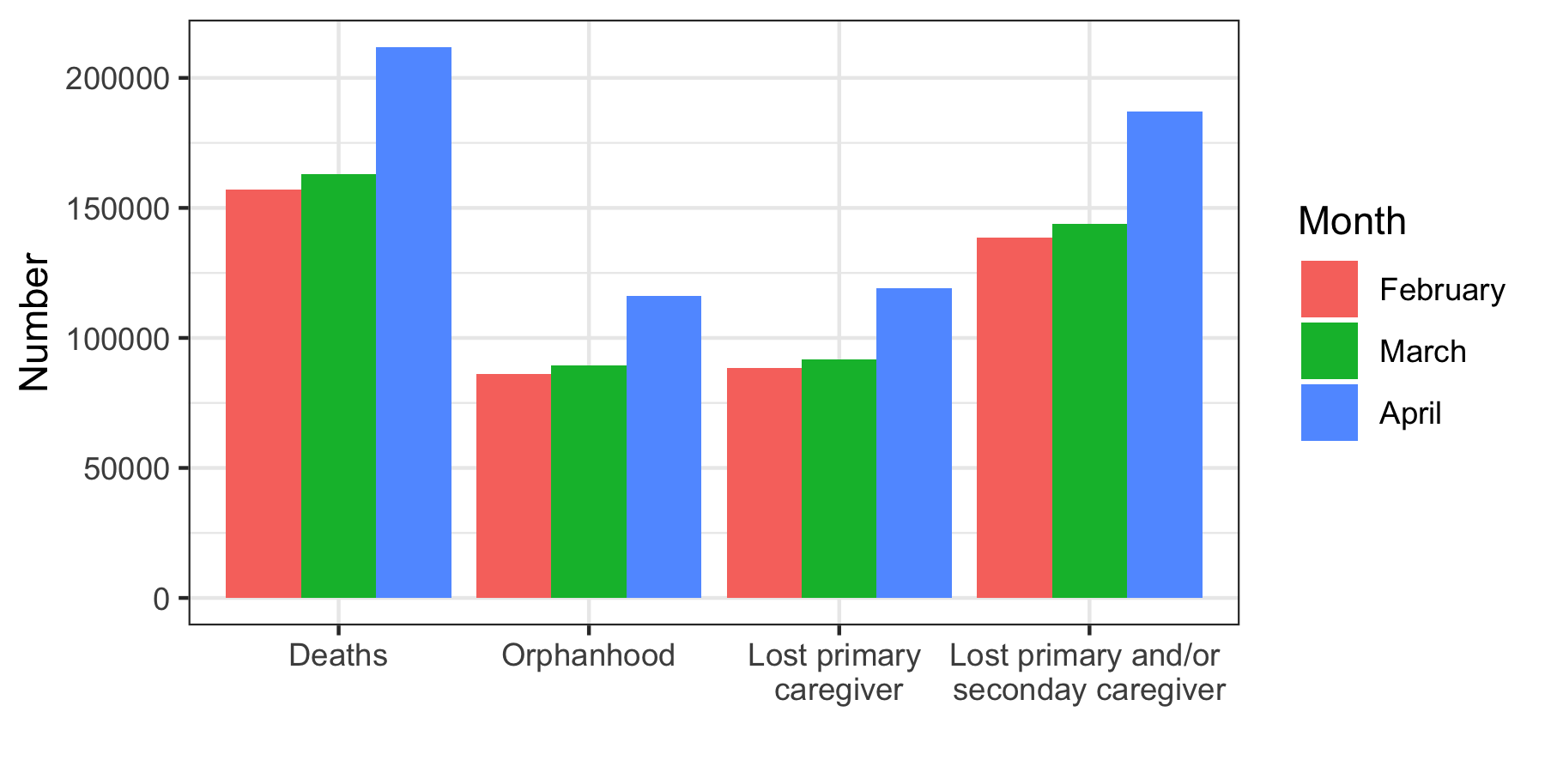
India Example: Total numbers of children orphaned or losing caregivers as of February, March, and April 2021
By April, estimates suggest an 8.5 fold increase in the number of children newly orphaned (>45,000 children from March 31 to April 30) compared to the increase in children newly orphaned observed in March (>5,000 children from February 28 to March 31).
[1] DHS program (https://dhsprogram.com/data/)
[2] www.un.org/development/desa/pd/data/living-arrangements-older-persons
[3] India COVID-19 dashboard (https://www.covid19india.org)
[4] Joe, W., Kumar, A., Rajpal, S., Mishra, U. & Subramanian, S. Equal risk, unequal burden? Gender differentials in COVID-19 mortality in India. Journal of Global Health Science 2 (2020).

Slide 10
Country estimates by region of rates per 1000 children 0-17-years-old orphaned and/or losing caregivers
Europe
Americas
Africa
South-East Asia
Eastern Mediterranean
Western Pacific
1.0

Slide 11
COVID-19 Deaths and Children’s Loss of Caregivers
~1.8M
Deaths
Nov 30 to Jan 14
45 d
~1.8M deaths
Oct 1 to Nov 30
60 d
1.5M deaths
900,000
children orphaned or
lost grandparents/ caregivers
July 1 to Sept 30
90 d
1.0M deaths
March 1 to June 30
120 d
500K deaths
Mar Apr May Jun Jul Aug Sep Oct Nov Dec
Notes:
Leah – the graph on the right needs some work so that it looks good. I sent an email about it earlier today.

Slide 12
Invisible Pandemic: Double the Danger, in Half the Time --
COVID-19 Deaths and Children’s Loss of Parents & Caregivers
1.8M
Deaths Mar-Dec 2020,
Doubled at 3.6M
Deaths Jan-May 2021
5 months
3,6 M deaths,
1.8 M
Children Orphaned, lose care
2020
900,000
Children Orphaned or Lost Grandparents/ Caregivers Mar-Dec 2020,
Doubles to 1.8M Jan-May 2021
10 months
1,8 M deaths,
900K
Children Orphaned, lose care
Data based on IHME sources
Notes:
Together we discovered a shadow pandemic -- we found that in just 10 months, 2 million pandemic dead had left over 1 million children impacted by deaths of their mothers, fathers, or grandparents living in their homes.
Of these, nearly 700,000 were orphaned because of deaths of parents or skip-generation grandparents functioning as parents.

Slide 13
During April 2021, due to COVID-19, every 12 seconds
1 child was orphaned or faced death of a grandparent or caregiver
These numbers will continue to increase and persist for years

Slide 14
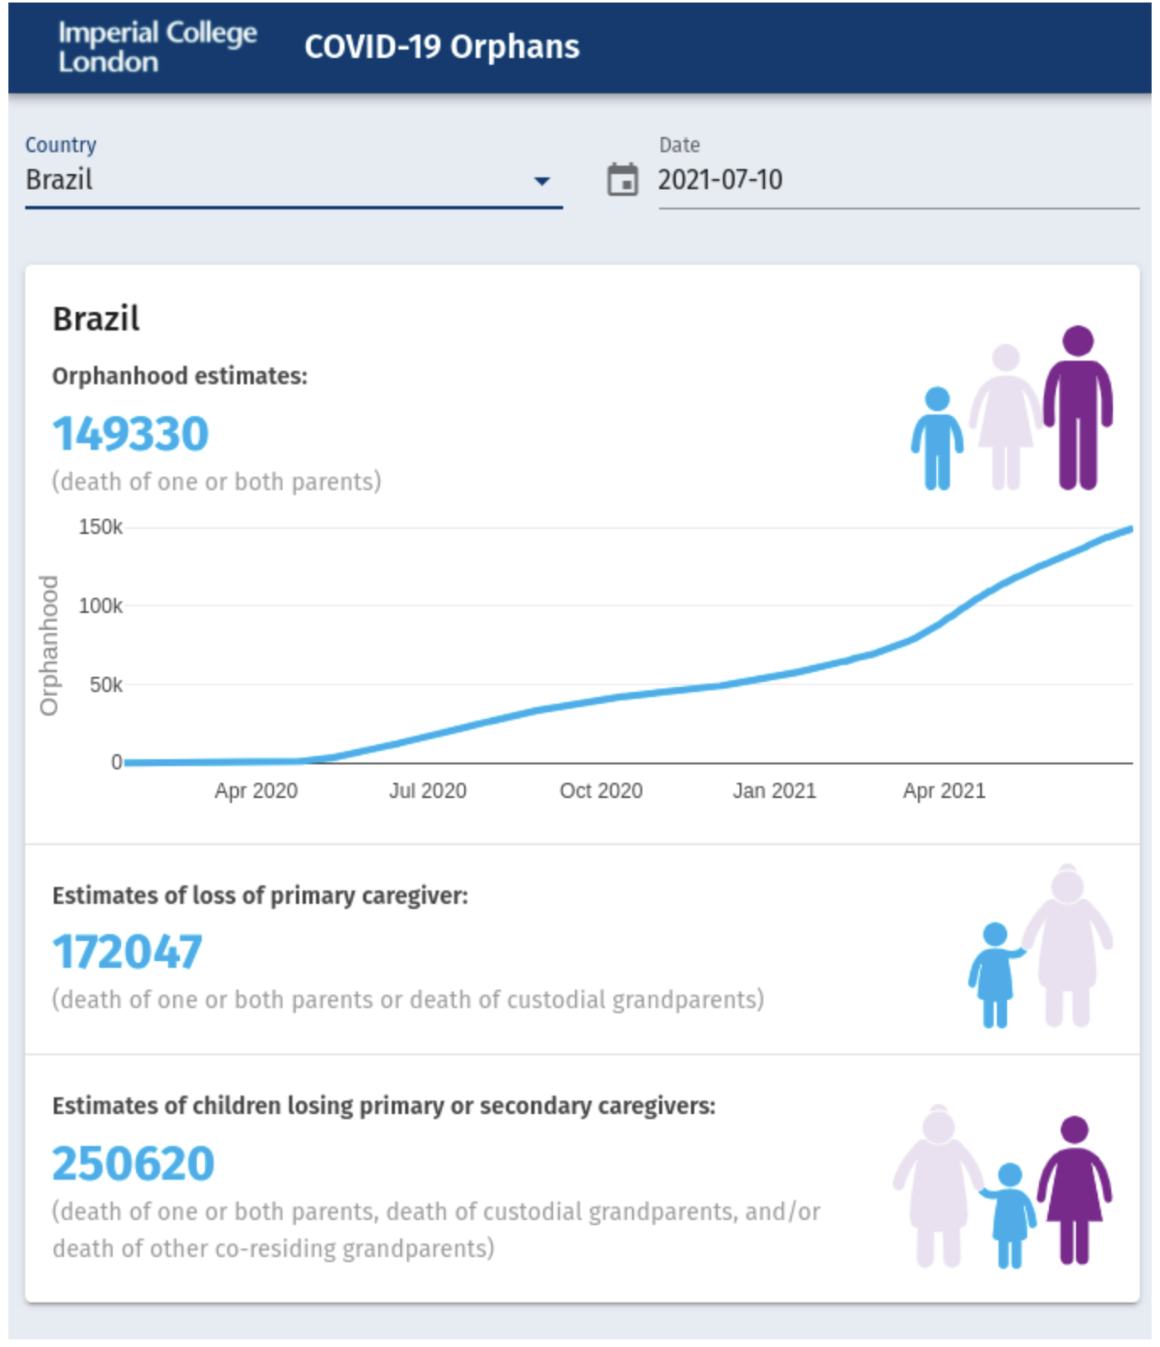
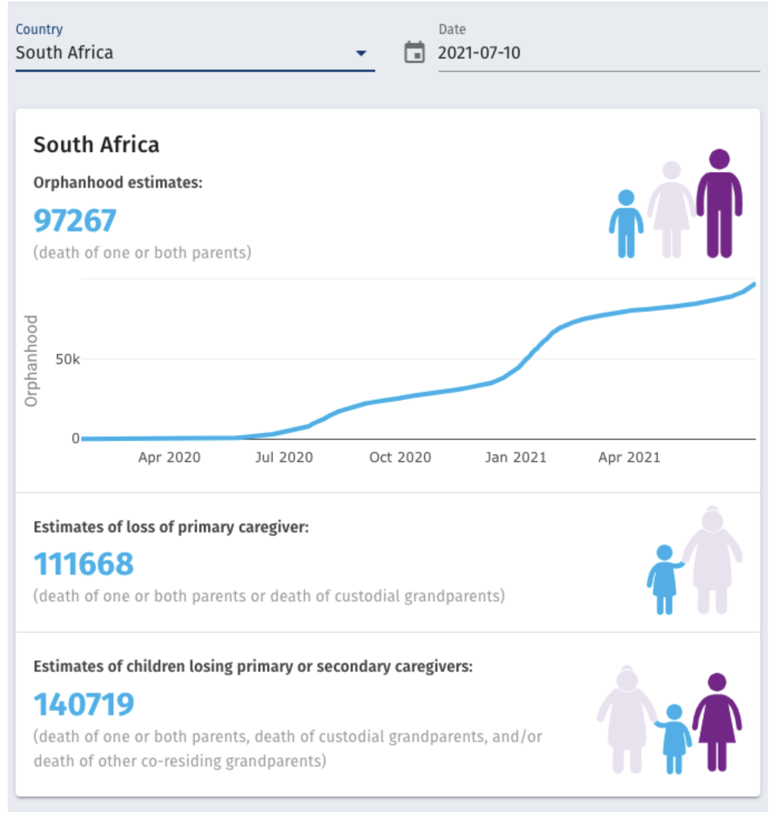
For Imperial College's Calculator for children affected by country: https://imperialcollegelondon.github.io/orphanhood_calculator

Slide 15
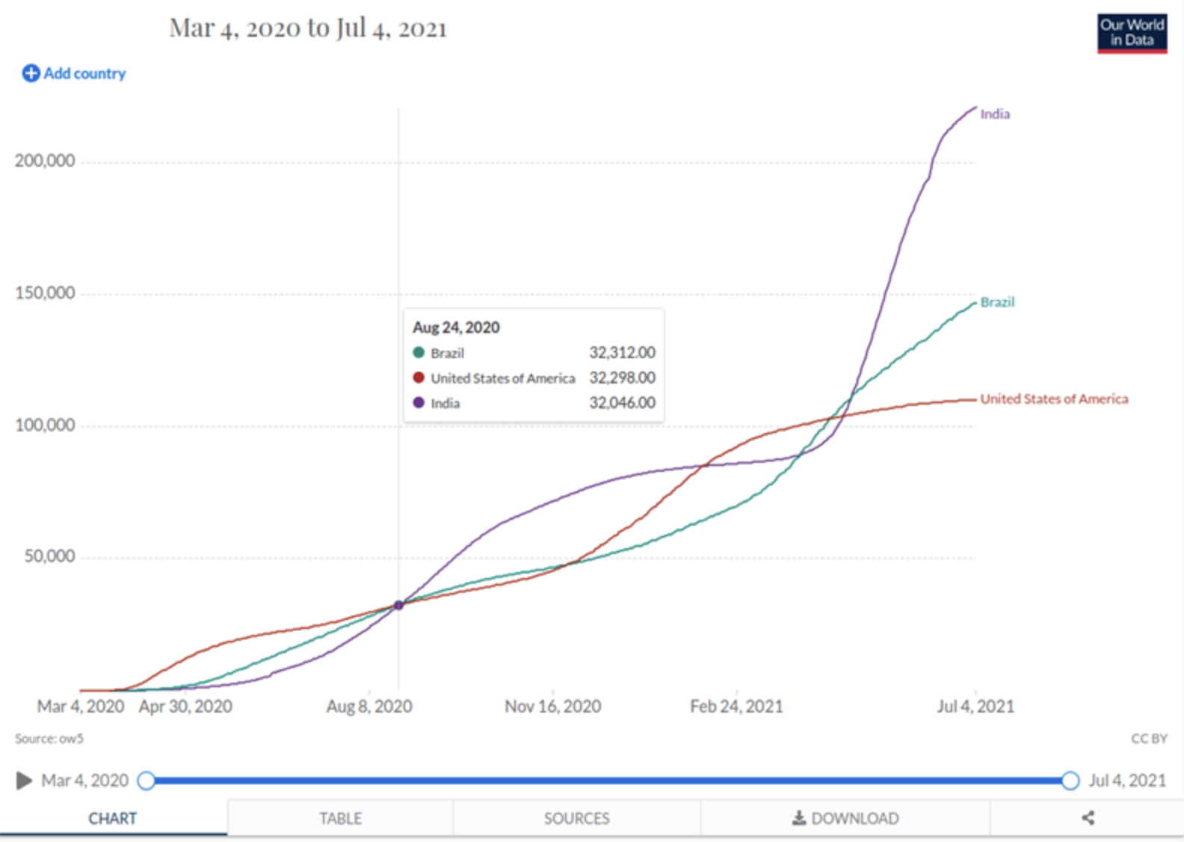
For Imperial College's Interactive visualization enabling comparisons between countries and over time: https://imperialcollegelondon.github.io/orphanhood_trends

Slide 16
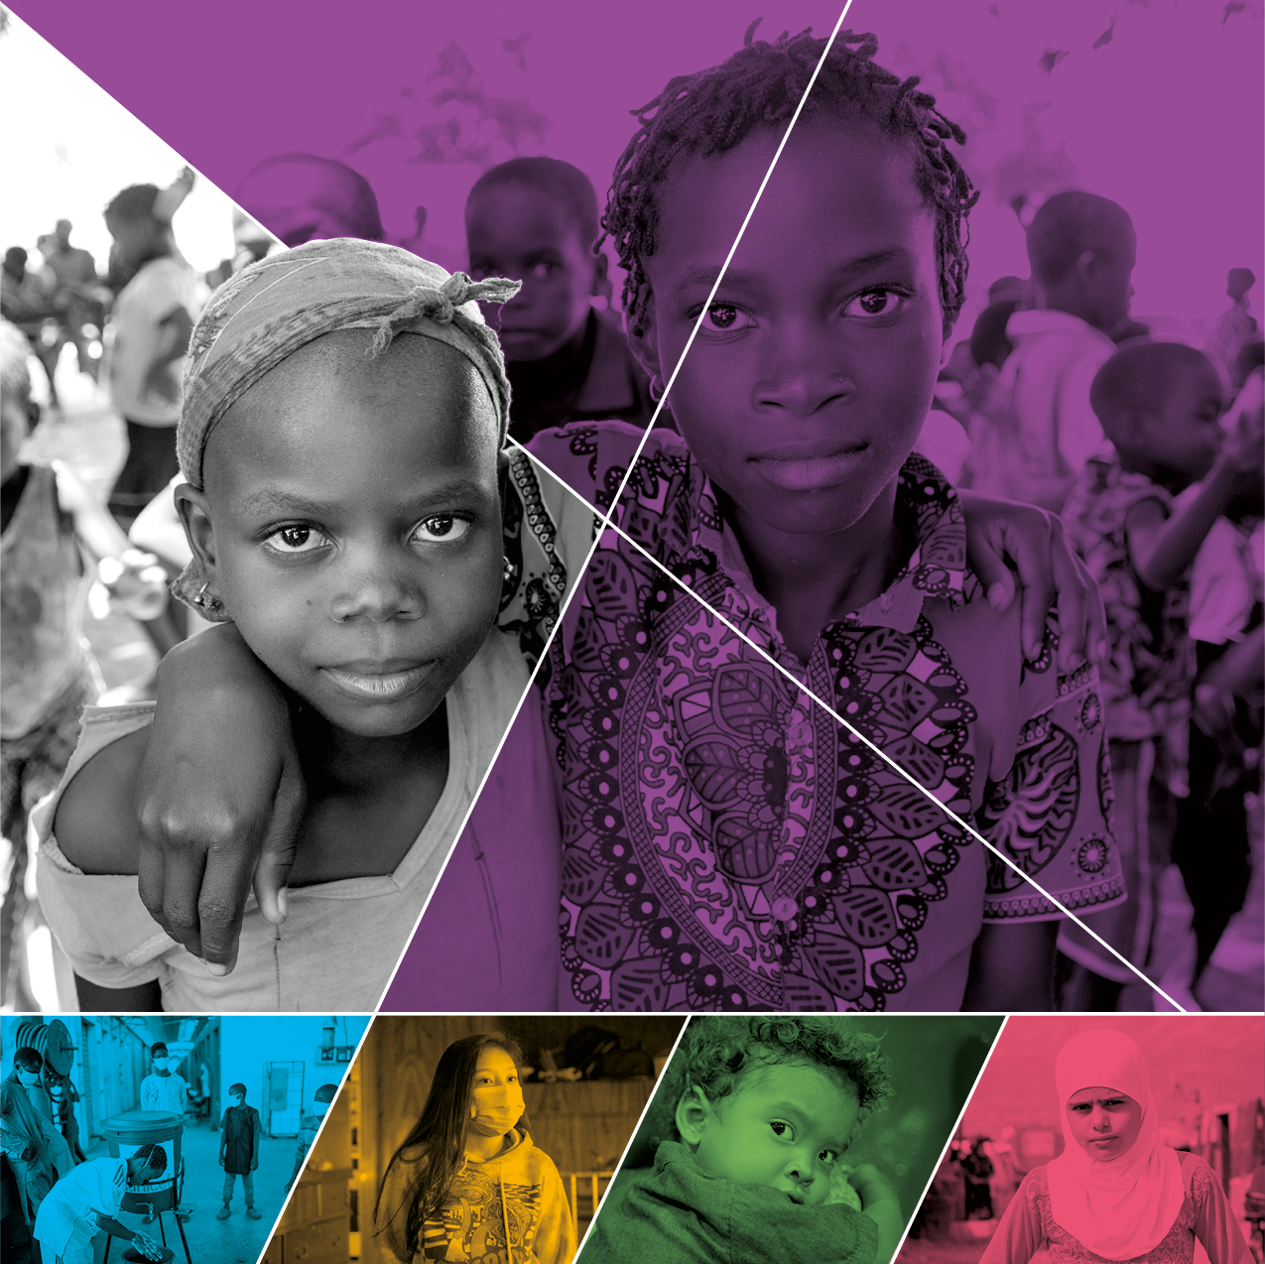


Children: The Hidden Pandemic 2021 –
A joint report of COVID-19 associated orphanhood and a strategy for action
Notes:
Globally, we are crossing the 100 million case threshold for reported cases of COVID-19 cases globally, and there have been more than 2 million reported COVID-related deaths. Although cases have been disproportionately affected younger people, deaths have been concentrated in individuals over 50 years old. And, while the numbers of cases among very young people are small, by no means does that imply a limited impact of the pandemic on this group.
One impact is reflected by an analysis that the ITF’s Mitigation Team has recently submitted into clearance. Using data from 18 countries representing approximately 75% of global COVID-19 deaths, this analysis generated estimates that globally, between March and December, 2020, more than one million children have lost a parent and/or caregiver to COVID-19. In the US, more than one of every 1,000 children has lost a parent or caregiver.

Slide 17
Global Minimum Estimates of Children Affected
by COVID-19-associated Orphanhood and
Death of Caregivers: A Modeling Study
Press coverage:
Over 150 media outlets
In 21 countries
9 languages
Notes:
Globally, we are crossing the 100 million case threshold for reported cases of COVID-19 cases globally, and there have been more than 2 million reported COVID-related deaths. Although cases have been disproportionately affected younger people, deaths have been concentrated in individuals over 50 years old. And, while the numbers of cases among very young people are small, by no means does that imply a limited impact of the pandemic on this group.
One impact is reflected by an analysis that the ITF’s Mitigation Team has recently submitted into clearance. Using data from 18 countries representing approximately 75% of global COVID-19 deaths, this analysis generated estimates that globally, between March and December, 2020, more than one million children have lost a parent and/or caregiver to COVID-19. In the US, more than one of every 1,000 children has lost a parent or caregiver.

Slide 18
Call to Action for Children Facing COVID-19-associated Orphanhood and Vulnerability:
PREVENT death: support vaccine equity and public health prevention
PREPARE families: support kinship, fostering, or adoption for children in need of alternative care, and avoid orphanages
PROTECT children: using evidence-based strategies that address increased risks of violence and vulnerability, and to strengthen their recovery and resilience

Slide 19
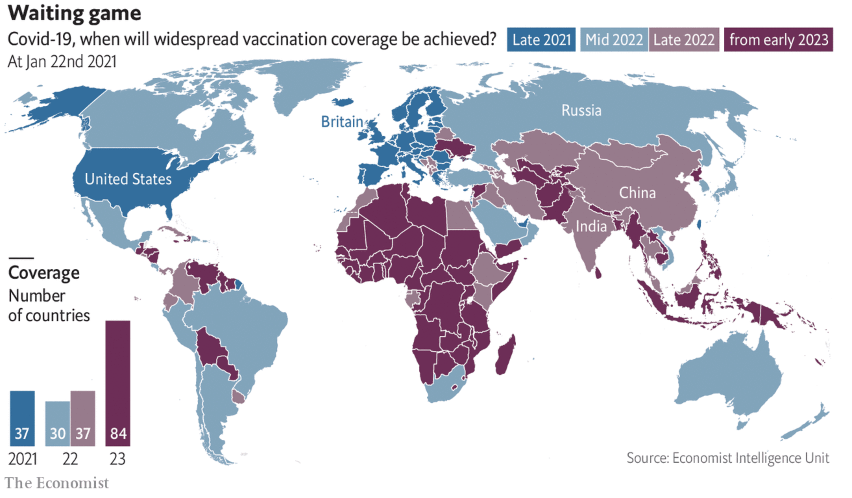
Prevent: Prevent the COVID-19 associated death of caregivers by implementing accelerating equitable access to vaccines and mitigation efforts and access to vaccines

Slide 20
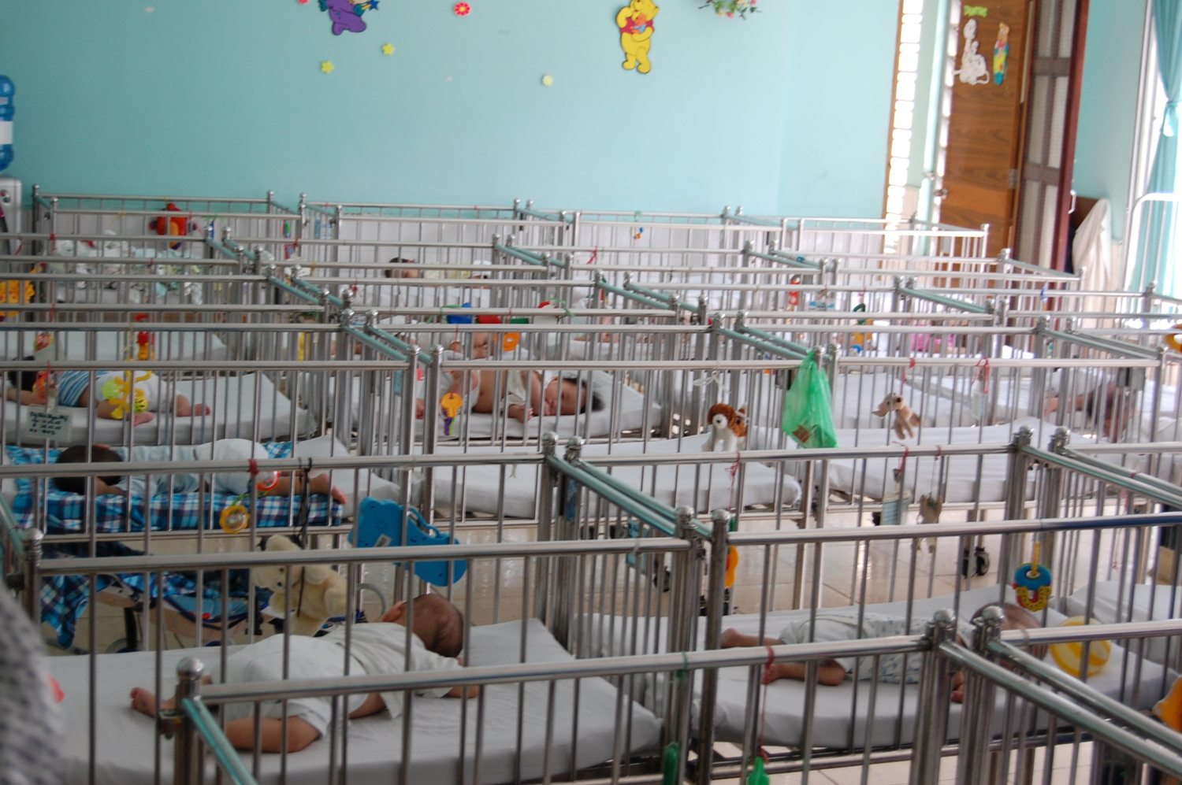

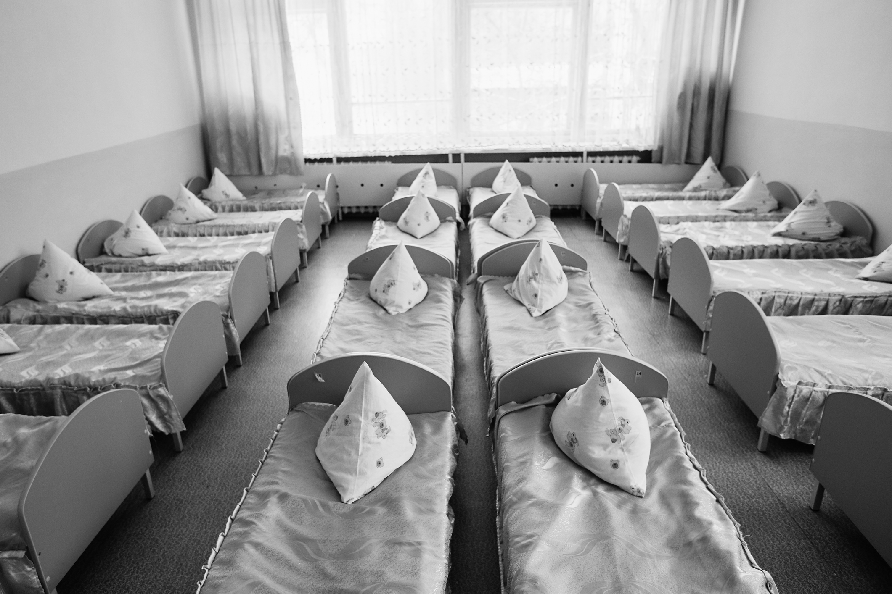
Prepare: Safe and loving family-based care support services (modeled after HIV programs) and avoid orphanages
AVOID INSTITUTIONS
AVOID INSTITUTIONS
AVOID INSTITUTIONS
Lancet Commission on Institutionalization and Deinstitutionalization of Children https://www.thelancet.com/commissions/deinstitutionalisation
Notes:
Globally, we are crossing the 100 million case threshold for reported cases of COVID-19 cases globally, and there have been more than 2 million reported COVID-related deaths. Although cases have been disproportionately affected younger people, deaths have been concentrated in individuals over 50 years old. And, while the numbers of cases among very young people are small, by no means does that imply a limited impact of the pandemic on this group.
One impact is reflected by an analysis that the ITF’s Mitigation Team has recently submitted into clearance. Using data from 18 countries representing approximately 75% of global COVID-19 deaths, this analysis generated estimates that globally, between March and December, 2020, more than one million children have lost a parent and/or caregiver to COVID-19. In the US, more than one of every 1,000 children has lost a parent or caregiver.

Slide 21
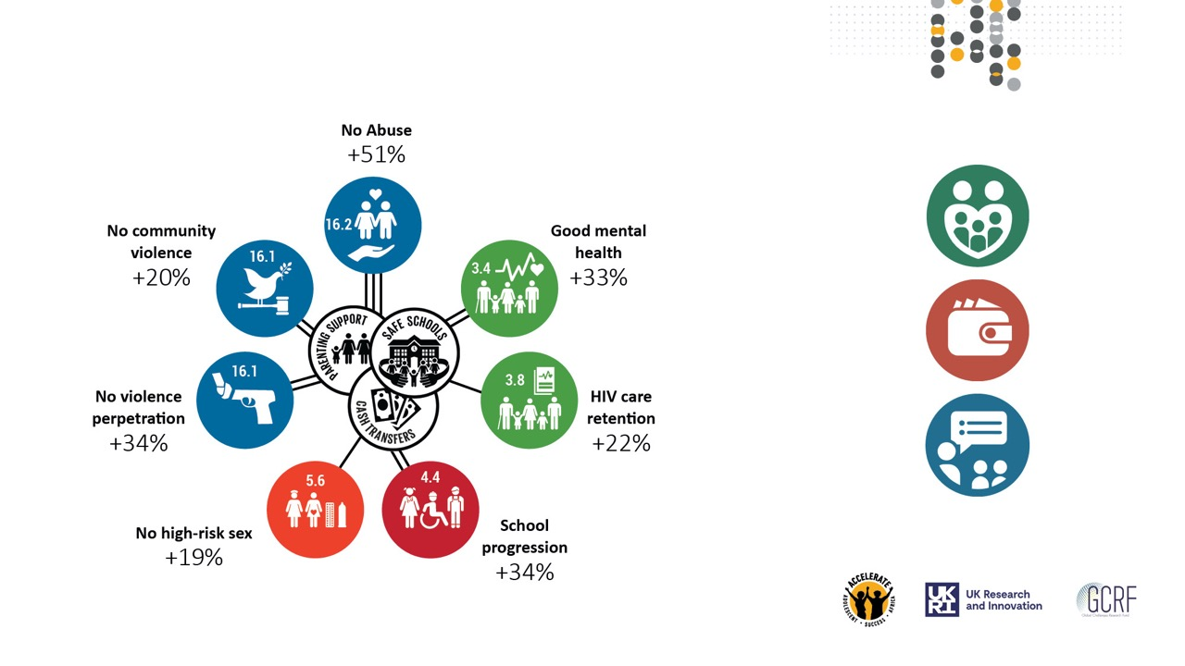
Protect children:
Using evidence-based strategies that address their increased vulnerability and exposures to violence and abuse, and strengthen their recovery and resilience
Positive parenting
Economic support
Educational growth
Cluver, Orkin, Toska, Campeau, Webb, Carlqvist, Sherr, (2019) , The Lancet CAH, N=1000 children & adolescents, South Africa, 45% maternally orphaned, 30% paternally orphaned
© UNICEF/UNI322371/Schverdfinger

