Slide 1

What is PrEP and why is it important?
Photo credit: Project PrEP - Unitaid
Presentation for: Enhancing HIV prevention in faith communities: what is PrEP, why it is important and how to better promote it in faith settings
28 July 2021
Robin Schaefer | Global HIV, Hepatitis and STIs Programmes | World Health Organization
www.who.int

Slide 2
What is pre-exposure prophylaxis (PrEP)?
Photo credit: pinknews.co.uk / Getty

Slide 3
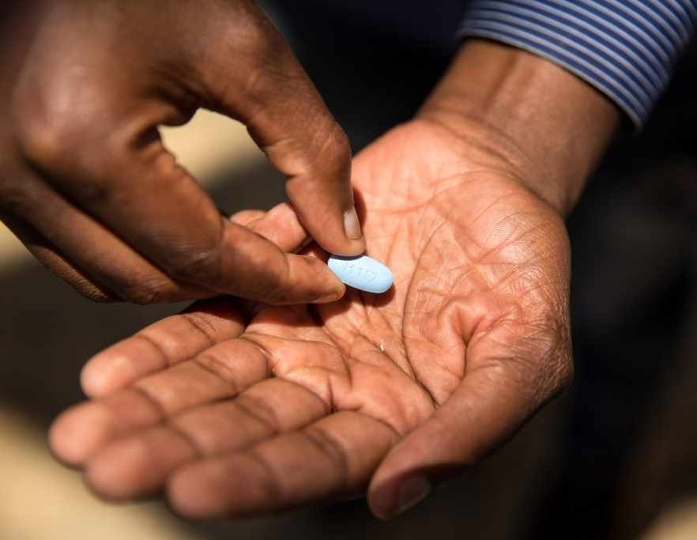
What is pre-exposure prophylaxis (PrEP)?
Photo credit: pinknews.co.uk / Getty

Slide 4
What is pre-exposure prophylaxis (PrEP)?
Antiretroviral medication used by people not infected with HIV to reduce the risk of HIV acquisition
Photo credit: pinknews.co.uk / Getty

Slide 5
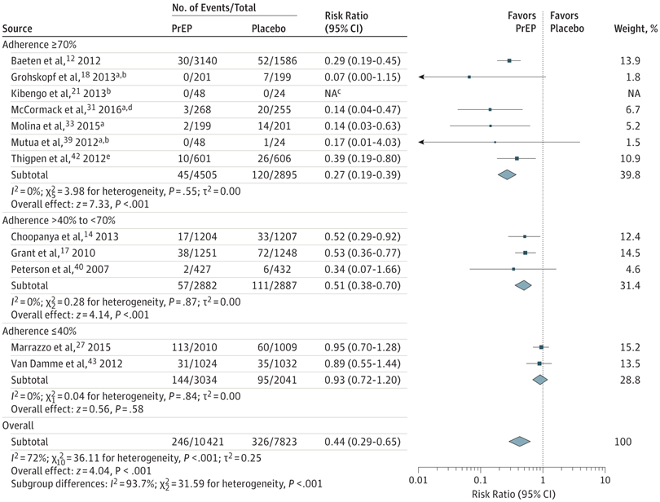
What is pre-exposure prophylaxis (PrEP)?
Antiretroviral medication used by people not infected with HIV to reduce the risk of HIV acquisition
Oral PrEP: Highly effective at preventing HIV infection when taken as prescribed
Source: Chou et al. 2019. JAMA.

Slide 6
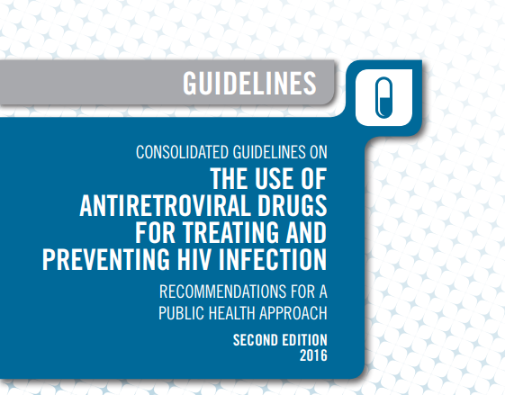
What is pre-exposure prophylaxis (PrEP)?
Antiretroviral medication used by people not infected with HIV to reduce the risk of HIV acquisition
Oral PrEP: Highly effective at preventing HIV infection when taken as prescribed
2015: WHO recommendation to offer daily oral PrEP to everyone at substantial risk of HIV; WHO guidelines in 2016
Source: World Health Organization 2016. Consolidated Guidelines on the Use of Antiretroviral Drugs for Treating and Preventing HIV infection: Recommendations for a Public Health Approach. Second Edition.

Slide 7
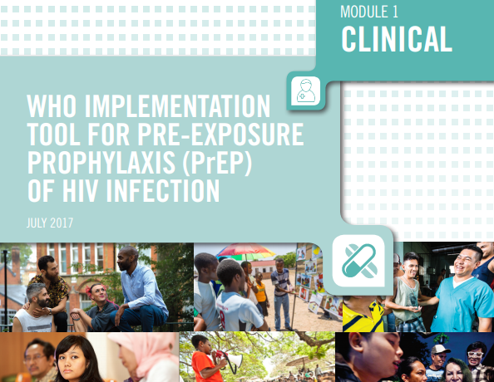
What is pre-exposure prophylaxis (PrEP)?
Antiretroviral medication used by people not infected with HIV to reduce the risk of HIV acquisition
Oral PrEP: Highly effective at preventing HIV infection when taken as prescribed
2015: WHO recommendation to offer daily oral PrEP to everyone at substantial risk of HIV; WHO guidelines in 2016
2017: WHO implementation guidance
Source: World Health Organization 2017. WHO Implementation Tool for Pre-Exposure Prophylaxis (PrEP) of HIV Infection. https://www.who.int/tools/prep-implementation-tool

Slide 8
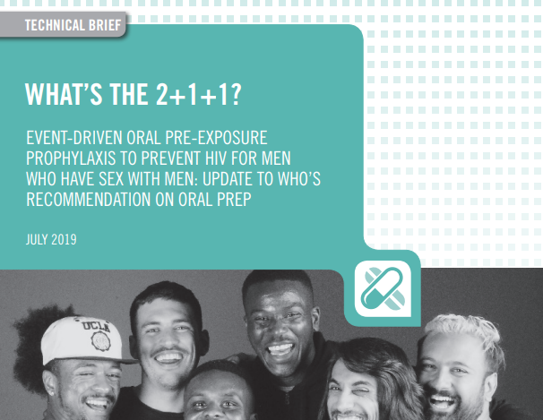
What is pre-exposure prophylaxis (PrEP)?
Antiretroviral medication used by people not infected with HIV to reduce the risk of HIV acquisition
Oral PrEP: Highly effective at preventing HIV infection when taken as prescribed
2015: WHO recommendation to offer daily oral PrEP to everyone at substantial risk of HIV; WHO guidelines in 2016
2017: WHO implementation guidance
2019: WHO guidance on event-driven PrEP (“2+1+1”)
Source: World Health Organization 2019. What’s the 2+1+1? Event-driven Oral Pre-Exposure Prophylaxis to Prevent HIV for Men Who Have Sex with Men: Update to WHO’s Recommendation on Oral PrEP.

Slide 9
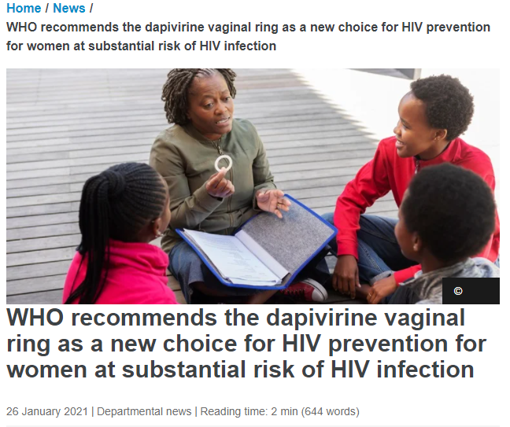
What is pre-exposure prophylaxis (PrEP)?
Antiretroviral medication used by people not infected with HIV to reduce the risk of HIV acquisition
Oral PrEP: Highly effective at preventing HIV infection when taken as prescribed
2015: WHO recommendation to offer daily oral PrEP to everyone at substantial risk of HIV; WHO guidelines in 2016
2017: WHO implementation guidance
2019: WHO guidance on event-driven PrEP (“2+1+1”)
2021: WHO recommendation to offer the dapivirine vaginal ring (DPV-VR) as an additional PrEP option
Source: https://www.who.int/news/item/26-01-2021-who-recommends-the-dapivirine-vaginal-ring-as-a-new-choice-for-hiv-prevention-for-women-at-substantial-risk-of-hiv-infection

Slide 10
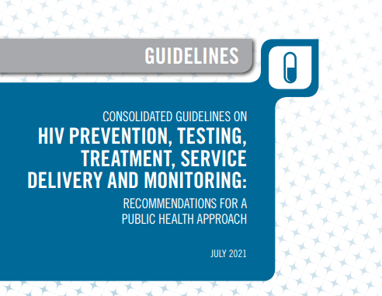
What is pre-exposure prophylaxis (PrEP)?
Antiretroviral medication used by people not infected with HIV to reduce the risk of HIV acquisition
Oral PrEP: Highly effective at preventing HIV infection when taken as prescribed
2015: WHO recommendation to offer daily oral PrEP to everyone at substantial risk of HIV; WHO guidelines in 2016
2017: WHO implementation guidance
2019: WHO guidance on event-driven PrEP (“2+1+1”)
2021: WHO recommendation to offer the dapivirine vaginal ring (DPV-VR) as an additional PrEP option
2021: WHO publishes new consolidated HIV guidelines
Source: World Health Organization 2021. Consolidated Guidelines on HIV Prevention, Testing, Treatment, Service Delivery and Monitoring: Recommendations for a Public Health Approach.

Slide 11
Why is PrEP important?

Slide 12
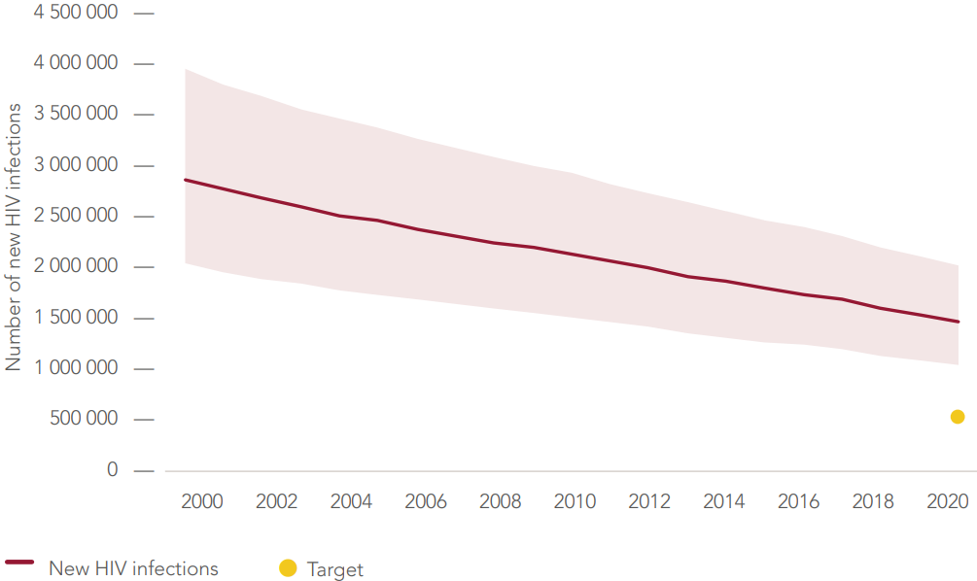
Why is PrEP important?
New HIV infections, all ages, global, 2000-2020
UNAIDS: Global AIDS Update 2021; aidsinfo.unaids.org

Slide 13
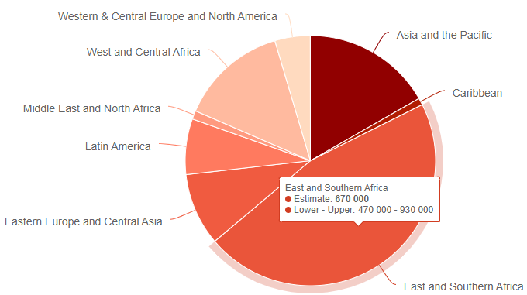
Why is PrEP important?
New HIV infections, all ages, global, 2000-2020
New HIV infections, all ages, by region, 2020
UNAIDS: Global AIDS Update 2021; aidsinfo.unaids.org

Slide 14
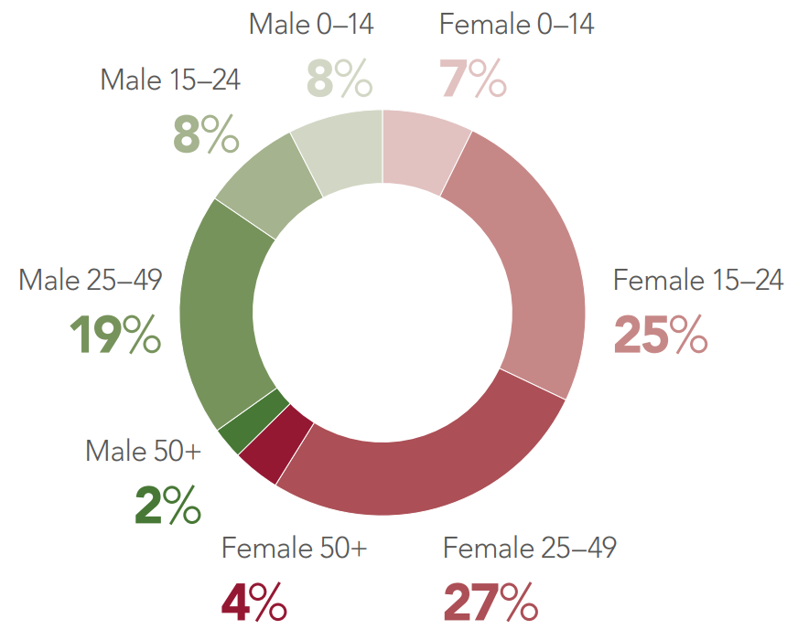
Why is PrEP important?
New HIV infections, by age and sex, sub-Saharan Africa, 2020
UNAIDS: Global AIDS Update 2021; aidsinfo.unaids.org

Slide 15
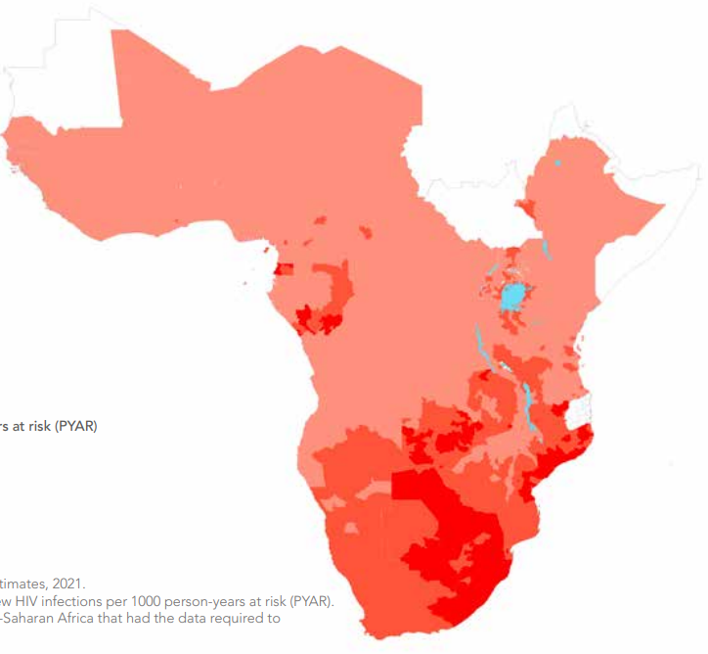
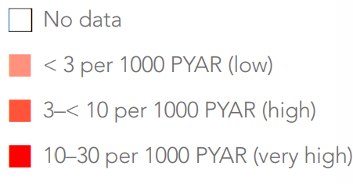
Why is PrEP important?
New HIV infections, by age and sex, sub-Saharan Africa, 2020
HIV incidence, females 15-24 years, sub-Saharan Africa, 2020
Incidence rate per 1000 person-years at risk (PYAR)
UNAIDS: Global AIDS Update 2021; aidsinfo.unaids.org

Slide 16
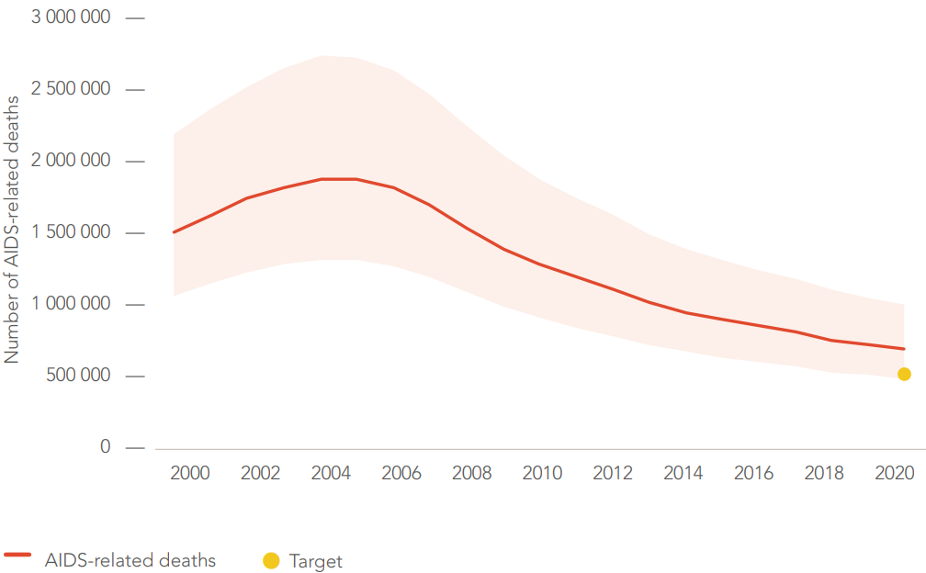
Why is PrEP important?
AIDS-related deaths, all ages, global, 2000-2020
UNAIDS: Global AIDS Update 2021; aidsinfo.unaids.org

Slide 17
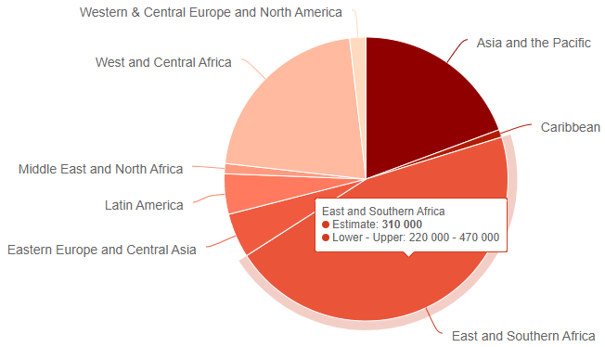
Why is PrEP important?
AIDS-related deaths, all ages, global, 2000-2020
AIDS-related deaths in 2020, all ages, by region
UNAIDS: Global AIDS Update 2021; aidsinfo.unaids.org

Slide 18
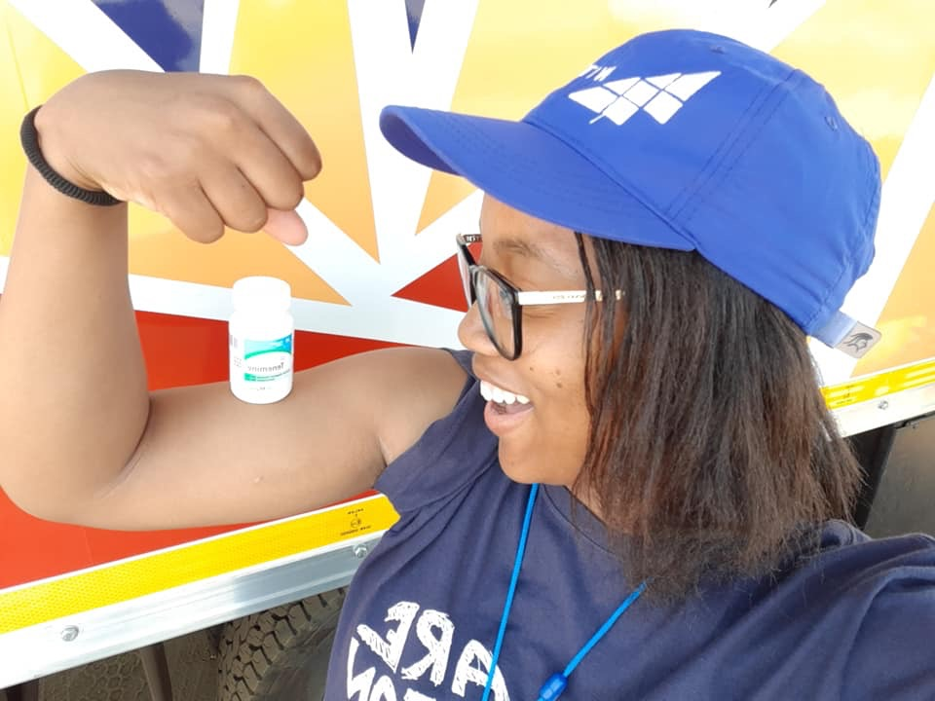
Why is PrEP important?
PrEP is safe, effective, and empowering for individuals and communities.
PrEP is an additional HIV prevention option as part of combination prevention
Particularly for those who do not want to or cannot consistently use condoms
Girls and women often cannot insist on condoms and don’t have other options
PrEP can make conception safer for couples where one partner has HIV and the other does not
Emotional and spiritual benefits: Reduced anxiety and empowerment.
Photo credit: Project PrEP - Unitaid

Slide 19
Why is PrEP important?
Large-scale PrEP roll-out in New South Wales, Australia
Has been shown to have an impact on population-level HIV incidence when scaled-up (e.g. NSW, Australia)
Decline in new HIV diagnoses in MSM
Source: https://www.health.nsw.gov.au/endinghiv/Publications/q2-2020-nsw-hiv-data-report.pdf

Slide 20
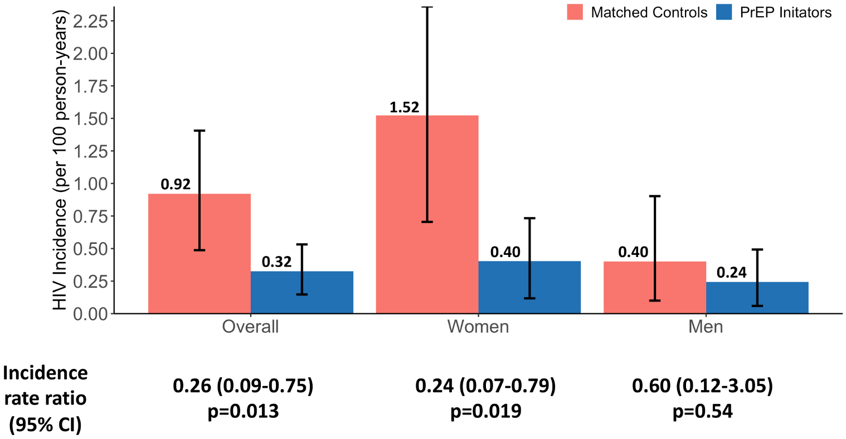
Why is PrEP important?
Large community-based PrEP study in Kenya and Uganda (2016-18)
Has been shown to have an impact on population-level HIV incidence when scaled-up (e.g. NSW, Australia)
Community-based scale-up possible with significant impact on HIV incidence (e.g. in Kenya and Uganda, SEARCH study)
75% lower HIV incidence among PrEP users
Source: Koss et al. 2021. PLOS Medicine.

Slide 21
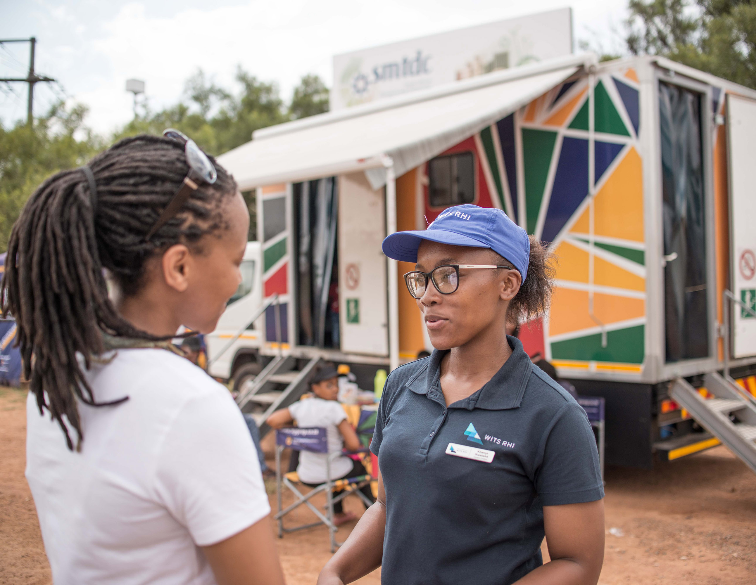
Why is it important for faith communities and leaders to know about PrEP?
Respected leaders in communities who play an important and positive role in the response to HIV
Your voices matter, so it is important to be informed about the science and give the best advice
PrEP is about protecting yourself, your partner, and your communities – it is not just about individuals
Discrimination- and stigma-free environments are critical for uptake and use of PrEP
Photo credit: Project PrEP - Unitaid

Slide 22
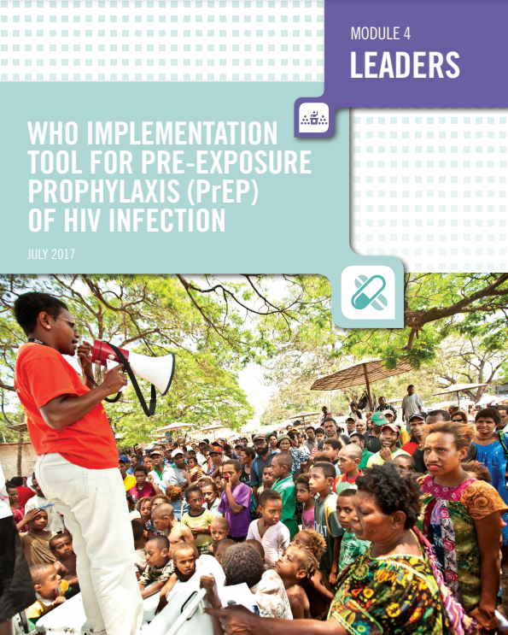
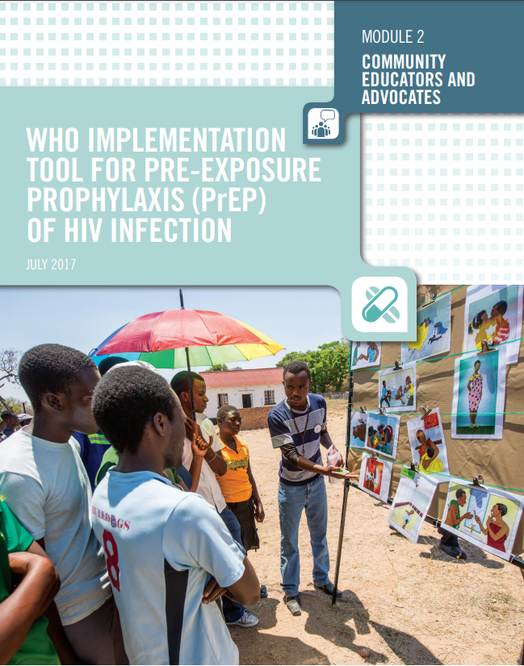
Why is it important for faith communities and leaders to know about PrEP?
WHO PrEP Implementation Tool: Modules for Leaders and Community Educators and Advocates
Respected leaders in communities who play an important and positive role in the response to HIV
Your voices matter, so it is important to be informed about the science and give the best advice
PrEP is about protecting yourself, your partner, and your communities – it is not just about individuals
Discrimination- and stigma-free environments are critical for uptake and use of PrEP
Source: World Health Organization 2017. WHO Implementation Tool for Pre-Exposure Prophylaxis (PrEP) of HIV Infection. https://www.who.int/tools/prep-implementation-tool

Slide 23

Frequently asked questions about PrEP
Photo credit: Project PrEP – Unitaid

Slide 24
Frequently asked questions about PrEP
Where in the world is PrEP available?
In over 70 countries, and it’s increasing!
Source: Schaefer et al. 2021. Lancet HIV.

Slide 25
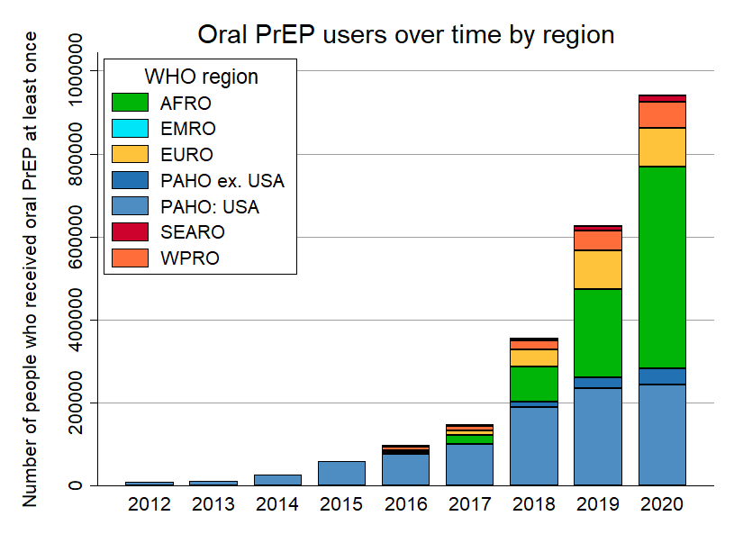
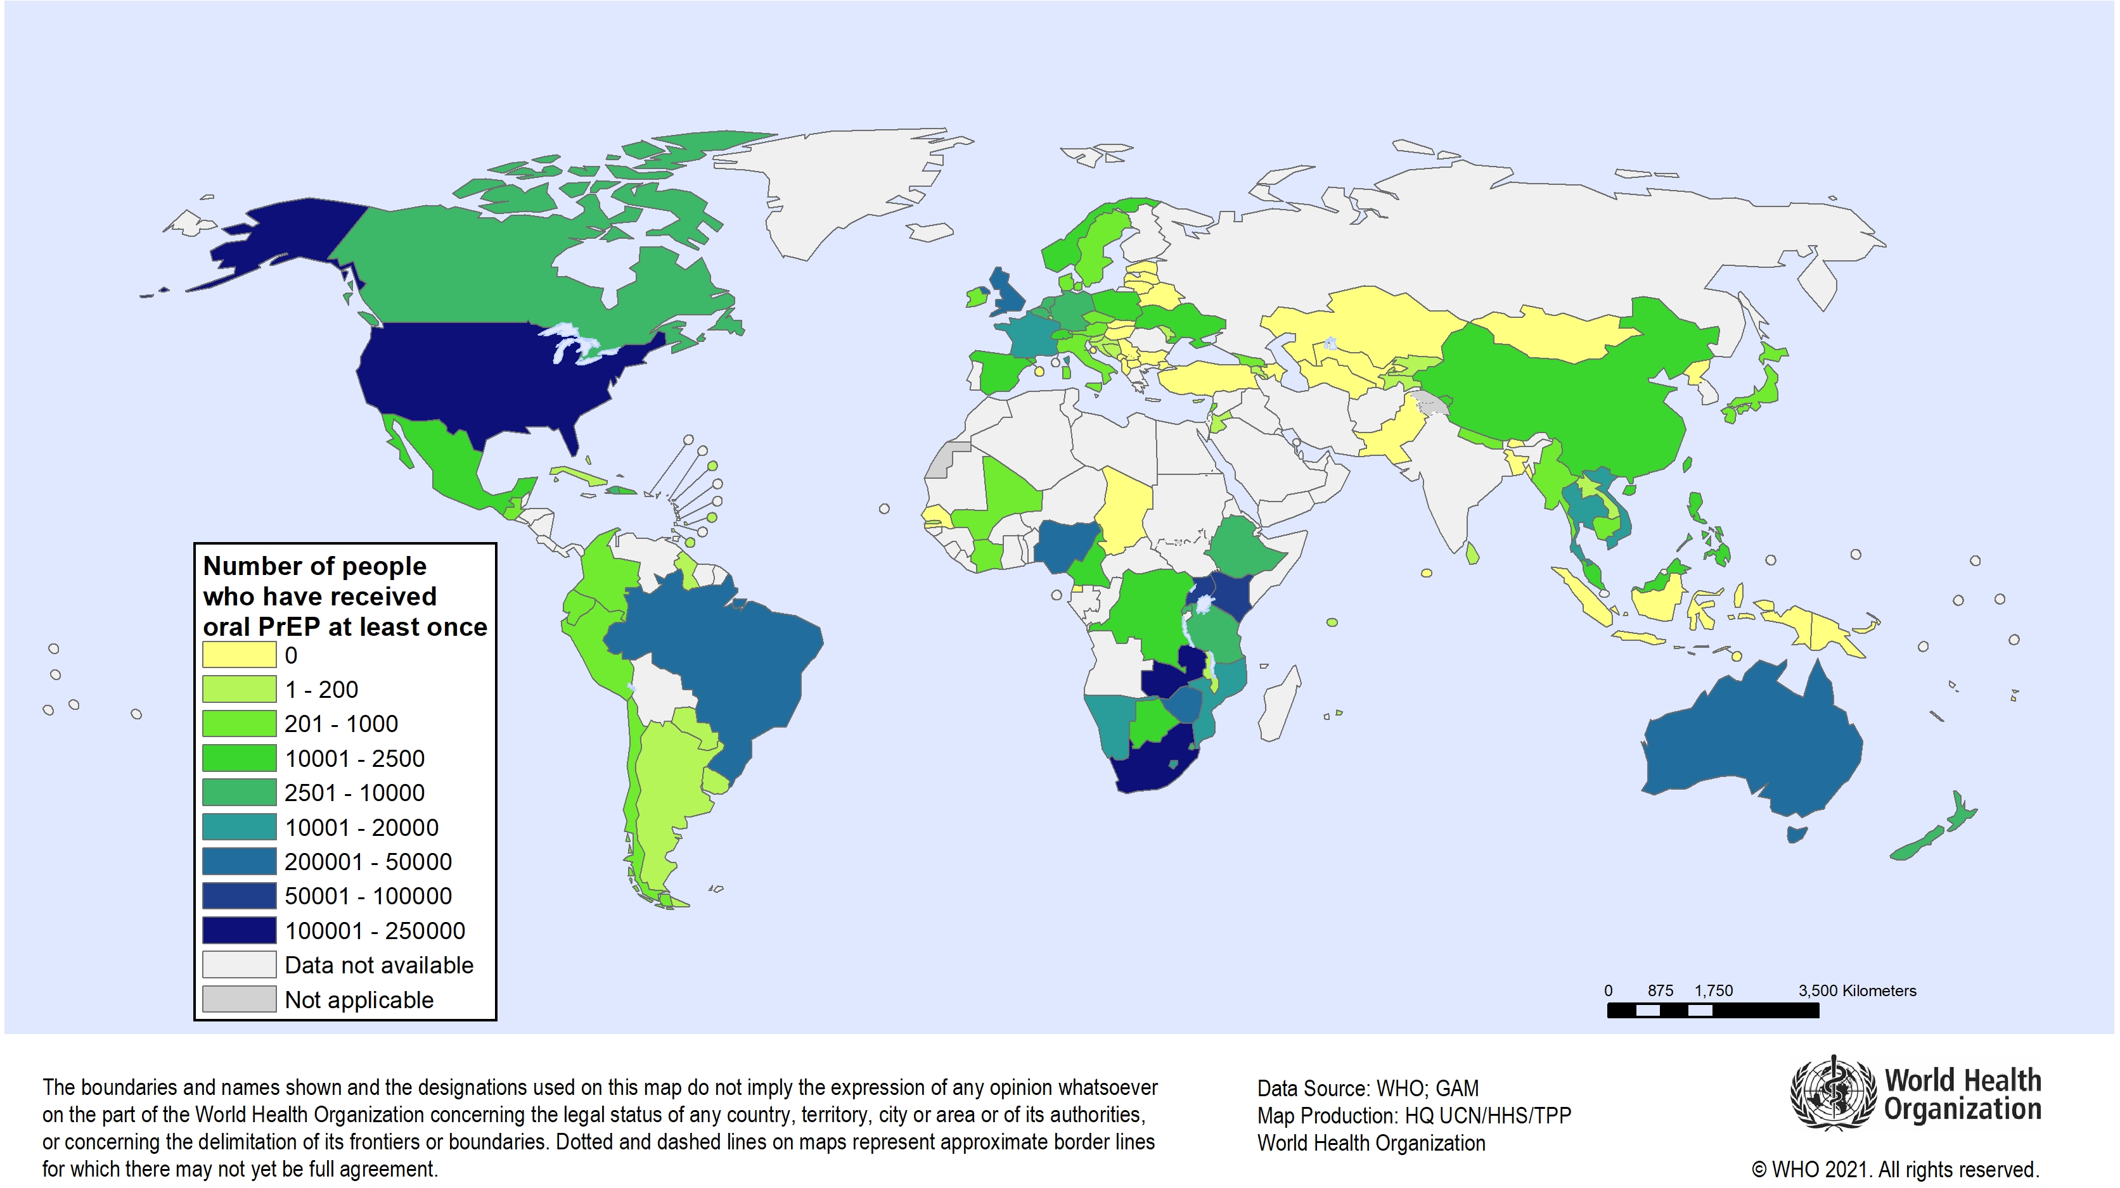
Frequently asked questions about PrEP
Global oral PrEP use in 2020 (#people received oral PrEP at least once)
Significant growth in global PrEP use in 2020 despite COVID-19 disruptions
Source: Schaefer et al. 2021. Presentation at IAS 2021, for 2020 data. Schaefer et al. 2021. Lancet HIV, for detailed data and information.

Slide 26
Frequently asked questions about PrEP
Is PrEP safe?
Yes!
Some people experience mild side effects (e.g. nausea, headache) at first.
They are no sign of danger and usually go away quickly.

Slide 27
Frequently asked questions about PrEP
Who can use PrEP?
WHO recommends PrEP as an additional option for any person at substantial risk of HIV.
Not restricted by age and PrEP programmes for adolescents have been successfully implemented.

Slide 28
Frequently asked questions about PrEP
Do people take PrEP for life?
No!
PrEP needs to be taken effectively during periods of possible exposure to HIV.
PrEP can be started, stopped, and re-started safely.

Slide 29
Frequently asked questions about PrEP
Does PrEP protect against STIs other than HIV?
No!
PrEP does not protect against STIs like gonorrhea or syphilis.
It is not intended to replace condoms, which protect against STIs.
PrEP programmes should provide STI testing and treatment services.

Slide 30
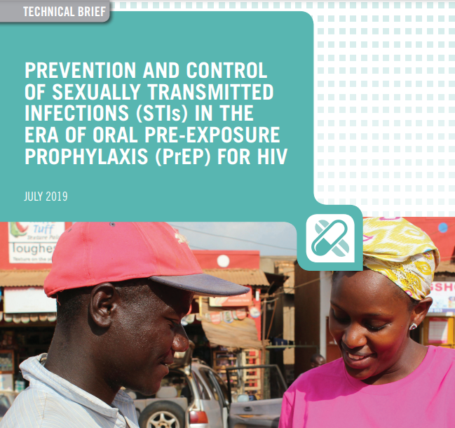
Frequently asked questions about PrEP
Does PrEP protect against STIs other than HIV?
Source: WHO 2019. Prevention and control of sexually transmitted infections (STIs) in the era of oral pre-exposure prophylaxis (PrEP) for HIV.

Slide 31
Frequently asked questions about PrEP
Is PrEP safe during pregnancy and breastfeeding?
Yes!
Period of pregnancy and breastfeeding associated with increased risk of HIV, so PrEP is a good option.
Can protect women and babies.

Slide 32
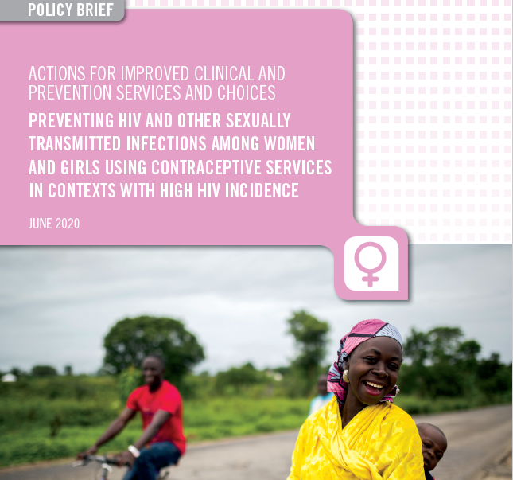
Frequently asked questions about PrEP
Is PrEP safe during pregnancy and breastfeeding?
Source: WHO 2020. Preventing HIV and other Sexually Transmitted Infections among Women and Girls Using Contraceptive Services in Contexts with High HIV Incidence.

Slide 33
Frequently asked questions about PrEP
Does PrEP use lead to changes in sexual behaviour?
Not widely observed.
PrEP needs to be part of combination prevention and comprehensive services, including for STIs.

Slide 34
Frequently asked questions about PrEP
What about other PrEP products?
2021: WHO recommended dapivirine vaginal ring as an additional PrEP option.
Awaiting regulatory approval in several African countries.
Female-initiated and can be empowering for women.

Slide 35
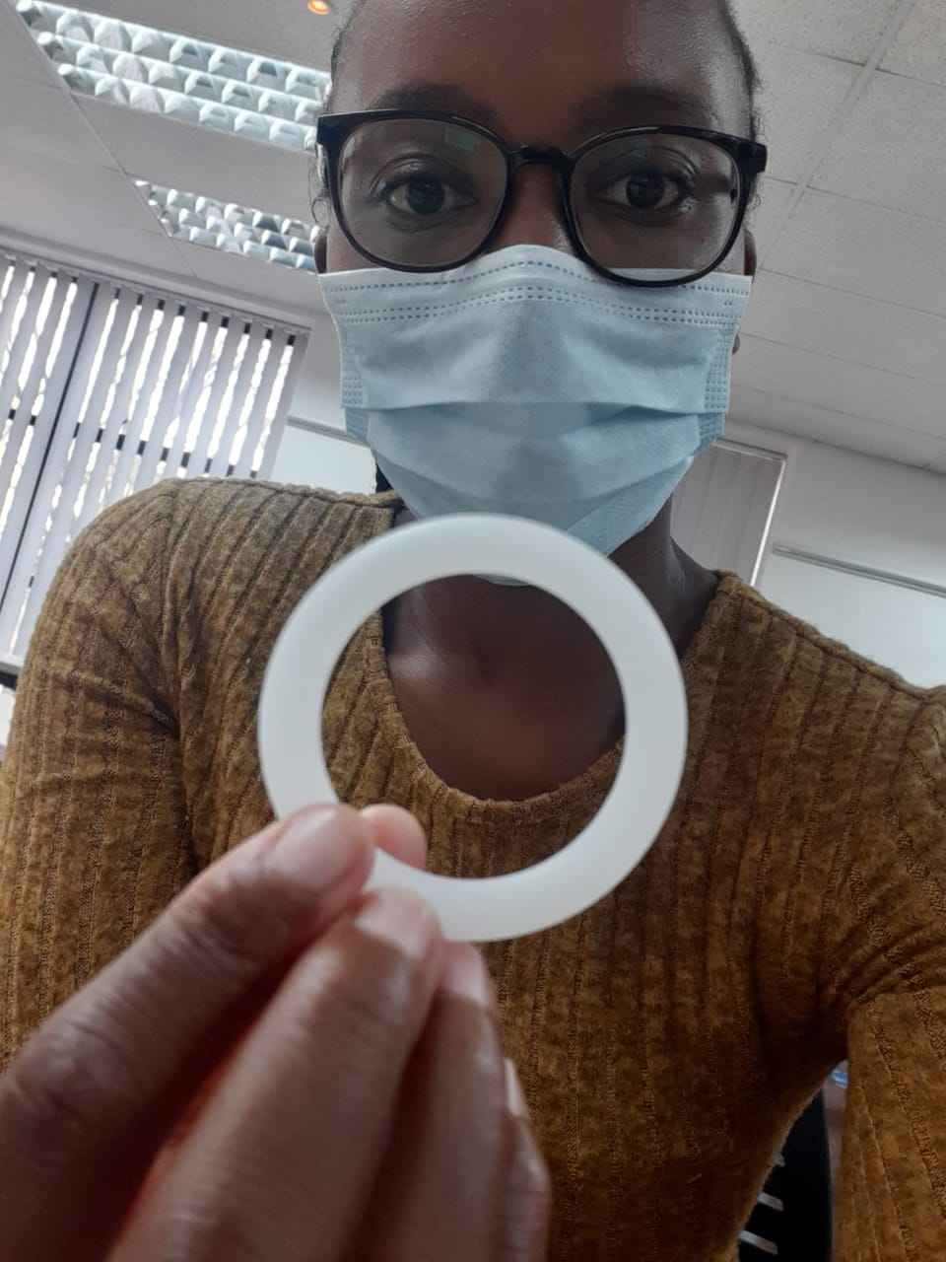
Frequently asked questions about PrEP
What about other PrEP products?
Photo credit: PROMISE - USAID

Slide 36
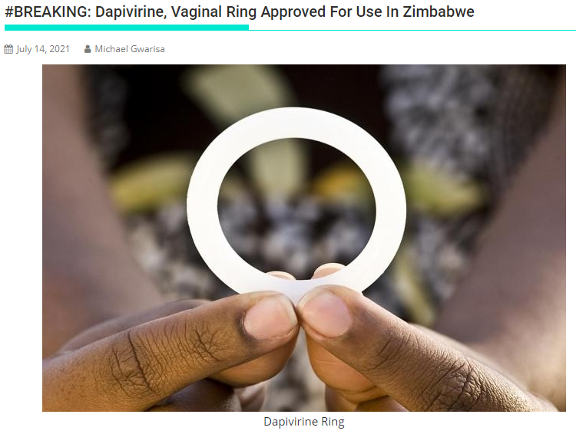
Frequently asked questions about PrEP
What about other PrEP products?
Source: https://healthtimes.co.zw/2021/07/14/breaking-dapivirine-vaginal-ring-approved-for-use-in-zimbabwe/

Slide 37


Frequently asked questions about PrEP
What about other PrEP products?
Additional products, e.g. injectable PrEP, may become available.
More choice for users.

Slide 38
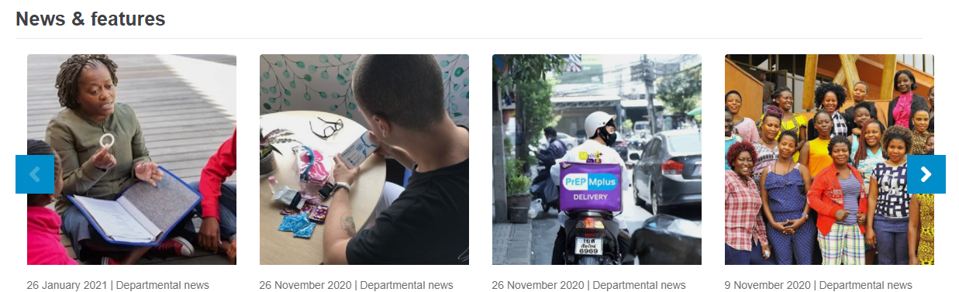
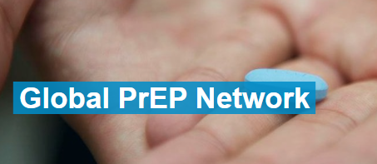
Frequently asked questions about PrEP
Where can I find more information from WHO on PrEP?
WHO information on PrEP
https://www.who.int/teams/global-hiv-hepatitis-and-stis-programmes/hiv/prevention/pre-exposure-prophylaxis
WHO Global PrEP Network
https://www.who.int/groups/global-prep-network

Slide 39

Thank you!
I thank my colleagues at WHO for support with this presentation: Rachel Baggaley, Michelle Rodolph, Heather-Marie Schmidt.
I thank the Unitaid-funded Project PrEP for photos used in this presentation.
Please contact me for questions or further information: schaeferr@who.int
Robin Schaefer | Global HIV, Hepatitis and STIs Programmes | World Health Organization
www.who.int

