Slide 1
Advancing Partnerships for South-to-South Collaborations that Sustain HIV Epidemic Control: The New Foundations of Hope Interactive Webinar Platform
June 2022

Slide 2
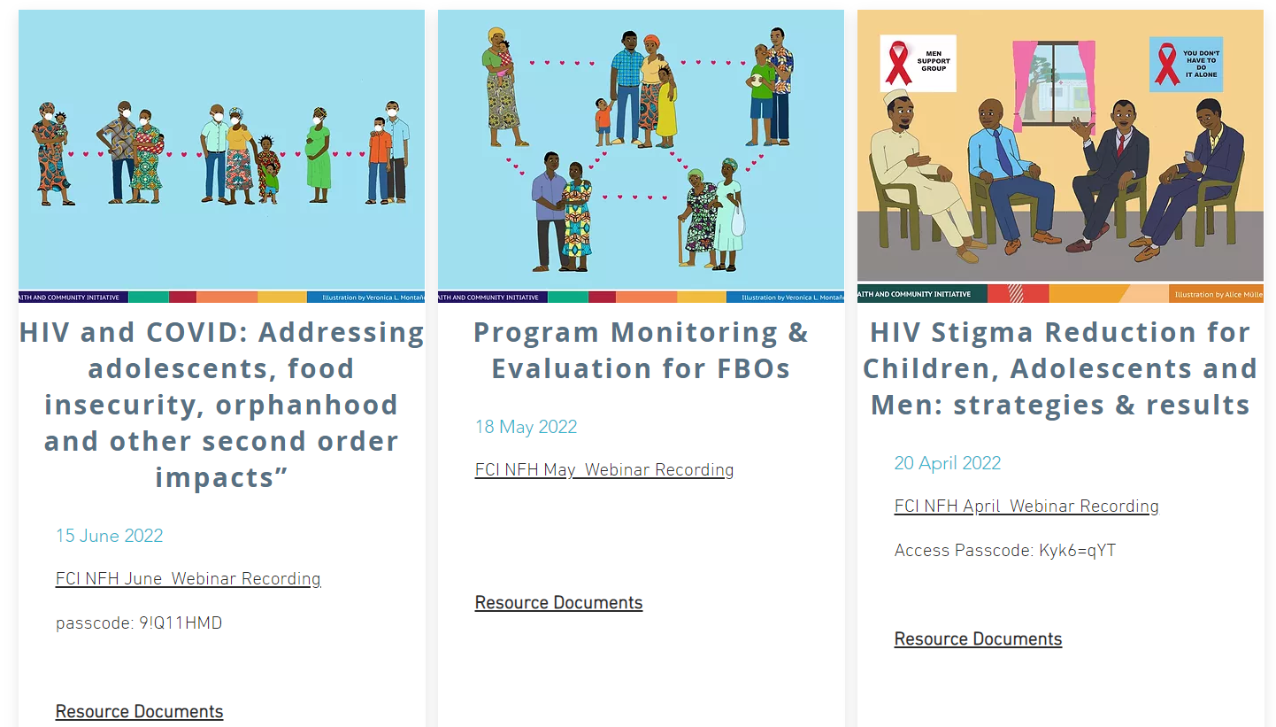
FCI New Foundations of Hope webinars
Consultative platform of monthly webinars
Geared toward faith leaders, FBO staff, USG FCI staff
Started April 2020
Monthly webinars; 22 webinars held by Oct 2022
Average of ~100 participants & 10 countries/webinar
Listserv of approximately 425 individuals

Slide 3
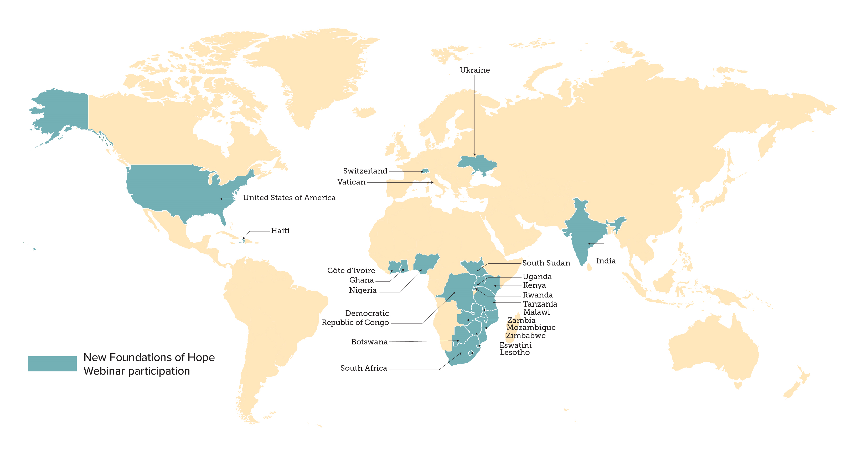
FCI New Foundations of Hope participant reach

Slide 4
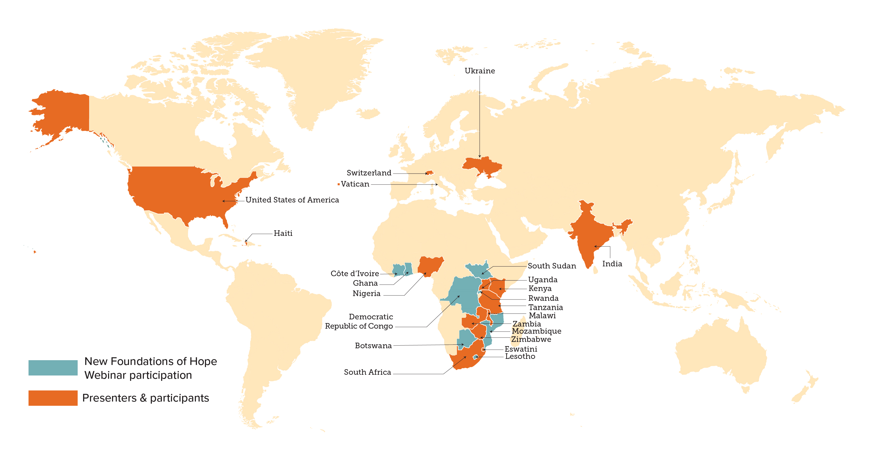
FCI New Foundations of Hope participant reach

Slide 5
FCI New Foundations of Hope South-to-South Platform
New Foundations of Hope platform
Faith Leaders
Bilaterals
FBOs/CSOs
Multilaterals
Faith Alliances
MOHs/ National Govts.
Catalyzing actions
Encouraging collaborations
Bi-directional information sharing and education
Participatory platform design
Reducing HIV stigma in faith communities
Sharing evidence-based COVID-19 information in real time
Increasing access and HIV services to children and men

Slide 6
FCI New Foundations of Hope South-to-South Webinars
Indicator | Total
Total countries reached | 23 (Botswana, Cote d’Ivoire, DRC, Eswatini*, Ghana, Haiti*, India*, Kenya*, Lesotho, Malawi*, Mozambique, Nigeria*, Rwanda, South Africa*, South Sudan , Switzerland*, Tanzania*, Ukraine*, Uganda*, USA*, Vatican*, Zambia*, Zimbabwe*) *led webinar presentations
Total participants reached | 425
Total number of person-sessions | 1,871 person-sessions
Types of organizations | FBOs (examples: Circle of Hope, Christian Health Association of Kenya, Mildmay Uganda, Zvandiri, Expanded Church Response, Luke Commission, EDARP, Catholic Medical Mission Board, etc.) Faith Alliances (WCC) Bilaterals (USAID, CDC, OGAC) Multilaterals (WHO, UNAIDS) Country Governments (MOHs)

Slide 7
Main Priorities Addressed
SVAC & GBV
HIV Stigma
OVC
Case finding & retention for adolescents
COVID + HIV
Faith Matters!
HIV Model Programs
Case-finding & services for children
HIV Messages of Hope
Case-finding & services for men
COVID-19 Vaccines
M&E for FBOs
PreP
COVID-19 Messages of Hope
Targeted HIV Testing for children
Psychosocial care
PEPFAR Strategy Objectives
1.2 Achieve durable viral suppression and improved survival for clients on ART including children, AGYW
1.3 Drive down HIV infections, particularly in children, AGYW and KP
1.5 Sharpen and support approaches for HIV case-finding, recency testing, public health surveillance and outbreak response
1.6 Drive and embrace innovation, including by rapidly scaling up proven new tools, technologies, and scientific breakthroughs
2.7 Strengthen an enabling environment for improved health by addressing critical policy, programmatic and structural barriers (e.g. stigma and GBV) and inequities in HIV service access, uptake and continuity, particularly for children, AGYW and KP
3.4 Engage the unique assets, capacities, and comparative advantage of communities, including FBOs to drive meaningful, people-centered and sustained impact
3.5 Leverage the very best of American ingenuity, including the scientific community, academic institutions and faith and community based organizations

Slide 8
97% of respondents in June 2021 NFH survey stated that they learned something in the webinars that impacted their work, and their ability to serve populations/ congregations. Specifically:
We have learned the need to care for the people who are caring for others.
I was empowered to be able to work under the current conditions and continue to fight against the spread of HIV.
The sharing from Nigeria on baby shower was an awesome way to finding the missing men.
COVID-19 Parenting Tips and Impact on OVCs and Vulnerable Communities’ webinar in February 2021 equipped me with right information that helped me to sensitize my other 11 program staff and 120 community members.
We were able to engage the faith leaders in the HIV and COVID-19 prevention discussions and care seeking processes.
I learned about several promising practices which I've followed-up on as part of documenting promising faith community interventions.
With the Parenting Tips material roll out, we slowly observed some families begin to relate. Deliberate plans for routine family fun and work schedules that enhanced parents and children relationships begun to build quality and healthy family times. In some cases, parents testified to "discovering" their children in whole new ways and appreciating every moment they were having together.
Spiritual & psychosocial care enhanced staff performance, as they are able to care for themselves.
Sharing of best practices and lessons is key to service improvement.
PrEP can help save lives.
As we have challenges in pediatric and adolescent identification, the knowledge garnered added more skills on how we can improve PEPFAR programs.
This has greatly helped in the protection of the vulnerable children and their caregivers from contracting COVID-19.

Slide 9
Thank you!

