Slide 1
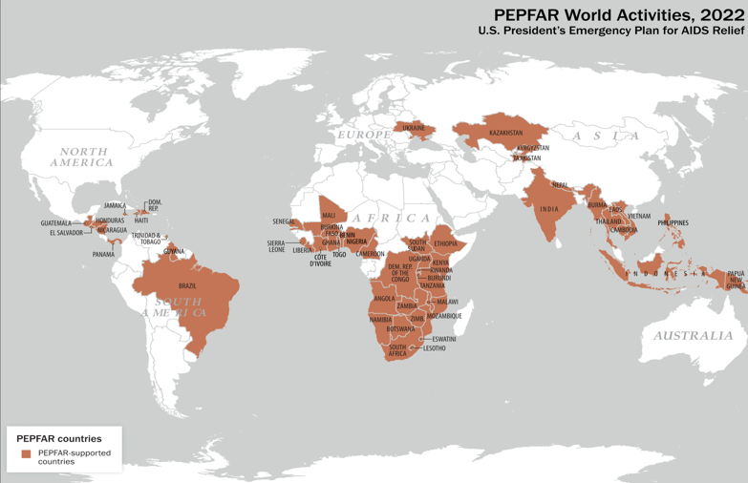
Leveraging Successful Platforms for Rapid Response
PEPFAR in partnership with U.S. Government Agencies and Faith-Based Organizations, have long track records of continuing success over two decades of caring for orphaned and vulnerable children

Slide 2
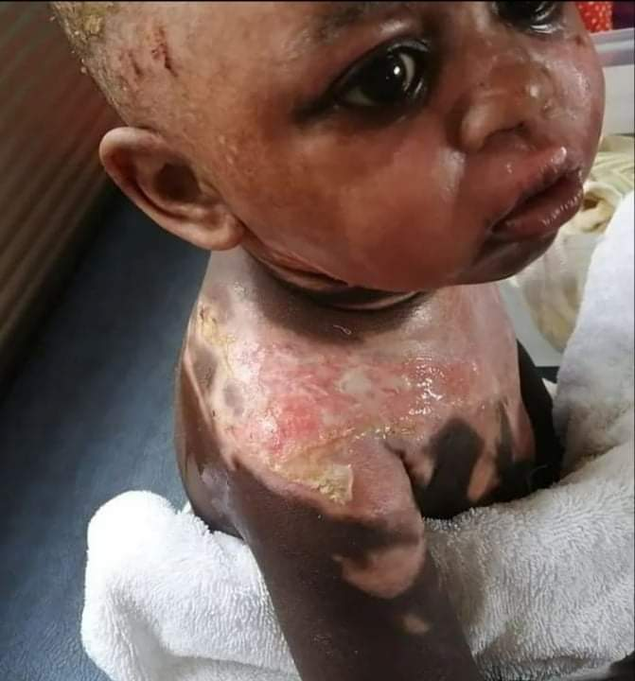
Every COVID surge hides faces of real children affected by the death of their mothers, fathers, and grandparent caregivers
This little girl from Zambia is 2 ½, and her mother died shortly after her birth. Her grandmother became her sole caregiver, and 3 months ago contracted COVID. The grannie died at home on day 9, with boiling water on the stove for the little girl’s morning tea. The toddler, apparently, seeing no one was pouring her tea, made her way to the stove to pour the boiling water into her cup…but the scalding water fell instead on her scalp and shoulders.
Her screams reached the ears of the pastor and his wife who lived nearby and rushed in to take her to the hospital.
Rev. Billiance Chondwe, PEPFAR Faith and Community Initiative, USAID Discover
Notes:
Put the whole story in here – it is so compelling. Move the graph to next slide

Slide 3
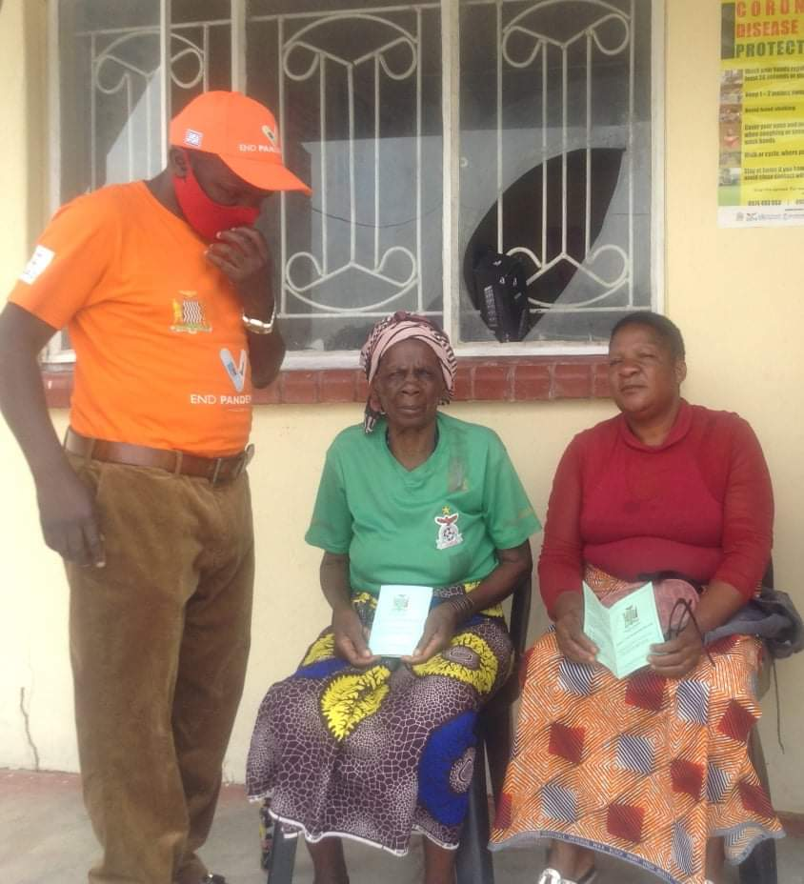
“The granny in the green shirt is begging for a vaccine, because she stays along the main road to the grave-site -- she is scared. In her lifetime, she never saw vehicles with coffins are passing in such great numbers. ‘In the old days,’ she said, ‘it will take over 2 weeks to see 4 coffins passing – but now on a daily basis, more than 20 coffins pass the same road from 9 AM to 3 PM.’ Then she cried.” Pastor Billy Chondwe, Zambia, January 3, 2022, 4th wave
Notes:
I think the child story is more powerful and we could potentially remove this or keep one of the quotes and use it later

Slide 4
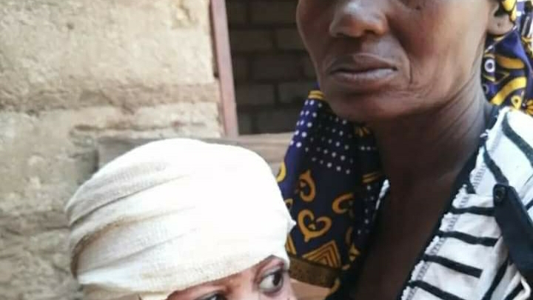
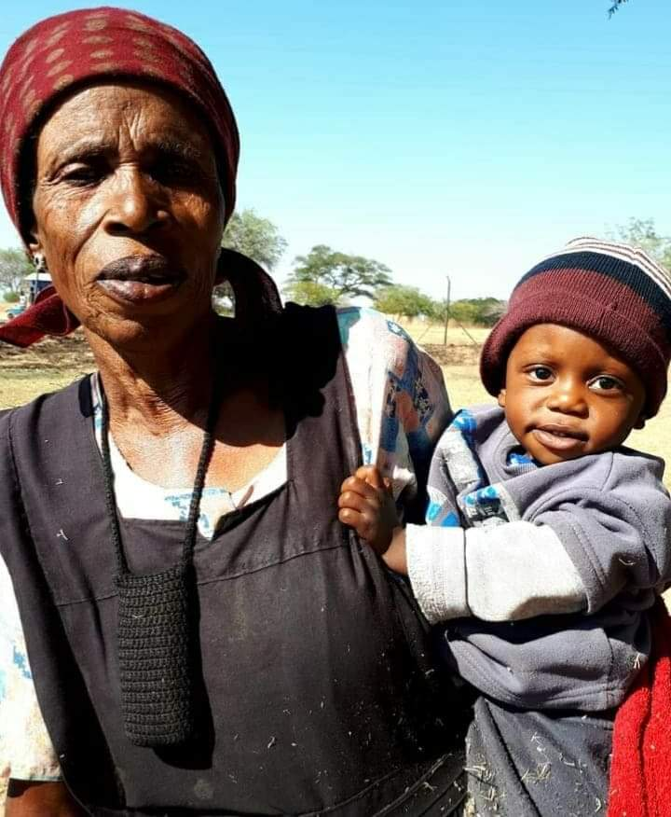
Diana – 3 months later
The pastor found Diana’s great aunt, a widow living in a nearby village, who agreed to adopt her. “She needs help to have enough juice, food, fruits, and transport for medical check ups for Diana.” Rev. B Chondwe

Slide 5
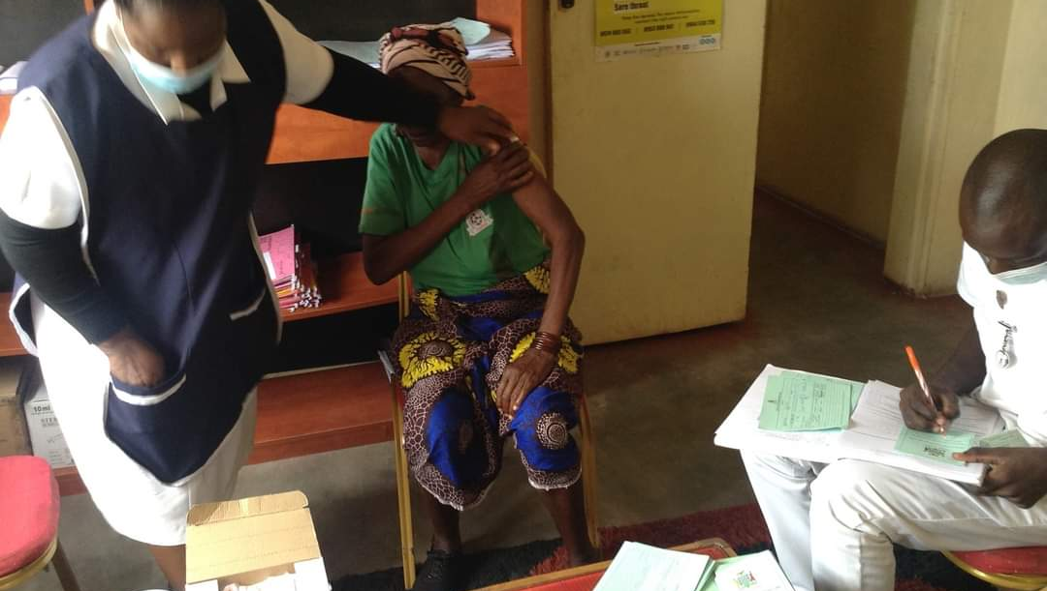
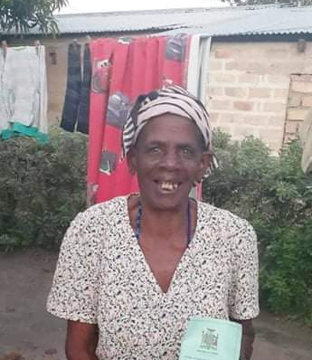
From tears to laughter
“We took the granny to the Health Center. The staff were on their last vial of vaccines for the day and had 1 dose left . When they gave it to her, she laughed.”

Slide 6
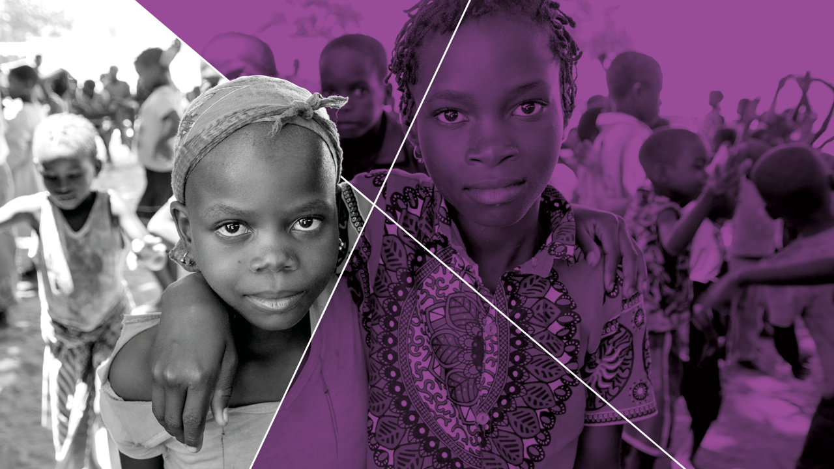
“
THANK YOU
Notes:
We may not need this one now

