Slide 1
Maintaining HIV Epidemic Control Gains During COVID-19
FCI New Foundations of Hope
The Luke Commission
May 19, 2021

Slide 2
Introduction
TLC is committed to collaborating, learning, and adapting to challenges in order to provide compassionate, comprehensive care
All TLC services, including HIV, TB, and COVID-19 care, are part of a comprehensive health care platform
TLC welcomes each patient as a father, mother, brother, sister or child
TLC support and trainings through FCI continues today

Slide 3
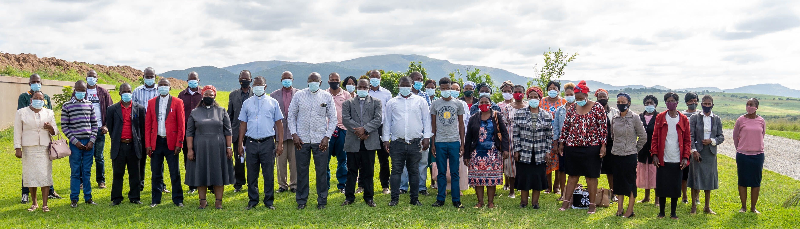
FCI Training, TLC Miracle Campus, 03/23/21

Slide 4
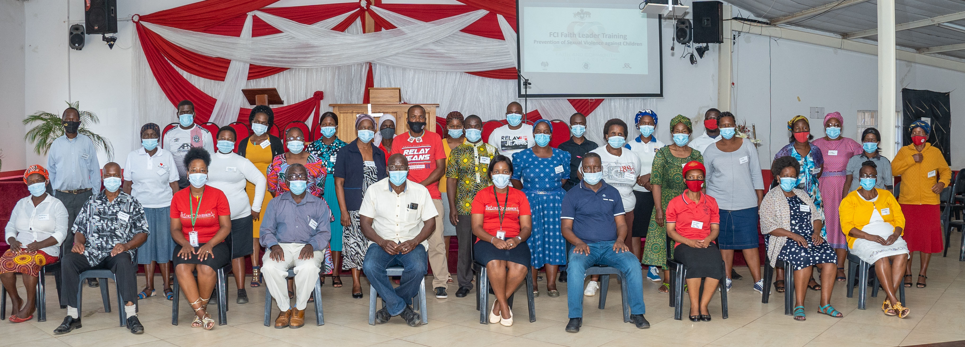
FCI Training, Hhohho Region, 04/27/21

Slide 5
Background for Contributing to National COVID-19 Response
Since March 2020, TLC has coordinated with the Ministry of Health and PEPFAR as part of a national response to COVID-19
While TLC adjusted strategies, service provision for HIV and TB care and treatment has continued throughout the pandemic
During the 2nd wave of COVID-19, TLC received 400 COVID-related admissions, 90% of whom were severe

Slide 6
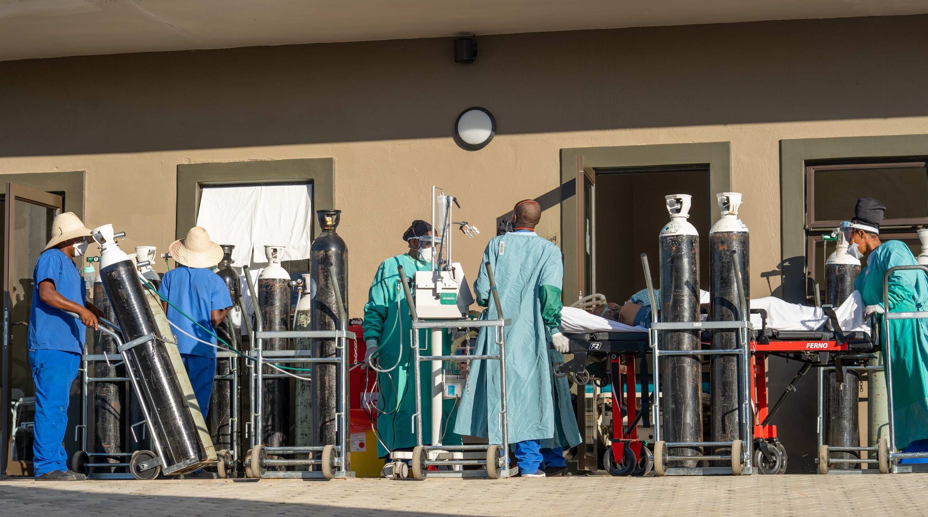

Slide 7
Maintaining HIV Epidemic Control During COVID-19

Slide 8
Maintaining Gains: Strategies
SMS refill reminders
MMD (stockout challenges)
DDD
batch all services
intensively follow missed clients
Patient transport sponsorship for eligible clients
24-hour patient hotline
Utilizing DREAMS on Wheels mobile outreaches to batch ART refills nearby clients (~ 60 teams visiting 120 sites/month)
Notes:
MMD – Multi-Month dispensing
DDD – Decentralized Drug Distribution

Slide 9
Data

Slide 10
Viral Load Suppression FY20Q3-FY21Q2, Including COVID-19 Surge, TLC, Eswatini
Data slide on PrEP
COVID-19 SURGE
Notes:
This slide shows that our Viral Load Suppression was maintained during both waves of COVID-19 in Eswatini. COVID surges in Q4 of COP20 (July 15-Sept 10) and Q1-Q2 of COP 21 (Dec. 11 through Feb. 11)

Slide 11
Summary of Male Data
Notes:
Although our MMD was affected by stockouts, overall the majority of males and females – roughly 65-70% – received 3-5 months or greater than 6 months’ supply of ARVs
Although our Loss to followup was low, it tended to be higher for females than for males every quarter, AND we were more likely to lose those on treatment more than 3 months

Slide 12
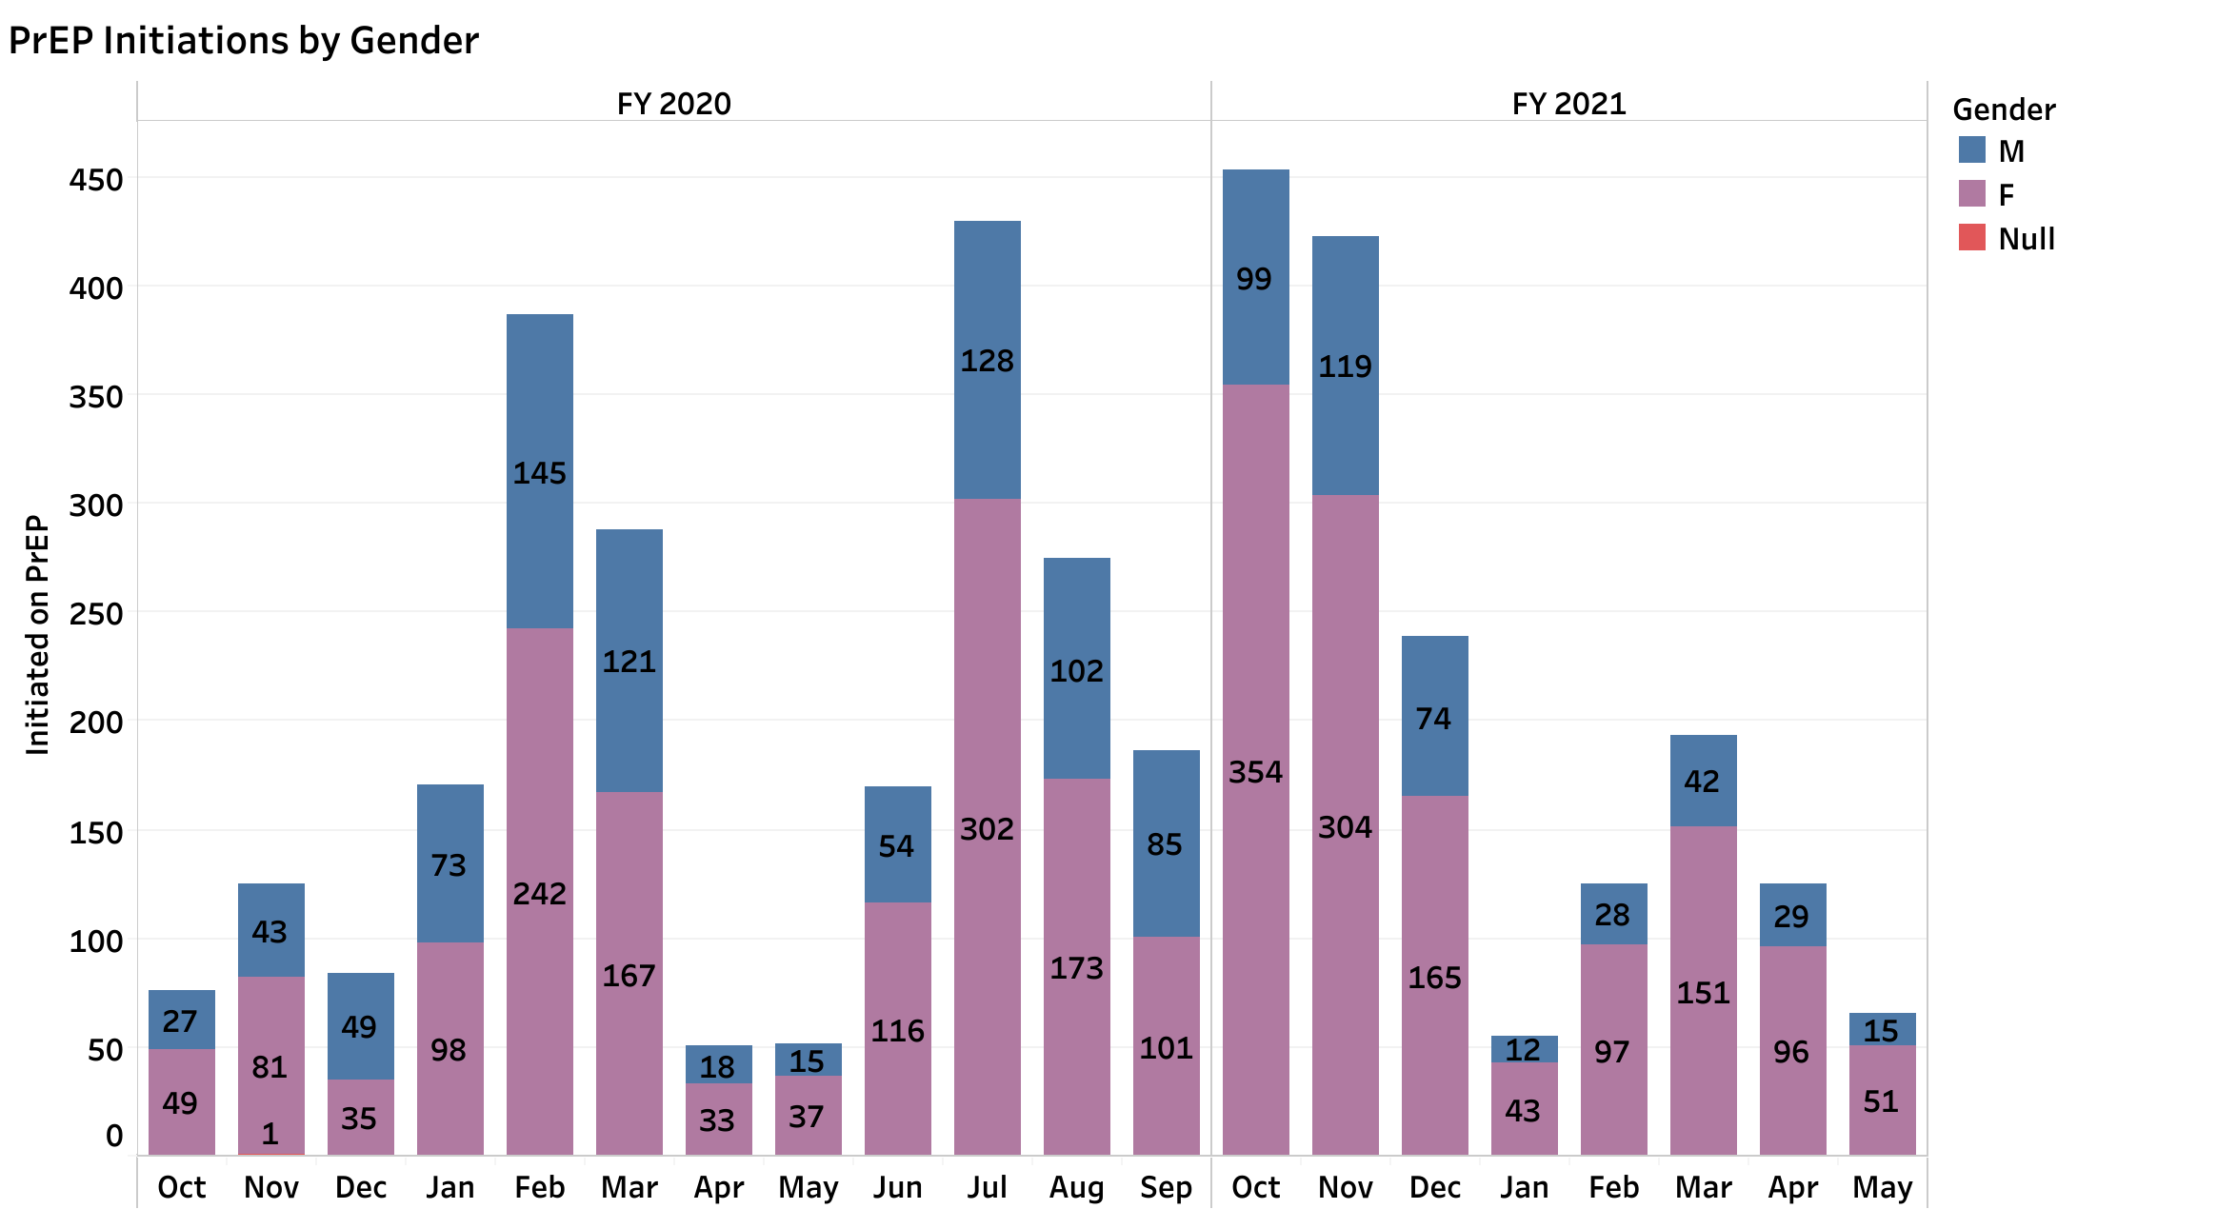
PrEP Initiations, Oct. 2019 - Apr. 2021
Notes:
During COVID-19, PrEP uptake has continued, though in smaller volumes. Faith leaders reported a greater confidence in sharing about PrEP with others as a result of the FCI training.

Slide 13
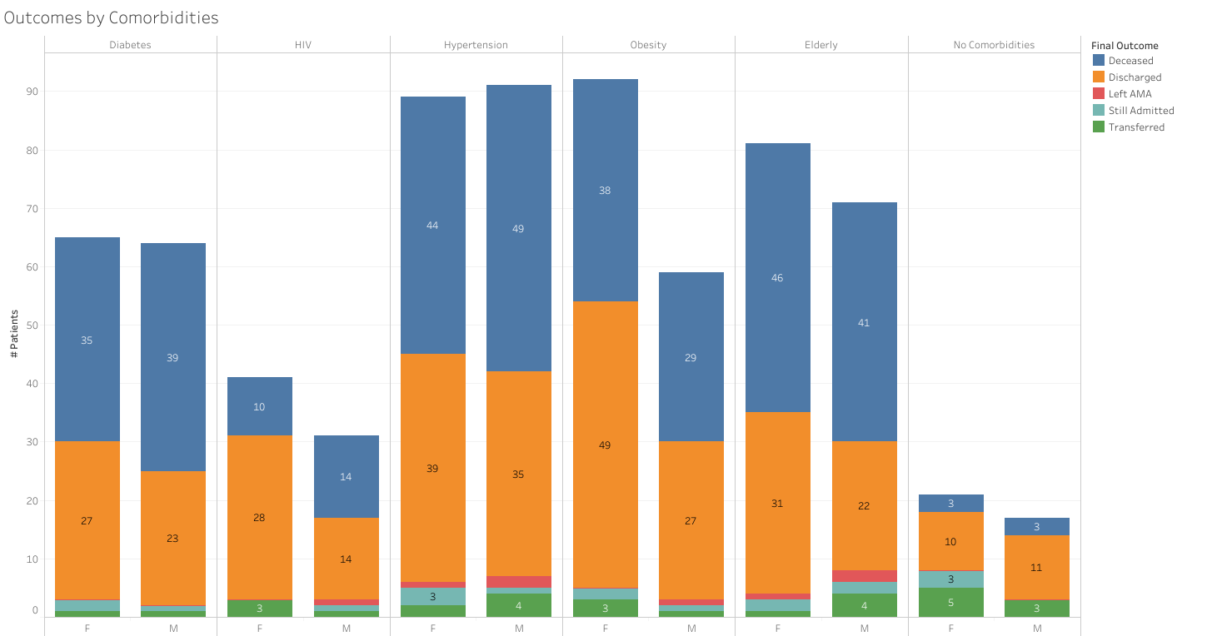
Outcomes by Comorbidities
Final Outcome
No
Comorbidities
Diabetes
HIV
Hypertension
Obesity
Elderly
Deceased
Discharged
Left AMA
Still Admitted
Transferred
Notes:
Here we see deaths in blue and discharges in orange, by comorbidity. We see here the high occurrence of deaths among those with diabetes, hypertension, or obesity, and the LOWER risk of death as shown in the last column, among those with no comorbidities. Total of 133 deaths from Dec. 1, 2020 – Feb 28, 2021.

Slide 14
Comorbidities Associated with Significantly Increased Risk of Death: Diabetes, Obesity, Hypertension
Comorbidity | Relative Risk of Death (unadjusted) | 95% Confidence Interval
HIV | 1.6 | 0.8, 3.6
Diabetes | 2.7 | 1.3, 5.5
Obesity | 2.1 | 1.02, 4.4
Hypertension | 2.5 | 1.2, 5.1
No comorbidity | 1.0 | Referent group
Notes:
An analysis of these data showed that among those admitted to our Miracle Campus with COVID-19, those with diabetes, obesity and hypertension were from 2.1 to 2.7 times as likely to die, compared to those who had no comorbidities.
As you also see, those with HIV were not at a significantly increased risk of death (this is shown by the fact that the 94% confidence interval includes 1.0).

Slide 15
Program Priorities for HIV Needed for COVID-19
Messages of Hope
Screening for testing eligibility
Contact tracing
Destigmatized, client-centered care
Psychosocial support
Notes:
We have actively connected strategies previously used for HIV epidemic control to strategies for COVID-19 response
Messages of Hope – TLC adapted these, sent out 1.5million with PEPFAR COVID-19 Activities Funding
Screening – integrated for all fixed-site and outreach activities via EMR
Contact tracing – integrated into EMR
Destigmatized/client-centered – separate spaces for COVID-19 suspects offering all services in comprehensive healthcare platform
Psychosocial support – psychosocial counseling, family support, prayer available for anyone requesting

