Slide 2
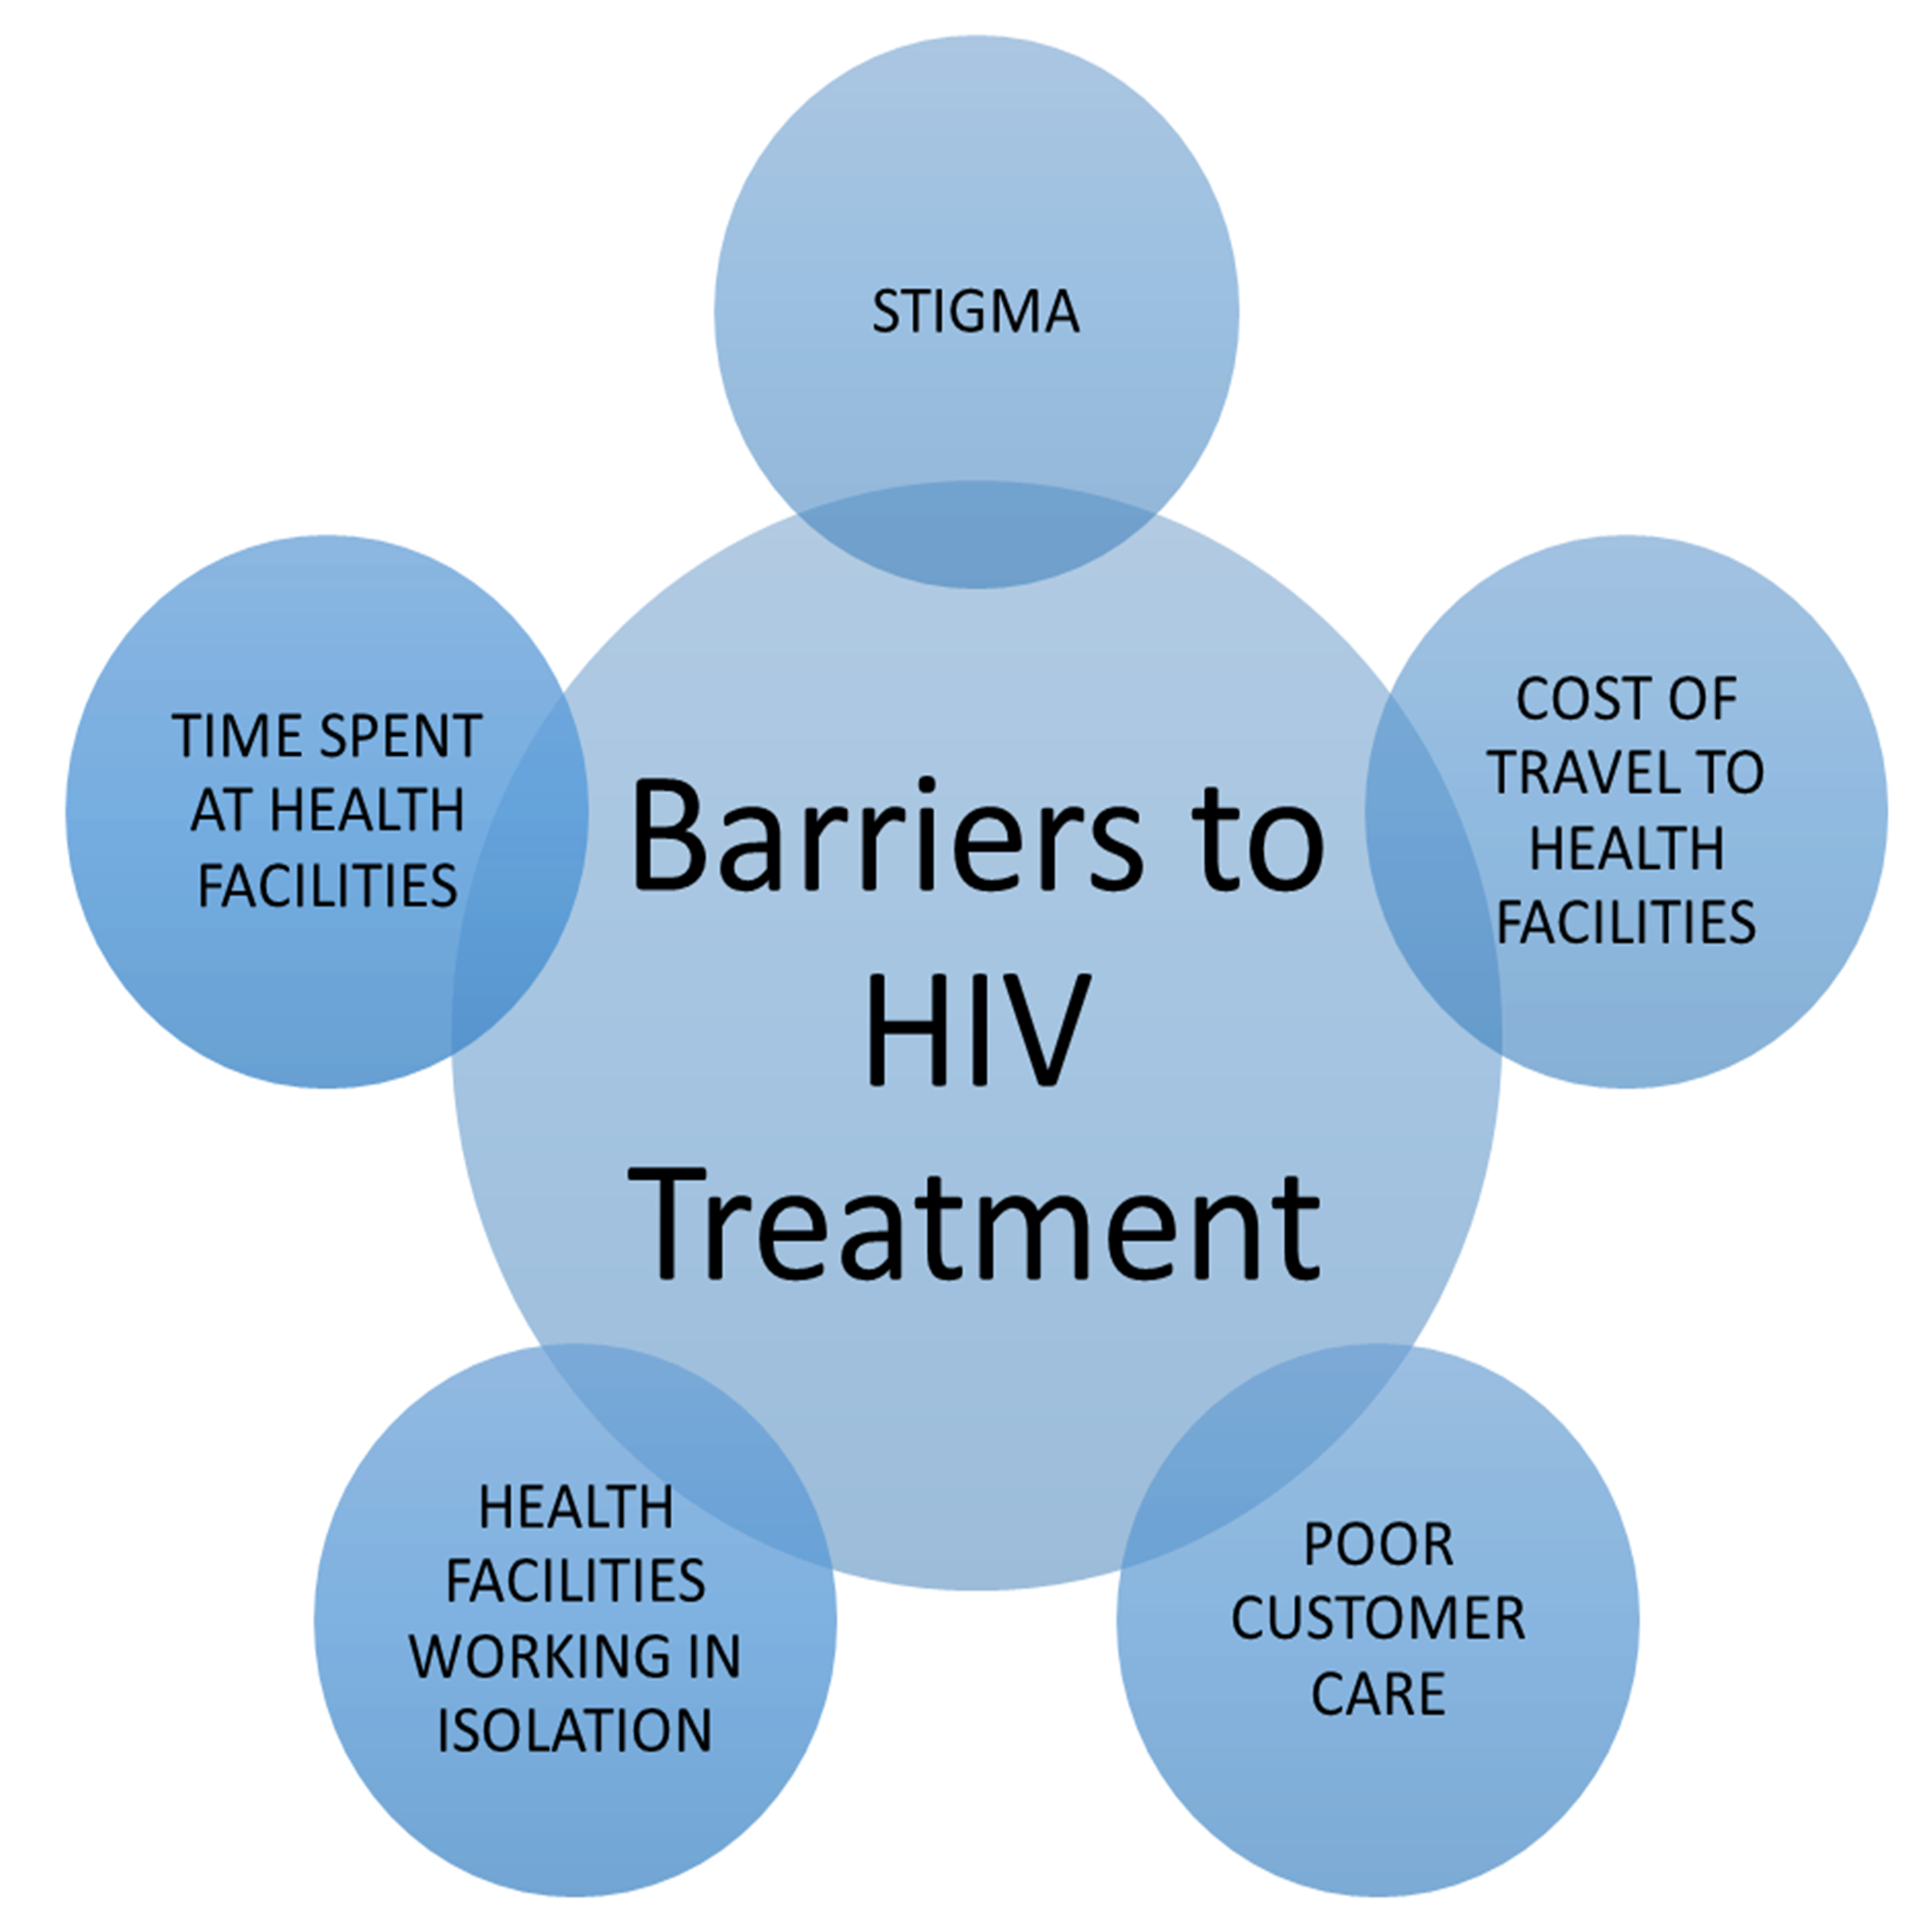
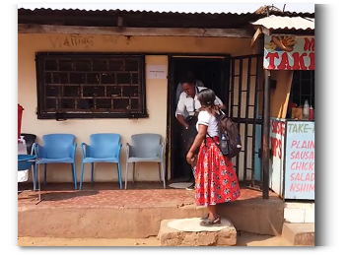
Faith-engaged community posts associated with over 1200% increase in new HIV case ascertainment, with high linkage and retention, Zambia
Gibstar Makangila¹, Albert Mwango², Minesh Shah³, Nzali Kancheya⁴, Kennedy Nkwemu⁴, Isaac Zulu³, Idongesit Essiet-Gibson³, Lauren Erickson Mamane³, Simon Agolory⁴, Susan Hillis⁵ 1 Circle of Hope (COH), Lusaka, Zambia; 2 Catholic Relief Services (CRS), Lusaka Zambia; 3 CDC, Atlanta, GA, USA; 4 CDC, Lusaka, Zambia; 5 Office of the Global AIDS Coordinator, Washington, DC, USA
CIRCLE OF HOPE IS A FAITH-BASED ORGANIZATION BASED IN LUSAKA, ZAMBIA. IT ENGAGES FAITH LEADERS AND DEPLOYS FAITH COMMUNITY MEMBERS TO DE-CENTRALIZED COMMUNITY POSTS (CPS), TO INCREASE:
Case-finding (including INDEX TETING)
LINKAGE
RETENTION

Slide 3
Faith-engaged community posts associated with over 1200% increase in new HIV case ascertainment, with high linkage and retention, Zambia

Slide 4
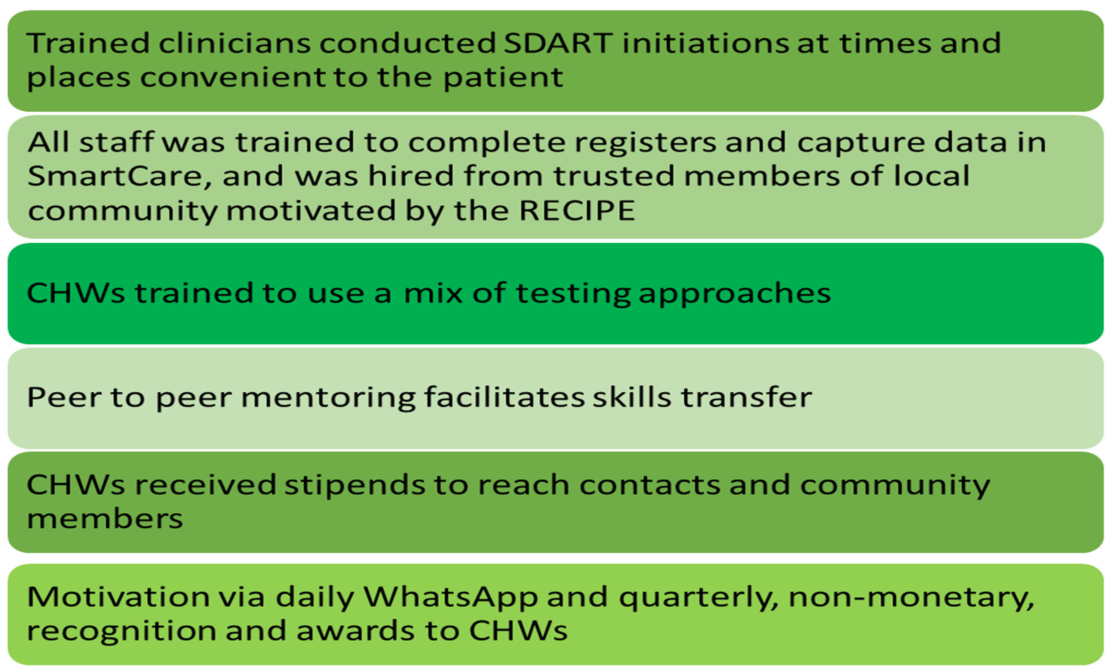
Faith-engaged community posts associated with over 1200% increase in new HIV case ascertainment, with high linkage and retention, Zambia

Slide 5
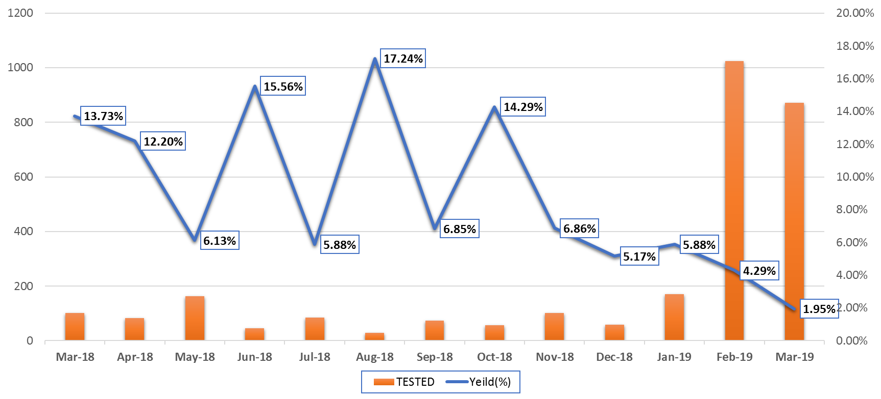
Faith-engaged community posts associated with over 1200% increase in new HIV case ascertainment, with high linkage and retention, Zambia
LESSONS LEARNED & CONCLUSIONS

