Slide 2
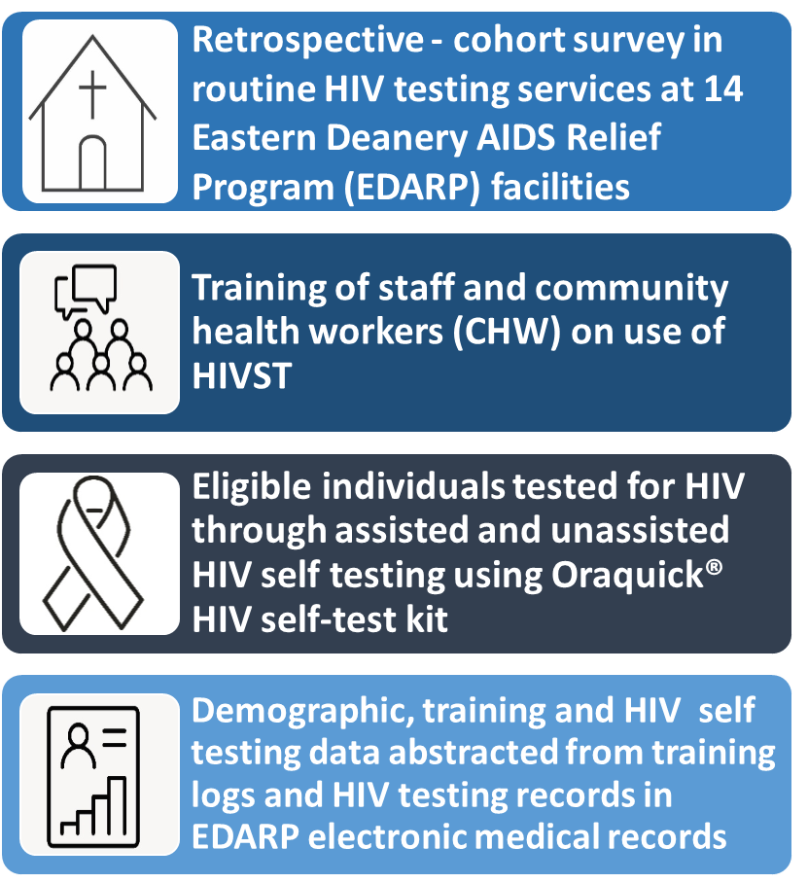
Engagement of faith leaders in targeted HIV self-testing increased case identification and new linkages to treatment in Nairobi, Kenya
Authors: R. Bauer , C. Simbiri , J. Motoku , A. Njoroge , H. Weyenga , J. Mwangi , S. Anangwe , V. Ojiambo , J. Barker , M. Maxwell , A. Katana , S. Hillis Affiliation: Eastern Deanery AIDS Relief Program, Nairobi, Kenya, CDC, Nairobi, Kenya, DOD/HJF, Nairobi, Kenya, USAID, Nairobi, Kenya, PEPFAR Coordination Office, Nairobi, Kenya, U.S. Office of Global AIDS Coordinator, Washington, DC, United States Kenya
BACKGROUND
DESCRIPTION
Gaps in HIV testing uptake and antiretroviral coverage, particularly for men, are evidence of significant barriers to health services. To increase HIV case-finding and linkage into care for persons living with HIV (PLHIV), particularly men, the faith based Eastern Deanery AIDS Relief Program (EDARP) engaged faith leaders in both community and clinical settings to introduce HIV self-testing (HIVST) in Nairobi Kenya.

Slide 3
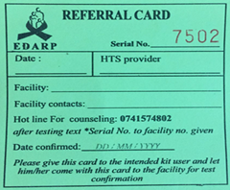
Engagement of faith leaders in targeted HIV self-testing increased case identification and new linkages to treatment in Nairobi, Kenya

Slide 4
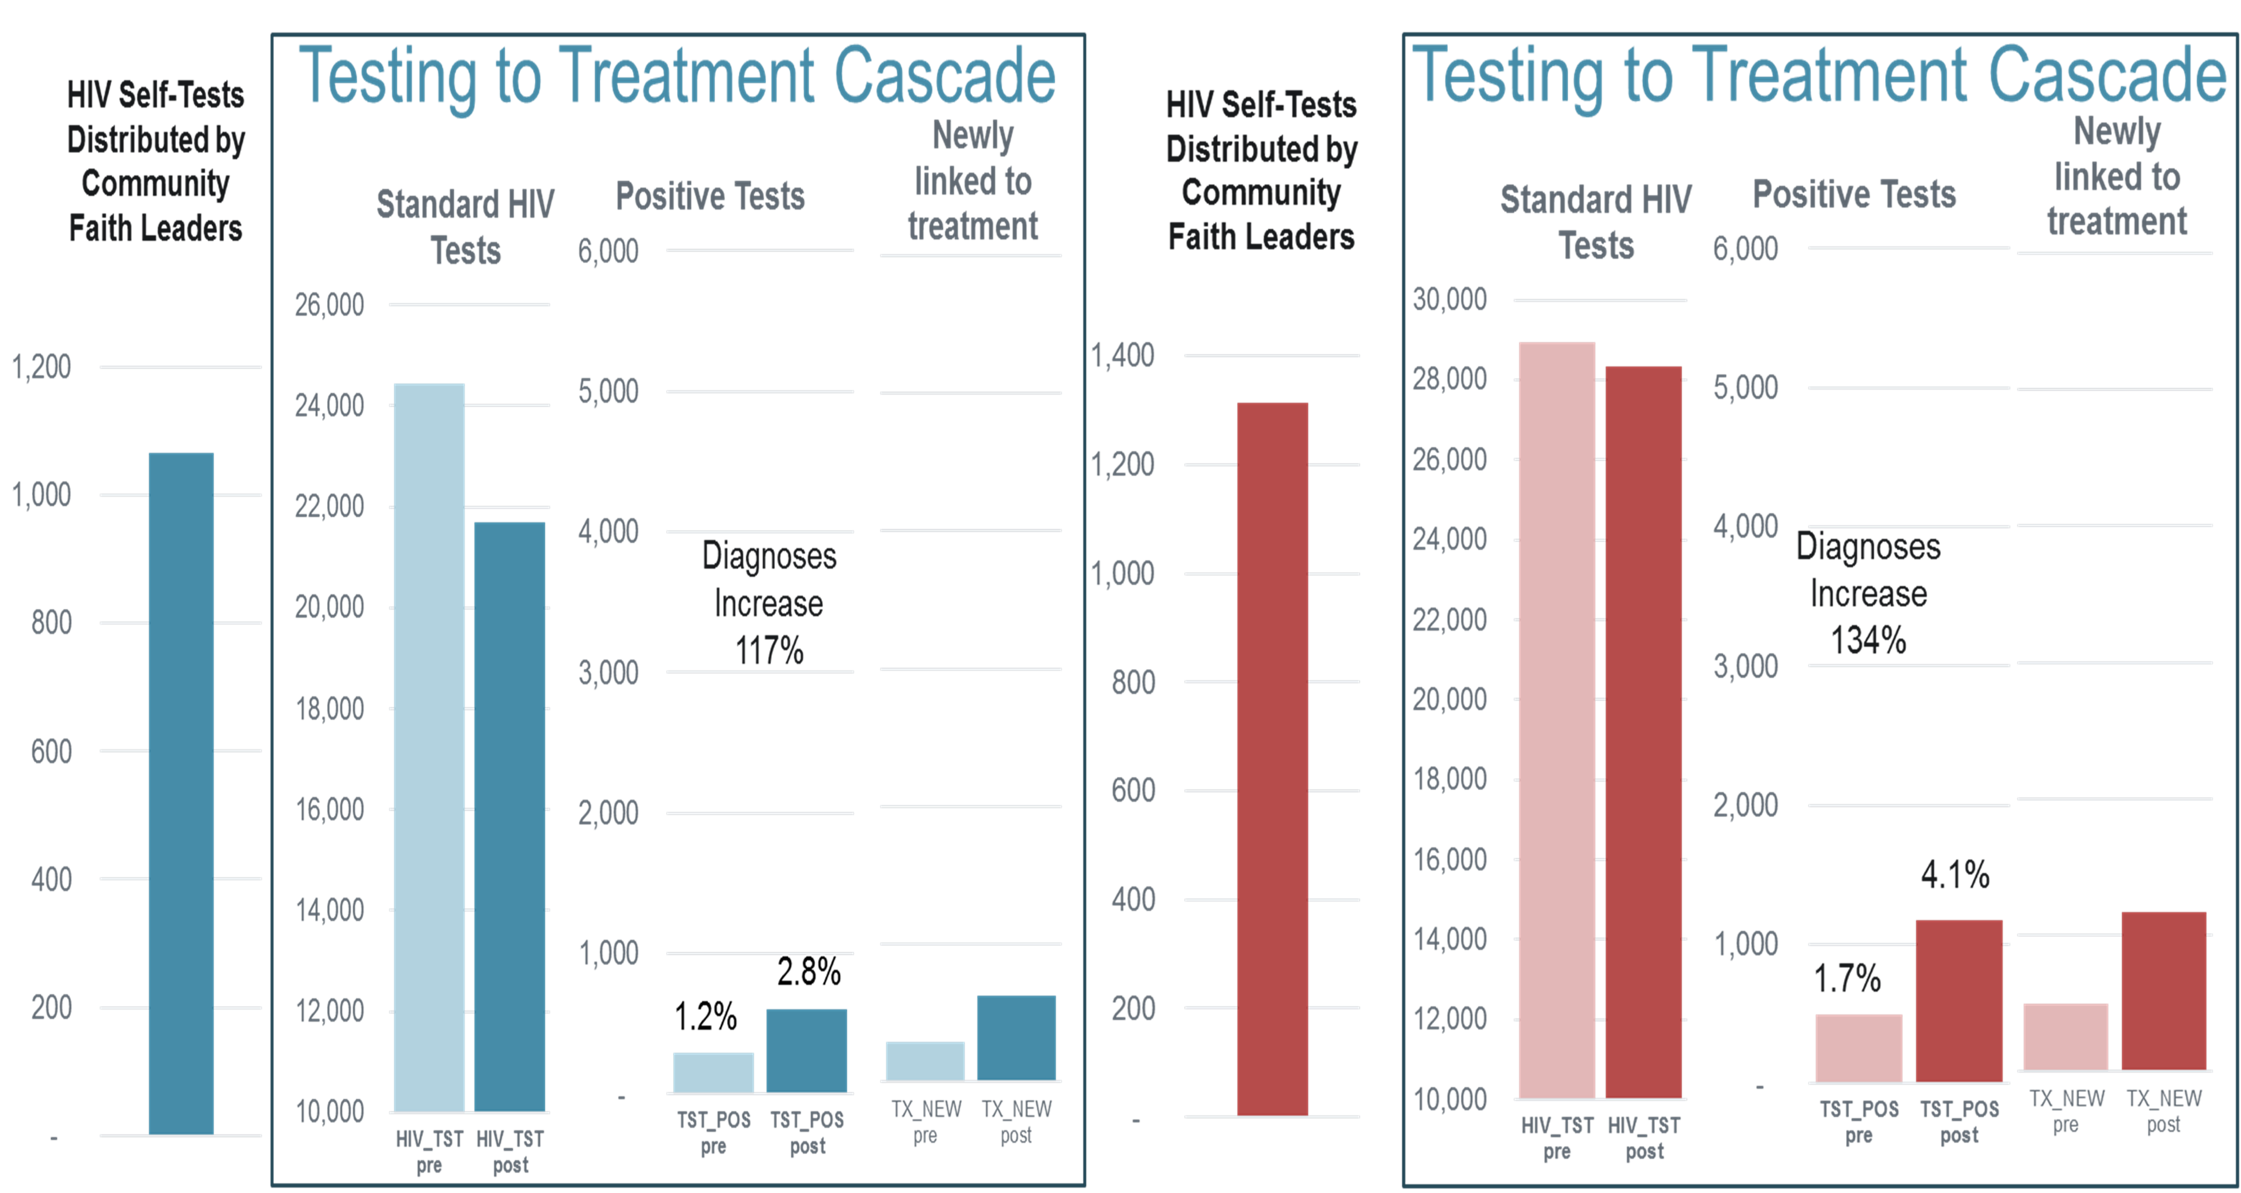
Engagement of faith leaders in targeted HIV self-testing increased case identification and new linkages to treatment in Nairobi, Kenya
RESULTS
TABLE: Increase in HIV positive test, linkages and testing yield among men and women in Nairobi, Kenya
1332 staff and CHW’s trained.
HIV diagnosis and linkage among men increased by 117%
HIV diagnosis and linkage among women increased by 134%
HIV testing yield increased from 1.2% (294/22,429)to 2.8% (604/21,703 p,<00001) among men
HIV testing yield increased from 1.7% (491/28,952) to 4.1% (1169/28,321 p<00001) among women.

Slide 5
Engagement of faith leaders in targeted HIV self-testing increased case identification and new linkages to treatment in Nairobi, Kenya
LESSONS LEARNT
Seamless community- clinical integration
Skills building for improved partner elicitation
Welcoming environment (especially for Key populations)
Staff emotional and spiritual support
24 hr hotline for HIVST users
Call back card utilization (Referral card)
Weekly progress review and celebration of top performing sites and staff

Slide 6
Engagement of faith leaders in targeted HIV self-testing increased case identification and new linkages to treatment in Nairobi, Kenya
CONCLUSIONS
Distribution of HIVSTs by faith leaders can substantially increase case-finding and linkage to care for both men and women
Expanding this model in and beyond Kenya may help advance epidemic control.

