Slide 1
Intro to Facebook Insights

Slide 2
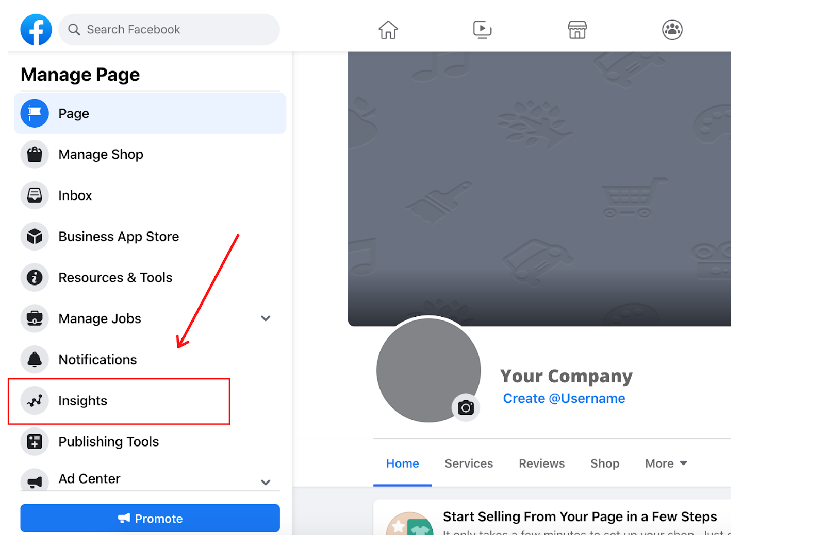
How to Access Facebook Insights
Once you log into Facebook, head to your business page. Then, click on "Insights," located on the sidebar to the left of the page.
You’ll then be on the “Overview” page which shows your page summary in the last 7 days, though you can adjust this time frame.
Scroll down and you’ll see your post performance
At the bottom Facebook will show your ’competitor’ pages so you can learn and compare to similar pages.

Slide 3
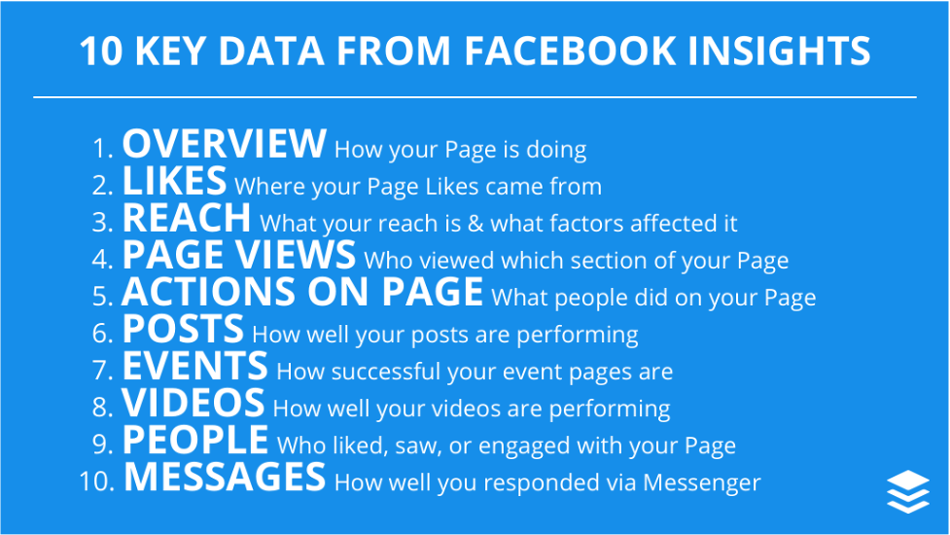
image credit: Buffer.com

Slide 4
Recommendations to Prioritize:
Overview
  Shows Page Likes, Post Engagement, and Reach, plus percentage change over time
Reach
  Can track reach and engagement (When a post receives engagement, Facebook will serve it to more people. More engagement, higher reach). Tip: set your date range and compare your averages over time.
Page Views
  Total views and also sources of views to your Page. You can break down views by section, age and gender, country, city, and device.
Posts
  Contains all the information about your posts such as reach and engagement. It also shows you how active your Facebook fans are, on average, on each day or the week and each hour of the day.
People
  A simple overview of the people who liked your Page, saw your posts, or engaged with your Page or posts.

Slide 5
Key Questions to Ask:
Follower Metrics
  How many people follow my page, and how much growth am I seeing?
  What are the demographics of my followers, and how does that affect the content I create?
Page Metrics
  How many people does my page reach, and how many people engage with my page (like, comment, share posts?)
  How many messages am I receiving/am I receiving any negative feedback (messages, comments, unlikes)?
Post Metrics
  Which posts perform best?
  What is my media mix (post, photos, videos, etc.) and which media types receive the most engagement and reach?

Slide 6
Sources:
Guide to Facebook Insights
Guide to Instagram Analytics

