Slide 2
Achieving Viral Load Suppression and Quality of Life for HIV+ Adults in Kenya
Authors: Heacock, M.*, Kimani, D*, Korir, L.*, Onyango, C*
*CARE for AIDS, Nairobi, Kenya
BACKGROUND
CARE for AIDS is a faith-based organization that aims to serve HIV+ adults living in urban slums throughout Kenya to move them toward viral load suppression (VLS) and reduction in internalized stigma. We serve the last 5% of virally unsuppressed and lost to follow up clients in an effort to contribute to 95, 95, 95, 95 goals, quality of life being the fourth 95.
When recruiting, CARE for AIDS staff prioritize lost-to-follow up clients and clients at highest risk of disease progression due to poverty, viral load at recruitment, or a combination of the two.
Clients represented in this dataset are aged 17-65 with the average age being 29. All clients represented in the dataset live in informal urban settlements in Kenya and graduated from the CARE for AIDS program in the 2018/2019 cohort.

Slide 3
Achieving Viral Load Suppression and Quality of Life for HIV+ Adults in Kenya
Authors: Heacock, M.*, Kimani, D*, Korir, L.*, Onyango, C*
*CARE for AIDS, Nairobi, Kenya
DESCRIPTION
CARE for AIDS centers are located within local churches, free of charge, and each center employs two social workers who are trusted leaders in the community motivated by compassion to serve the most vulnerable in their communities. Each center serves a cohort of 80 HIV+ adults annually—many of these HIV+ clients are non-suppressed and lost to follow up clients referred to CARE for AIDS centers through government clinics. All CARE for AIDS clients in this dataset live in urban slums and survive on less than $1 per day.
CARE for AIDS centers serve all persons in the community without discrimination. In an effort to move clients to viral load suppression (VLS) and to achieve the fourth 95, quality of life, or as CARE for AIDS defines it, reduction in internalized stigma, our centers implement the following interventions:

Slide 4
Achieving Viral Load Suppression and Quality of Life for HIV+ Adults in Kenya
Authors: Heacock, M.*, Kimani, D*, Korir, L.*, Onyango, C*
*CARE for AIDS, Nairobi, Kenya
LESSONS LEARNED
Lessons learned regarding success include:
Establishing trusting relationships between government clinics and CARE for AIDS Centers
Locating CARE for AIDS centers in existing community churches
Targeting the last 5% of unsuppressed and lost to follow up clients
Welcoming environment for all, particularly key populations
Employing Compassion-driven local staff in all CARE for AIDS centers
Integrating medical and emotional health interventions in the context of counseling and group therapy
Lessons learned regarding serving the last 5%, partnering with both local churches and government clinics, and, leveraging local, compassion driven staff can be extended to other settings throughout Sub Saharan Africa to help reach VLS for vulnerable populations.

Slide 5
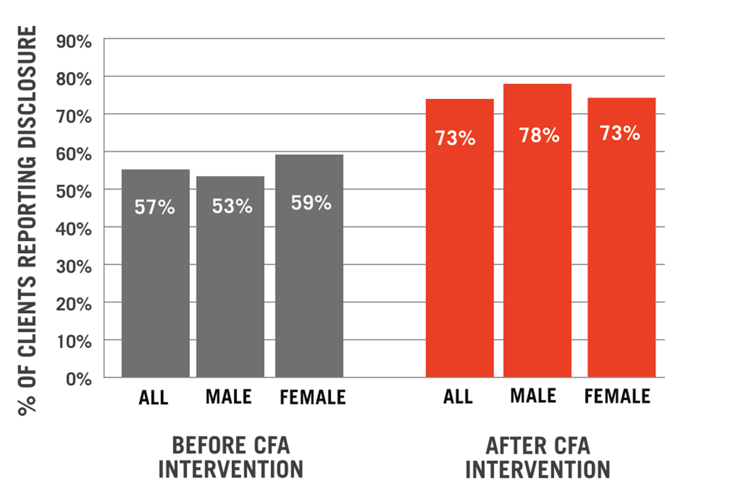
Achieving Viral Load Suppression and Quality of Life for HIV+ Adults in Kenya
Authors: Heacock, M.*, Kimani, D*, Korir, L.*, Onyango, C*
*CARE for AIDS, Nairobi, Kenya
INTERNALIZED STIGMA RESULTS

Slide 6
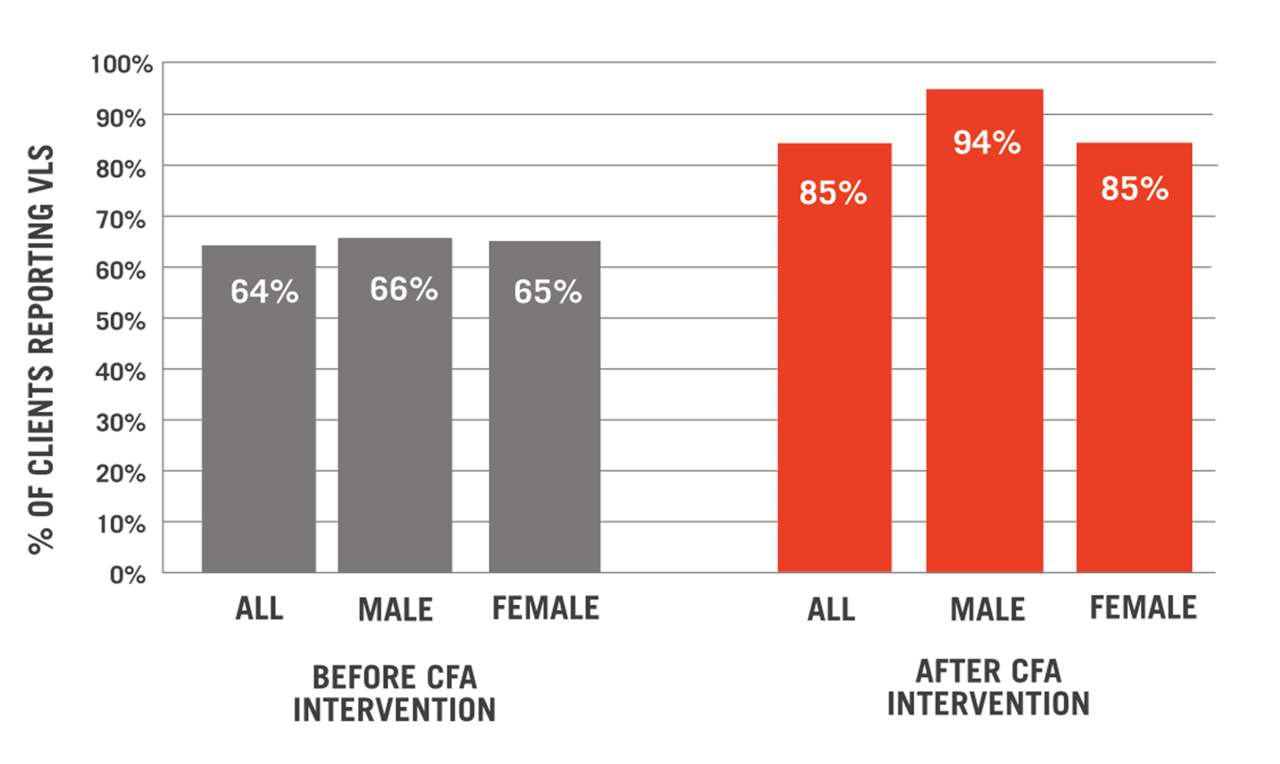
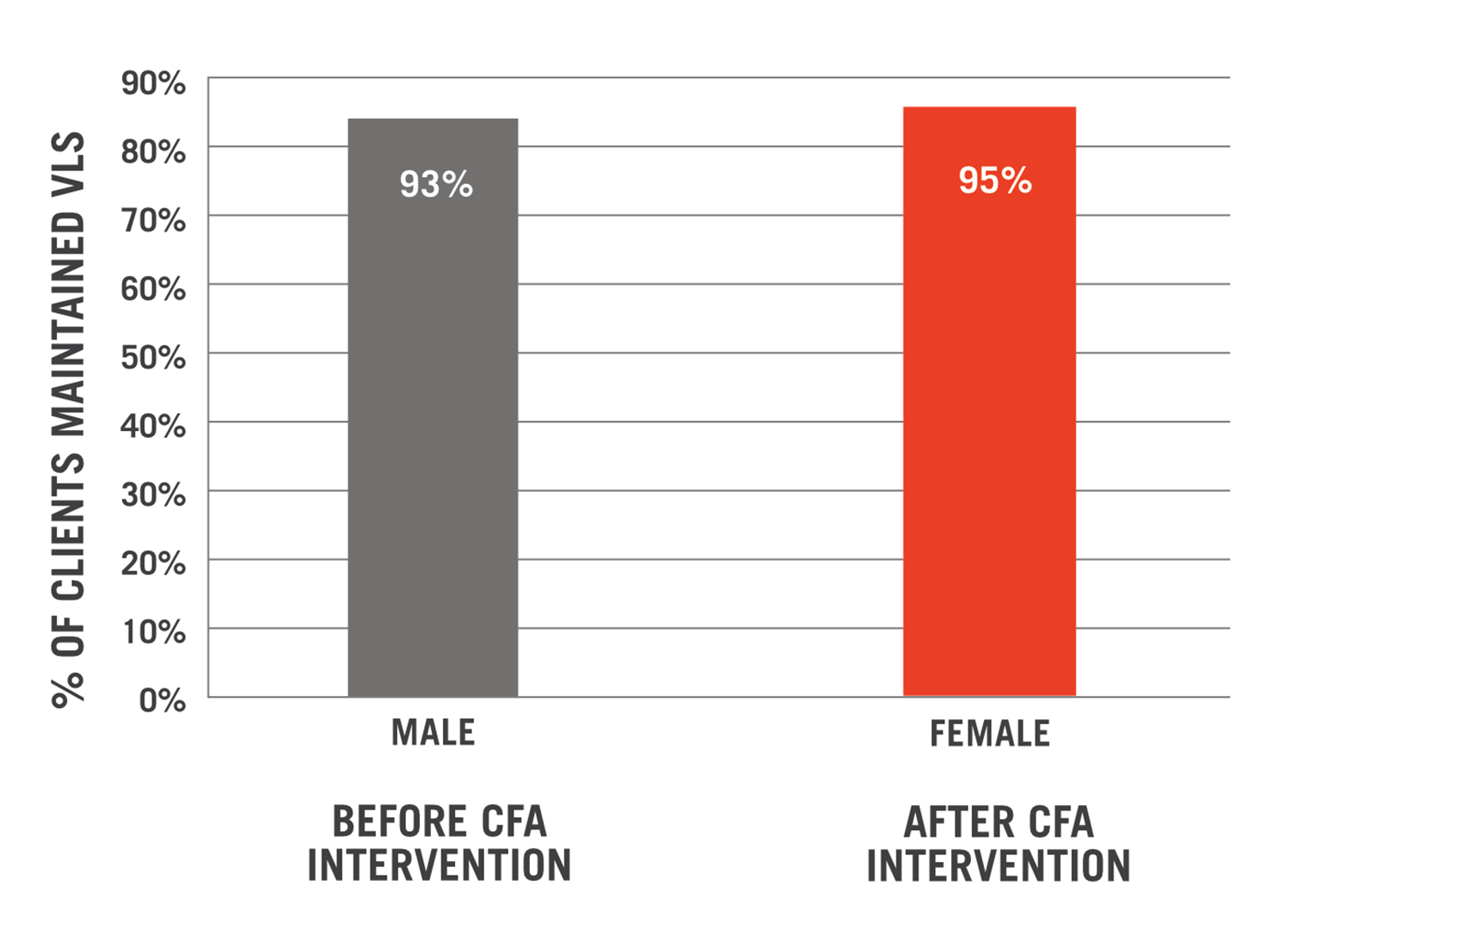
Achieving Viral Load Suppression and Quality of Life for HIV+ Adults in Kenya
Authors: Heacock, M.*, Kimani, D*, Korir, L.*, Onyango, C*
*CARE for AIDS, Nairobi, Kenya
VIRAL SUPPRESSION RESULTS
Viral load suppression maintained among those who were virally suppressed at baseline:
Overall Viral Suppression Data: N= 637

Slide 7
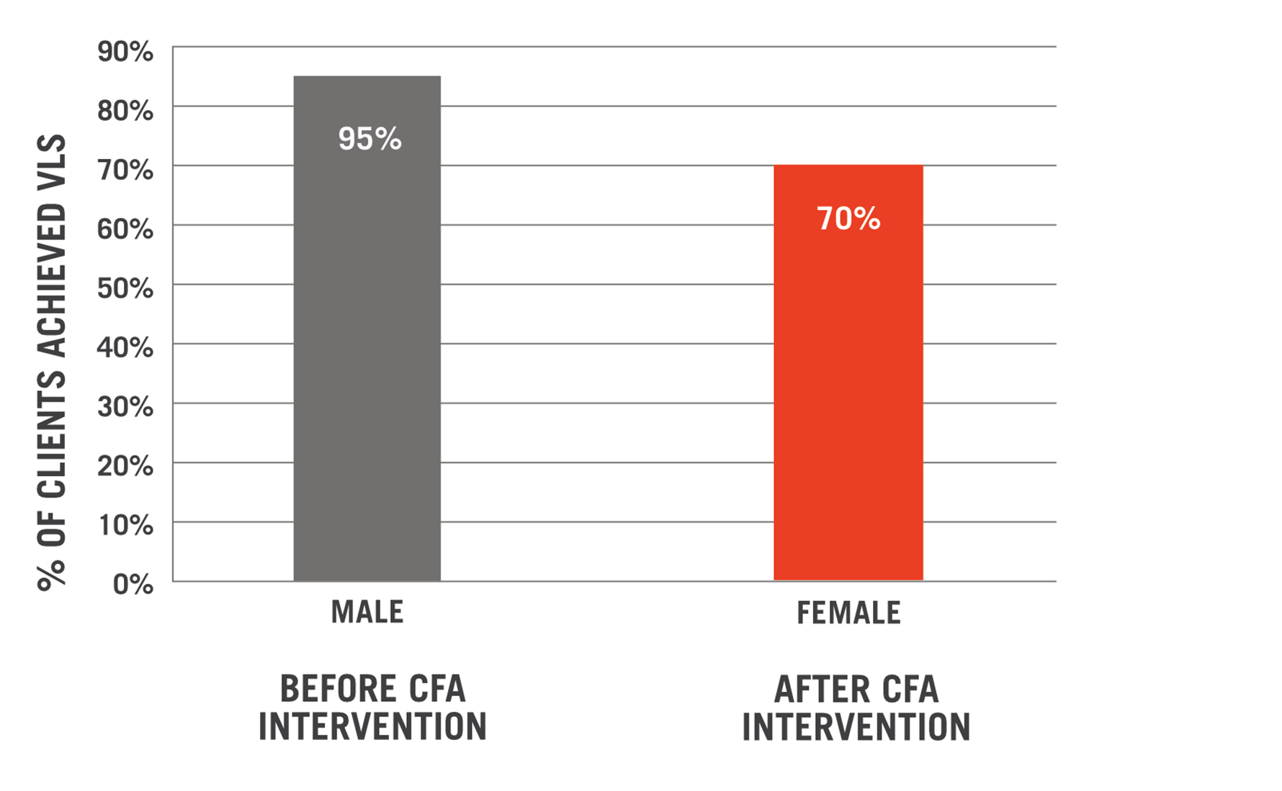
Achieving Viral Load Suppression and Quality of Life for HIV+ Adults in Kenya
Authors: Heacock, M.*, Kimani, D*, Korir, L.*, Onyango, C*
*CARE for AIDS, Nairobi, Kenya
VIRAL SUPPRESSION RESULTS
CONCLUSION
Viral load suppression achieved among those who were NOT virally suppressed at baseline:
HIV/AIDS who have historically been left behind.
Faith-based interventions that integrate mental and physical health care result in substantial improvements in achieving viral load suppression and disclosure rates among a segment of people living with HIV/AIDS who have historically been left behind.

