Slide 1

Echo VanderWal, Colin Moody – The Luke Commission

Slide 2


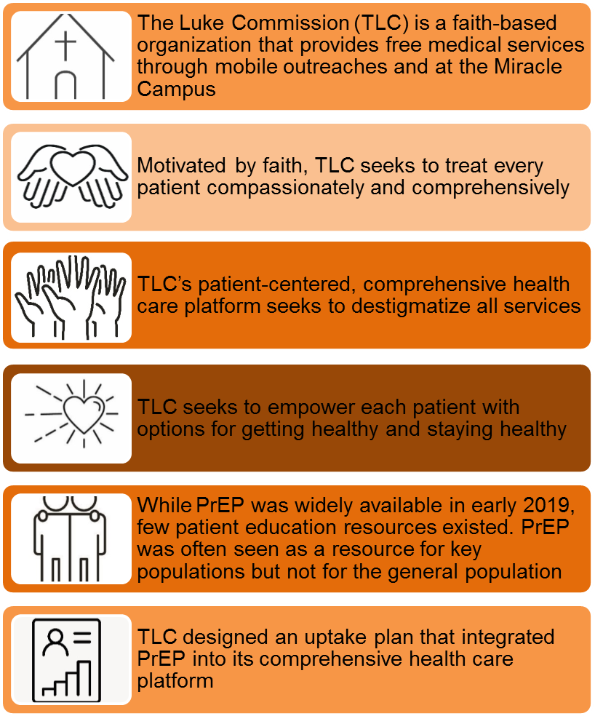


Increasing PrEP Uptake through HTS Counselor Sensitization, Integrated Screening, and Client Education
Authors: VanderWal, Echo; Benzerga, Wendy; Lukhele, Njabuliso

Slide 3
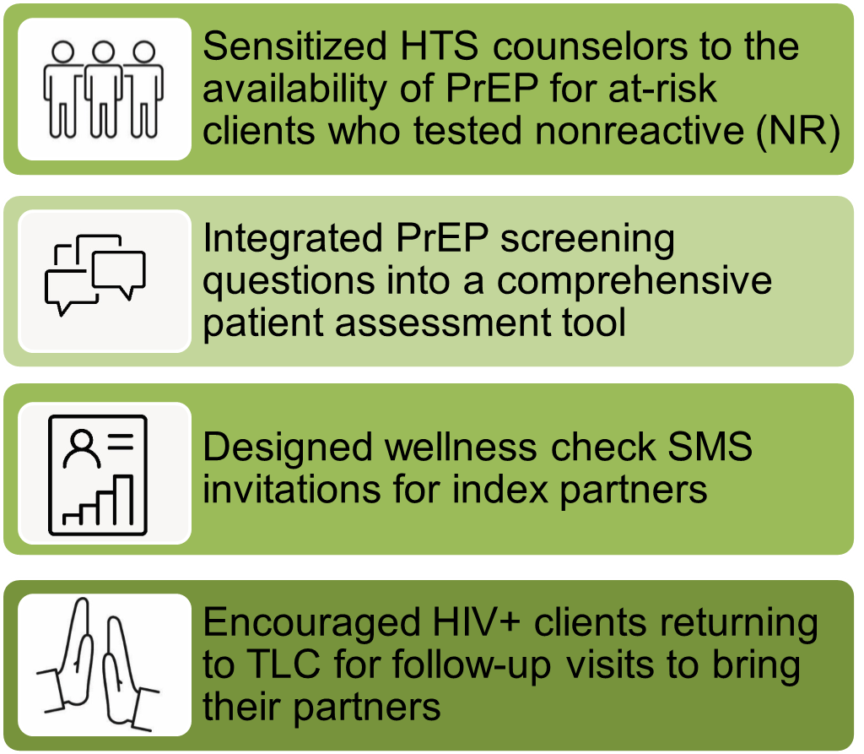
Increasing PrEP Uptake through HTS Counselor Sensitization, Integrated Screening, and Client Education
Authors: VanderWal, Echo; Benzerga, Wendy; Lukhele, Njabuliso

Slide 4
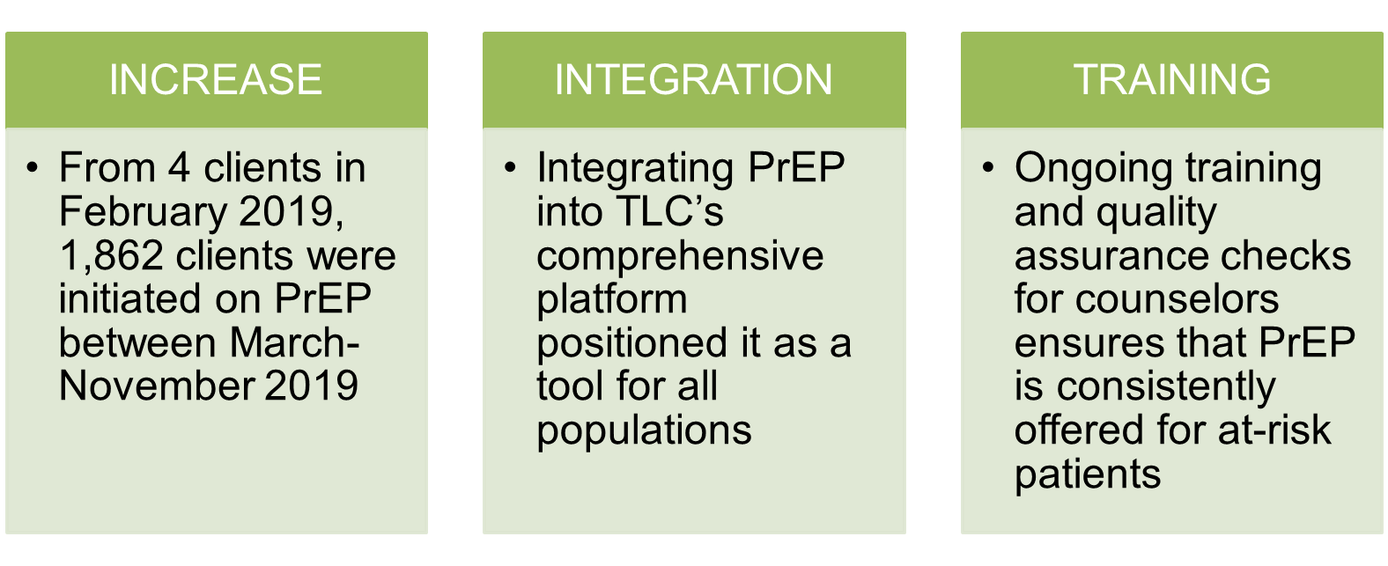
Increasing PrEP Uptake through HTS Counselor Sensitization, Integrated Screening, and Client Education
Authors: VanderWal, Echo; Benzerga, Wendy; Lukhele, Njabuliso
LESSONS LEARNED

Slide 5
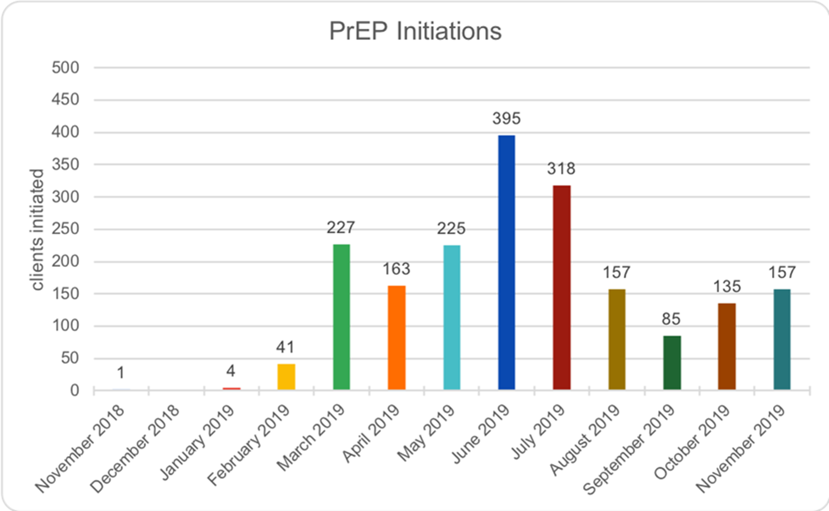
Increasing PrEP Uptake through HTS Counselor Sensitization, Integrated Screening, and Client Education
Authors: VanderWal, Echo; Benzerga, Wendy; Lukhele, Njabuliso
CONCLUSIONS
Initial uptake of PrEP was high in the early months of the initiative; however, one-month retention was low as many clients did not return for a first refill. In response, TLC adjusted strategy to focus on more extensive education and counseling about consistent use of PrEP
By including a private code in SMS invitations, indexed HIV-negative clients were identified to counselors without stigma as potential candidates for PrEP.

Slide 6


