Slide 1
Engaging Faith Communities to Find Men and Children: Messages of Hope for Men and Children Tool

Slide 2
Training Objectives
This Messages of Hope for Men and Children Tool follows the slide deck called Engaging Faith Communities to Find Men and Children: New Choices – New Treatment – New Timing – New Hope These key Messages of Hope for Men and Children will be adapted for the cultural context in each country.

Slide 3
Reaching Men by
Breaking the Silence
“[In reference to early AIDS epidemic in Botswana] “Speaking became a healing space, silence was killing us.”
- (Professor Musa Dube, University of Botswana)
“Need more role models. Culture of silence. “Men are still dying in silence.”
- (Elsie Alexander, Chair of Gender and Social Welfare Committee at Anglican Diocese )
Stanley Monageng
Notes:
A recurring theme during discussions with hundreds of faith leaders across the 10 Faith and Community Initiative countries was this: we must break the silence.
Professor Dube, a member of the Religious Studies Dept at the University of Botswana, reflected on how early on in the AIDS epidemic silence was killing them. No one wanted to talk about HIV. But speaking became a way for healing and the church played an important role in that.
The Chair of Gender and Social Welfare, Elsie Alexander, from the Anglican Diocese, also commented that there is still a culture of silence, and that men are still dying in silence.
Stanley Monageng is one man trying to change that by being a role model for other men. He said when he found out he had HIV he wasn’t afraid of HIV itself because he was a nurse and he knew about treatment. The most painful thing he faced when coming out with his HIV status was the stigma and discrimination. He is actively engaged in the community trying to eliminate stigma and show others how to live positively with HIV.

Slide 4
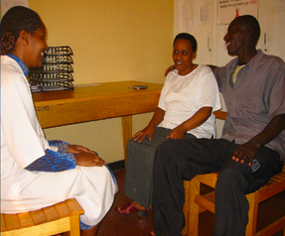
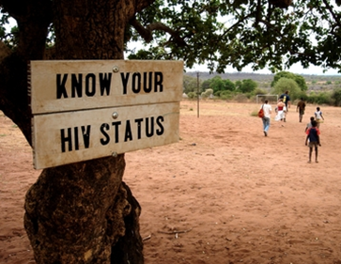
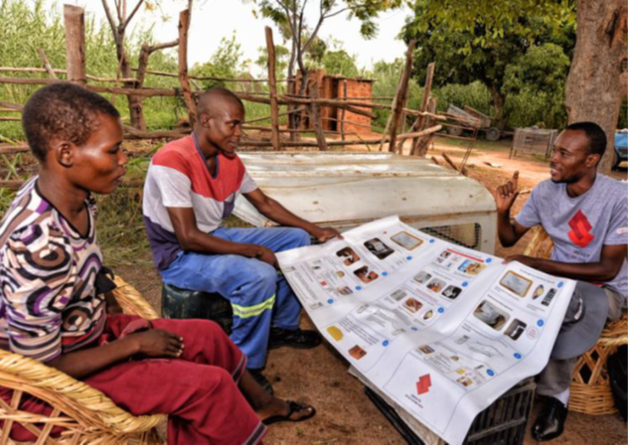
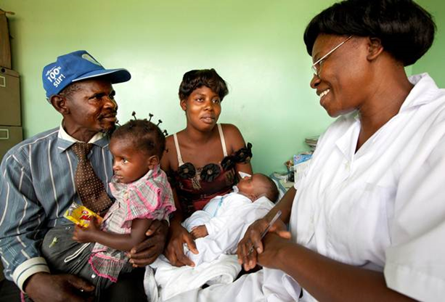
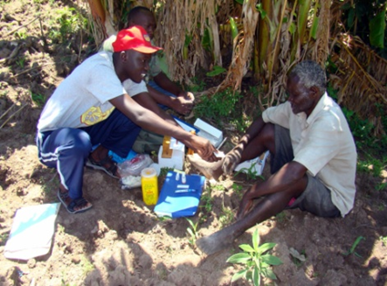
PEPFAR Research Findings: Together we can Close the Gap!
Notes:
Over the past 2 years, PEPFAR teams learned from research on barriers to reaching men with life-saving HIV testing and treatment services. They also sat face-to-face with community and faith leaders from 10 sub-Saharan African countries to discuss how to end the HIV/AIDS pandemic and ensure the future health of our children, our adolescents, our fathers, and our mothers.
These examples of messages shared in this session are a result of both research and of the critical discussions during which local leaders proposed community-based ideas and solutions.

Slide 5
Disseminating Messages of Hope Down and Across Faith Community Infra-structures
Notes:
A key PEPFAR priority is to engage faith leaders to advance {read slide}.

Slide 6
Messages of Hope for Men and Chilldren Tool –
Disseminate Key Messages of Hope in each Parent Body
Faith and Community
Initiative Leads
Council of Churches
Muslim Alliances
Evangelical and Pentecostal Churches
Catholic and Episcopal Council
Other faith groups
Churches
Mosques
Churches
Churches
Congregations
Notes:
The figure provides an example of the types of religious bodies that are common in each country.
By engaging key leaders/general secretaries of each main religious ‘Parent Body,’ or ‘Mother Body,’ in a country, it is possible to catalyze widespread national dissemination of key messages of hope down faith infra-structures, from national, to regional, to district, to zonal, to local. These messages can be regularly disseminated as part of weekly gatherings in churches and mosques, both of entire congregations and also of sub-groups, such as men’s, mothers’, couples’, and youth groups.
Additionally, at the district level for the high-priority districts, these messages can be widely disseminated through existing structures, including district inter-faith alliances, pastors’s forums/fraternities, or religious leaders’ forums. It is particularly effective when these groups, which often meet monthly, actually meet on the property of one of the district health facilities.

Slide 7
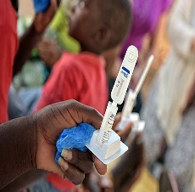
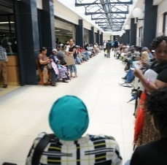
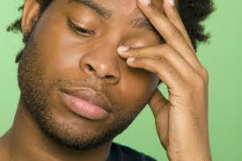
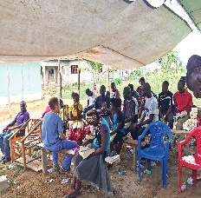
Men’s Journey -
Faith and Community Settings
Self Test
Ready to Test
Test at Clinic
Accompaniment to Start Treatment
Support for Adherence
Virally Suppressed
In Denial
Internalize the RISK
Accept they could COPE
Test in Community
How Men Feel
Men & Clinics
Engaging Men
How Providers Feel
New Messages
Mothers’ Voices
Faith Leaders for Children & Youth
Notes:
Here on the slide the blue boxes show where Faith Community Leaders can help!
By disseminating the 6 categories of messages shown at the bottom of this slide, faith leaders can move men from the red circle of ‘in denial’ to the first blue circle, of being ‘ready to test.’ Often men prefer to do this first step in the community, or as a self-test. This first step advances the 1st 95. Next, faith community members can help provide accompaniment to those needing to link into care and start treatment – thus increasing the 2nd 95. Finally, faith leaders can provide adherence support – thereby increasing the 3rd 95.

Slide 8
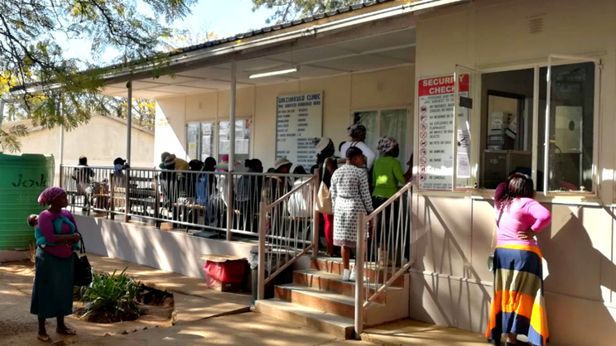
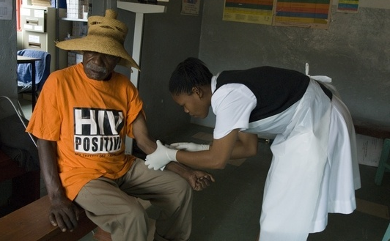
Key Messages of Hope based on Research – Adaptations for Faith Leaders on 6 Topics
How Men Feel
Engaging Men
Men & HIV Care
How Care Providers Feel
Mothers’ voices
Faith Leaders for Children and Youth
Notes:
Here are the 6 categories of research that were used to identify opportunities to address gaps in reaching men and youth with HIV testing and services.
[facilitator reads categories from slide]

Slide 9
Before focusing on the 6 topics for
New Messages of Hope,
Let’s be sure to AVOID old negative messages
AVOID negative messages, like AIDS KILLS!
AVOID messages that use guilt, shame, fear, pressure
AVOID messages that may cause men to feel that being HIV positive is yet another failure
AVOID messages telling men, “get over it and be a man”
DON’T use approaches that force or coerce
DON’T reinforce stigma around HIV
DON’T focus on sickness and death
Notes:
[facilitator reads slide]

Slide 10
Messages Addressing How Men Feel
How Men Feel – Research Insights
Men associate HIV with weakness, unattractiveness, disability
Men want option of community-based self-testing, with quality and competence
Men are ignorant about VL suppression and “intransmissability”
Messages are unaware of the benefits of couples testing together
How Men Feel - Message Adaptations for Faith Leaders
TAKE CARE OF YOURSELF AND TAKE CARE OF YOUR FAMILY! – An HIV test may help you and your family stay strong and live well! With self-testing available you chose where and when! If you or someone in your family has risk or is living with HIV, make sure you and your partners and children get tested.
ARV’s are GOOD FOR YOU! -- Your life matters! Live productive, strong & long -- with HIV treatment for life!
ARV’s are GOOD FOR YOUR FAMILY! – Treatment stops the virus from passing!
ARV’s are GOOD FOR YOUR FAITH! – The Church needs men like you, so live well with ARVs -- start treatment at once and stay on treatment every day!
TESTING can IMPROVE COUPLES COMMUNICATION! Give each other courage to test together, or apart and disclose; when two become one, they are open about health – because they are ONE!
Notes:
In the red text we see the research insights about how men feel – these include:
[facilitator reads red text]
In the black text we see message adaptations for faith leaders about ho men feel – these can be contextualized to your settings:
[facilitator reads black text]
FACILITATOR ASKS: ‘HOW CAN YOU AS A FAITH LEADER HELP SPREAD THESE MESSAGES?’

Slide 11
Messages Addressing Engaging Men
Engaging Men - Research Insights
“Wellness” is not seen as an aspirational value for men
Messages of hope are not promoted or received among men – there is a clear need to use trusted influencers (faith leaders, mothers, fathers), peer expert clients, & community radio to spread messages of hope
Engaging Men - Message Adaptations for Faith Leaders
REAL MEN CELEBRATE HEALTH in body and soul!
REAL MEN SHOW REAL STRENGTH by asking for help when we need it!
PROTECT YOURSELF AND PROTECT YOUR FAMILY! by taking your ARVs religiously, as prescribed! Prayer together with ARV adherence protects you and those you love!
STRONG MEN STAND together in health for body and soul, as we pursue our dreams for ourselves, our families, our congregation, our nation!
WE RAISE A VOICE OF HOPE! – with open arms to those living with HIV!
Broadcast radio messages from expert client champions in faith settings, “I AM A STRONG MAN! I TAKE CARE OF MY FAMILY! I AM OPEN ABOUT MY STATUS!”
BE SMART! REALIZE YOUR DREAMS by taking ARVs every day!
WE ARE OUR “BROTHERS KEEPERS’- HIV affects us all, so we care for one another!
Notes:
In the red text we see the research insights about engaging men – these include:
[facilitator reads red text]
In the black text we see message adaptations for faith leaders about engaging men, which can be contextualized to your settings:
[facilitator reads black text]
FACILITATOR ASKS: ‘HOW CAN YOU AS A FAITH LEADER HELP SPREAD THESE MESSAGES?’

Slide 12
Messages Addressing Men’s Preferences for Care
Men’s Preferences for HIV Care – Research Insights
Go to where men are to expand confidential, efficient community testing
Role for FIRST TEST at home/church/community as self-test, 2nd at clinic
Create ‘Men-Friendly’ branding for faith, clinic & community settings
Men’s Preferences for HIV Care - Message Adaptations for Faith Leaders
‘MEN-FRIENDLY’ MEETINGS IN SAFE FAITH SPACES open new doors of hope. Simple health education and HIV self-tests can be integrated into regular positive structures (bible studies, services, sports, conferences) for men's meetings (weekly/monthly/ quarterly/annually). When a man has a partner who may be at risk of, or living with HIV, it is important for him to test.
WITH LIFE AT IT’S BEST -- MEN CHOOSE WHERE TO TEST! - at churches and mosques, it’s easy, private, and fast! Combining health fairs with testimonies and self-tests for the right people, with accompaniment and support groups can keep families strong!
RESPONSIBLE MEN PLAN AND GET TESTED FOR HIV because it is the first step to a healthy life and a healthy family!
Notes:
In the red text we see the research insights about men’s preferences for care – these include:
[facilitator reads red text]
In the black text we see message adaptations for faith leaders about men’s preferences for care, which can be contextualized to your settings:
[facilitator reads black text]
FACILITATOR ASKS: ‘HOW CAN YOU AS A FAITH LEADER HELP SPREAD THESE MESSAGES?’

Slide 13
Messages Addressing How Providers Feel Adaptations
How Care Providers Feel – Research Insights
Need to engage men to find and care for men
Need to engage trusted faith leaders to help counsel & support men
Make it easy with first test in home/church/mosque/community as self-test
Provide tools & resources that train providers and counsellors in compassion
How Care Providers Feel – Message Adaptations for Faith Leaders
WE MAKE IT EASY FOR MEN TO TEST, with our HIV champions to help the right people get tested right here. We support each other to live well and stay strong! We will say more about this at our next Men’s Meeting!
WE ARE REPLACING OLD MESSAGES OF DEATH WITH NEW MESSAGES OF LIFE for every person living with HIV and who knows someone living with HIV! And the leaders of our men’s groups, alongside our HIV champions, will encourage, build up, and support every man who needs testing and every man who needs treatment, to LIVE STRONG with HIV by taking treatment for life.
OUR TRAINED CARERS GIVE HOPE THROUGH ACCOMPANIMENT AND SUPPORT GROUPS for anyone living with HIV! Prayer together with ARV adherence protects everyone we love!
IN THE FACE OF ANY CHALLENGE, WE STAND in compassion, hope, and love!
Notes:
In the red text we see the research insights about how providers feel – these include:
[facilitator reads red text]
In the black text we see message adaptations for faith leaders about how care providers feel; these can be contextualized to your settings:
[facilitator reads black text]
FACILITATOR ASKS: ‘HOW CAN YOU AS A FAITH LEADER HELP SPREAD THESE MESSAGES?’

Slide 14
Messages Addressing How Mothers Can Help
How Mothers Can Help – Research Insights
A mother’s voice is still the most influential in the life of an adult man!
A mother is also influential for the whole family….husbands, partners, children, teenagers, brothers and sisters!
How Mothers Can Help – Message Adaptations for Faith Leaders
TAKE CARE OF YOUR FAMILY!
An HIV test helps you and your family stay strong and live well!
If you or someone in your family is living with HIV, make sure your partners and children get tested.
EVERYONE LIVING WITH HIV DESERVES TREATMENT RIGHT NOW!
Treatment is free, and it works – for sons and daughters, for fathers and mothers, for brothers and sisters – for the whole family!
HIV TREATMENT PROTECTS YOU AND THOSE YOU LOVE!
Everyone in your family can live strong with HIV treatment for life! And treatment stops the virus from passing!
REMEMBER THAT CHILDREN CAN GET HIV, TOO.
If you are caring for children after one of their parents died, be sure they get tested for HIV, too!
All children with HIV can take treatment, and most children who start ART right away can look forward to growing and developing normally, going to school, and making friends.
Notes:
In the red text we see the research insights about how mothers can help – these include:
[facilitator reads red text]
In the black text we see message adaptations for faith leaders about how mothers can help, which can be contextualized to your settings:
[facilitator reads black text]
FACILITATOR ASKS: ‘HOW CAN YOU AS A FAITH LEADER HELP SPREAD THESE MESSAGES?’

Slide 15
Messages Addressing How Children’s & Youth Leaders Can Help
How Children’s & Youth Leaders Can Help – Research Insights
A Sunday School or Madrasa teacher often is one of the most trusted adults in a child’s life and as such, can pass on messages of hope about HIV.
How Children’s & Youth Leaders Can Help – Message Adaptations
CHILDREN CAN GET HIV, TOO –
Sometimes as babies, from their mothers -- so if it’s possible the parents of someone you know may have HIV, it’s good for their children to get tested! Free ARVs will keep them healthy for life!
All children with HIV can take treatment, and most children who start ART right away can look forward to growing and developing normally, going to school, and making friends.
EVERYONE LIVING WITH HIV DESERVES TREATMENT RIGHT NOW!
Treatment is free, and it works for everyone – for children, for sons and daughters, for fathers and mothers, for brothers and sisters – for the whole family!
HIV TREATMENT PROTECTS YOU AND THOSE YOU LOVE!
Everyone in your family can live strong with HIV treatment for life!
Treatment stops the virus from passing!
WE YOUTH LEADERS STAND STRONG FOR HEALTH! We are creating dramas, clips, youtube, WhatsApp, and social media messages for youth in our communities about living well with HIV! We use youth language in messaging, like “Getting an HIV test is dope!” ☺
Notes:
In the red text we see the research insights about how children’s and youth leaders can help – these include:
[facilitator reads red text]
In the black text we see message adaptations for faith leaders about how children’suth leaders can help, which can be contextualized to your settings:
[facilitator reads black text]
FACILITATOR ASKS: ‘HOW CAN YOU AS A FAITH LEADER HELP SPREAD THESE MESSAGES?’

Slide 16
Training Objectives and Agenda
Faith leaders from the front lines of their communities can change the course of HIV for their entire nations, by reaching the men with messages of hope

Slide 17
Thank You!

