Slide 1
PEPFAR Eswatini FCI:
HIVST Kit Activities Update
July 15, 2020
Notes:
Thank you for joining today.

Slide 2
Eswatini FCI Overall Coordination Arrangement
The FCI is lead by a TWG composed of nationally recognized faith leaders, PEPFAR, Ministry of Health and Implementing partners. The coordination and management of the FCI is lead by the National Church Forum on HIV/AIDS. Faith Leaders were identified and mobilized through the Church Forum and FCI TWG.
National FCI Program Manager
IP and Sub FCI Teams
Faith Leader & Community Caregivers
FCI TWG
Church Forum
National Level
Implementation Level
2
COVID-19 Adaptations
3
Justice for Children

Slide 3
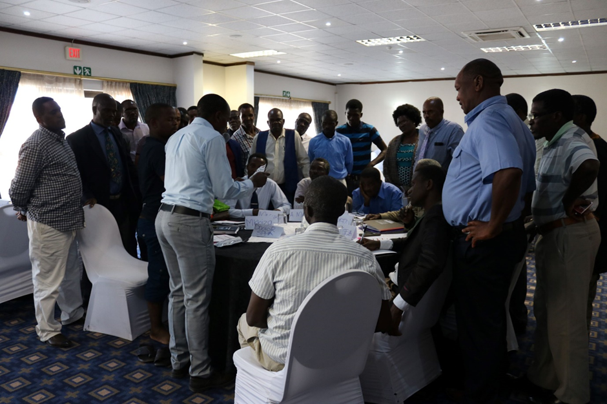
Eswatini FCI: Finding the Missing
FCI Faith Leader and Community Caregivers were trained on a curriculum that was developed specifically for, and in, Eswatini.
HIVST Demonstration during a FL training
Jan 2020
Community Caregivers are primarily responsible for distribution of HIVST kits. Their curriculum expanded to cover additional topics.
Faith Leader and Community Caregivers Engagement and Training
Topics Covered Include:
HIV 101
Prevention
Testing
Treatment
Messages of Hope and Faith
Action Planning
Faith Healing
GBV
Additional Topics Covered Include:
Counselling
Linkage to Care
Monitoring and Evaluation
Integrity, Professionalism and Confidentiality
Quality Assurance
Supply Chain Management
Train the Community Carers on the HIV epidemic, FCI and how to support their communities
Community Carer Training
Messages of Hope delivered to congregants and communities
Messages of Hope
Prevention messages, materials and support delivered to congregants
Prevention Knowledge
Distribution of HIVST kits to at-risk congregants
HIVST Kit Distribution
Linkage to treatment or prevention services
Linkage
Adherence support to those struggling in faith communities
Adherence
Notes:
Community Carers are trained on counselling practices and methods to encourage congregants who have reactive tests to link to treatment, and those with non-reactive tests to link to prevention services. Partners support each other for difficult-to-link clients with reactive tests and use the FCI Community Carer tools and Referral Tool to estimate linkage. PSI’s national 1212 hotline is also being used as a hotline for testing and linkage for those who want anonymous support.

Slide 4
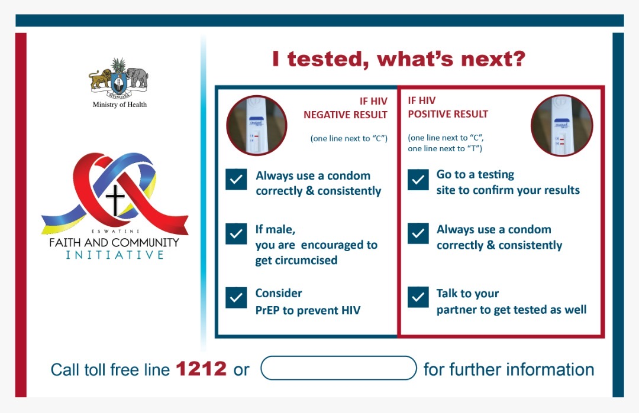
HIVST Distribution Methods and Channels
Distribution Methods
Option A: Congregation delivery
Interpersonal targeted delivery
Discreet delivery
Option B: Guest delivery
Option C: Voucher
Option D: Community
Interpersonal targeted individual delivery
Distribution at targeted community events
Option E: Combo
Distribution Channels
Churches
Pharmacies
Home deliveries
National and community gatherings

Slide 5
HIVST Kit Distribution Projections and Results
FCI P1 Implementation Timeline: Projections
5

Slide 6
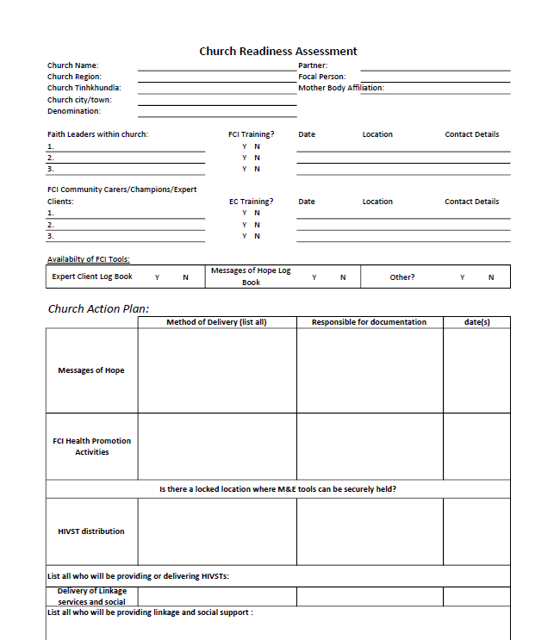
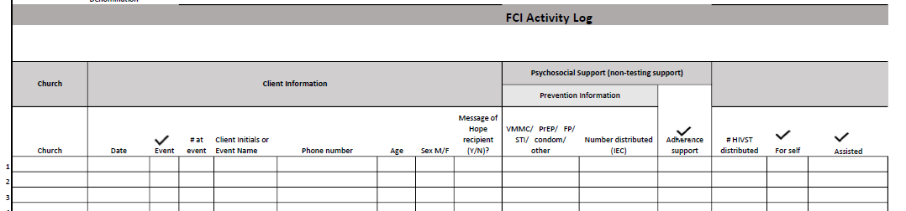
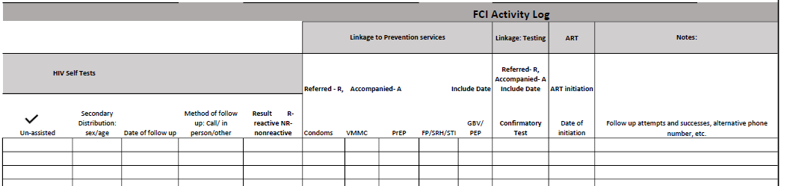
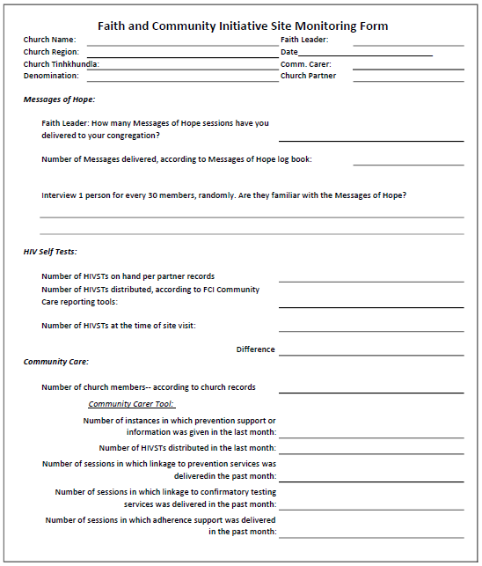
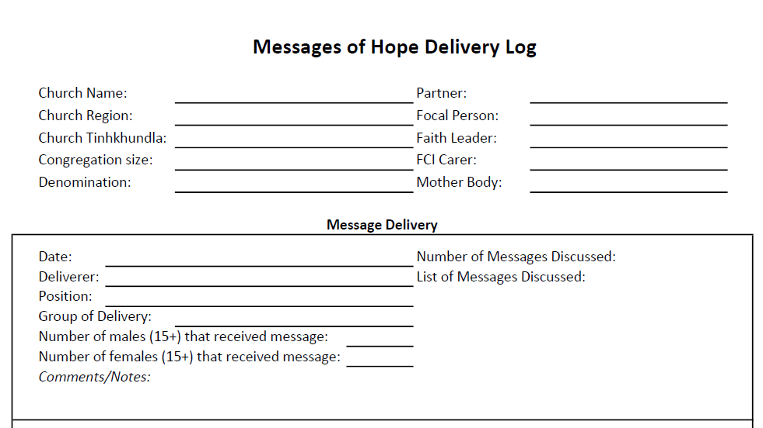
Monitoring and Evaluation
FCI M&E Program tools capture site-level information on all services delivered, allowing for routine analysis to identify gaps on retaining men and preventing LTFU
6

Slide 7
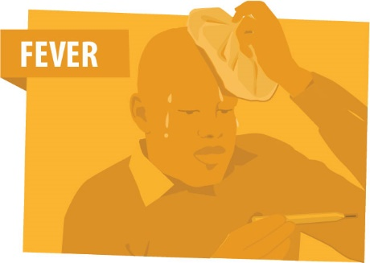

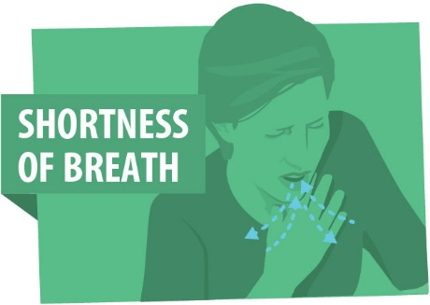
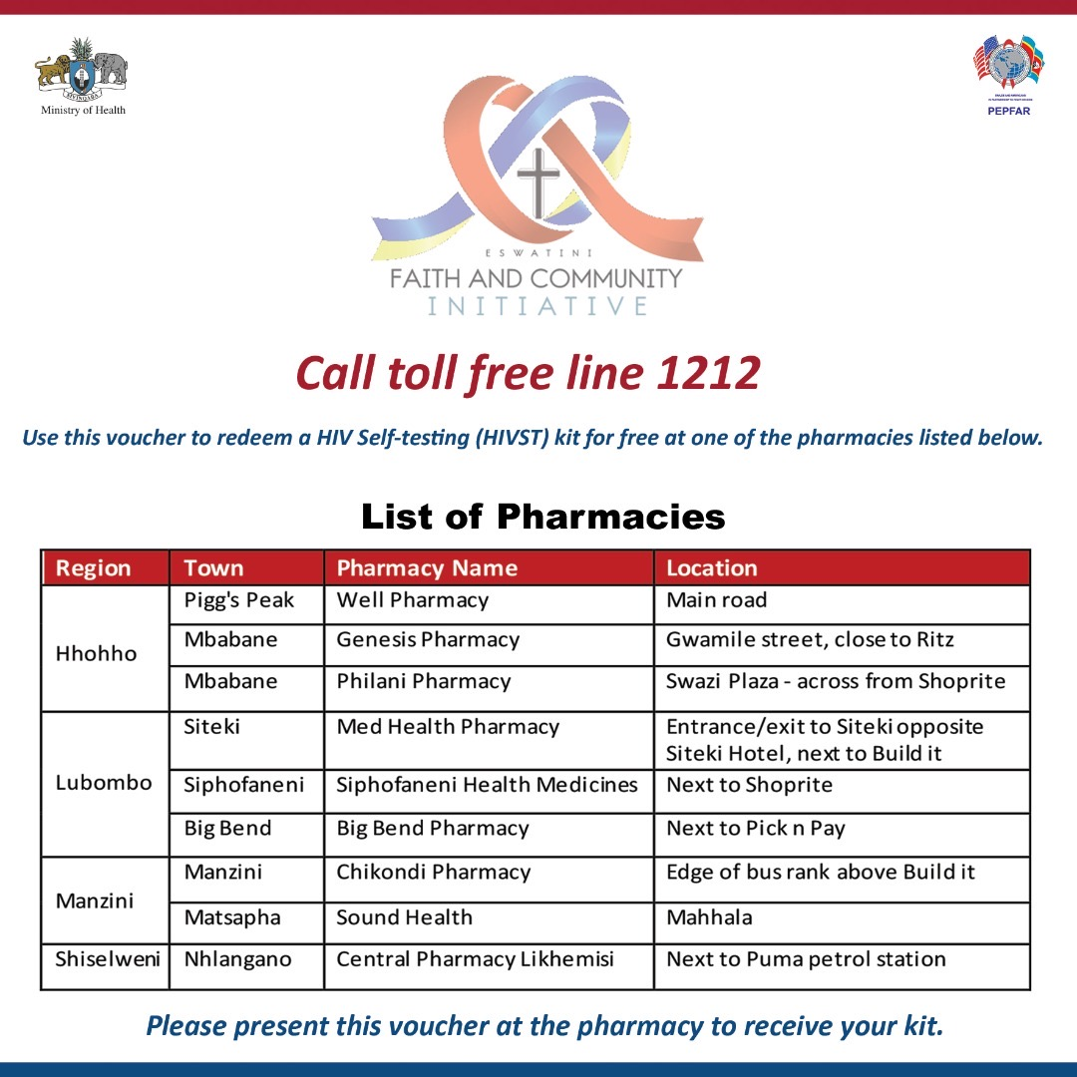
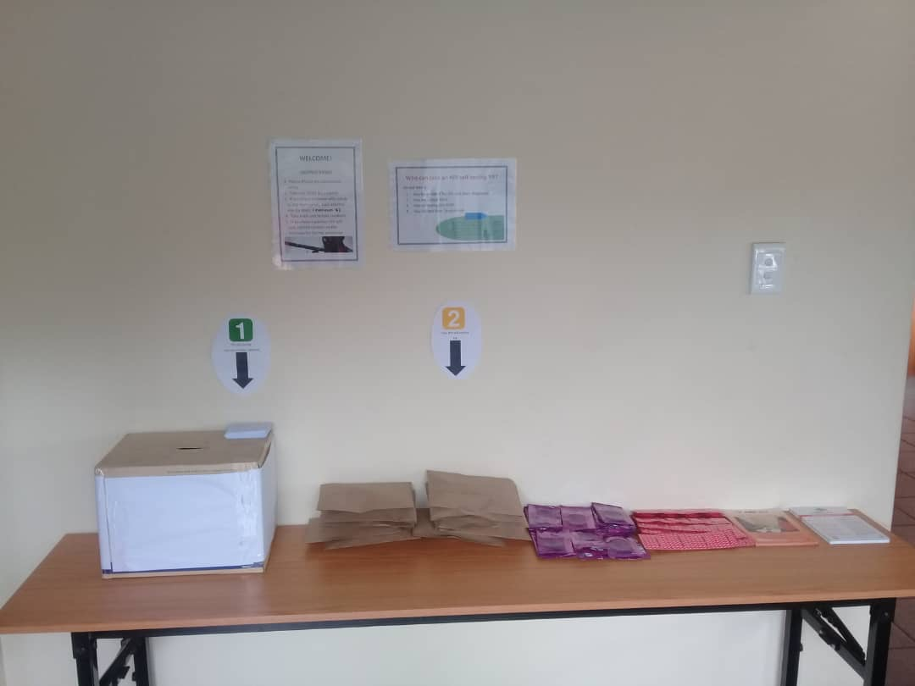
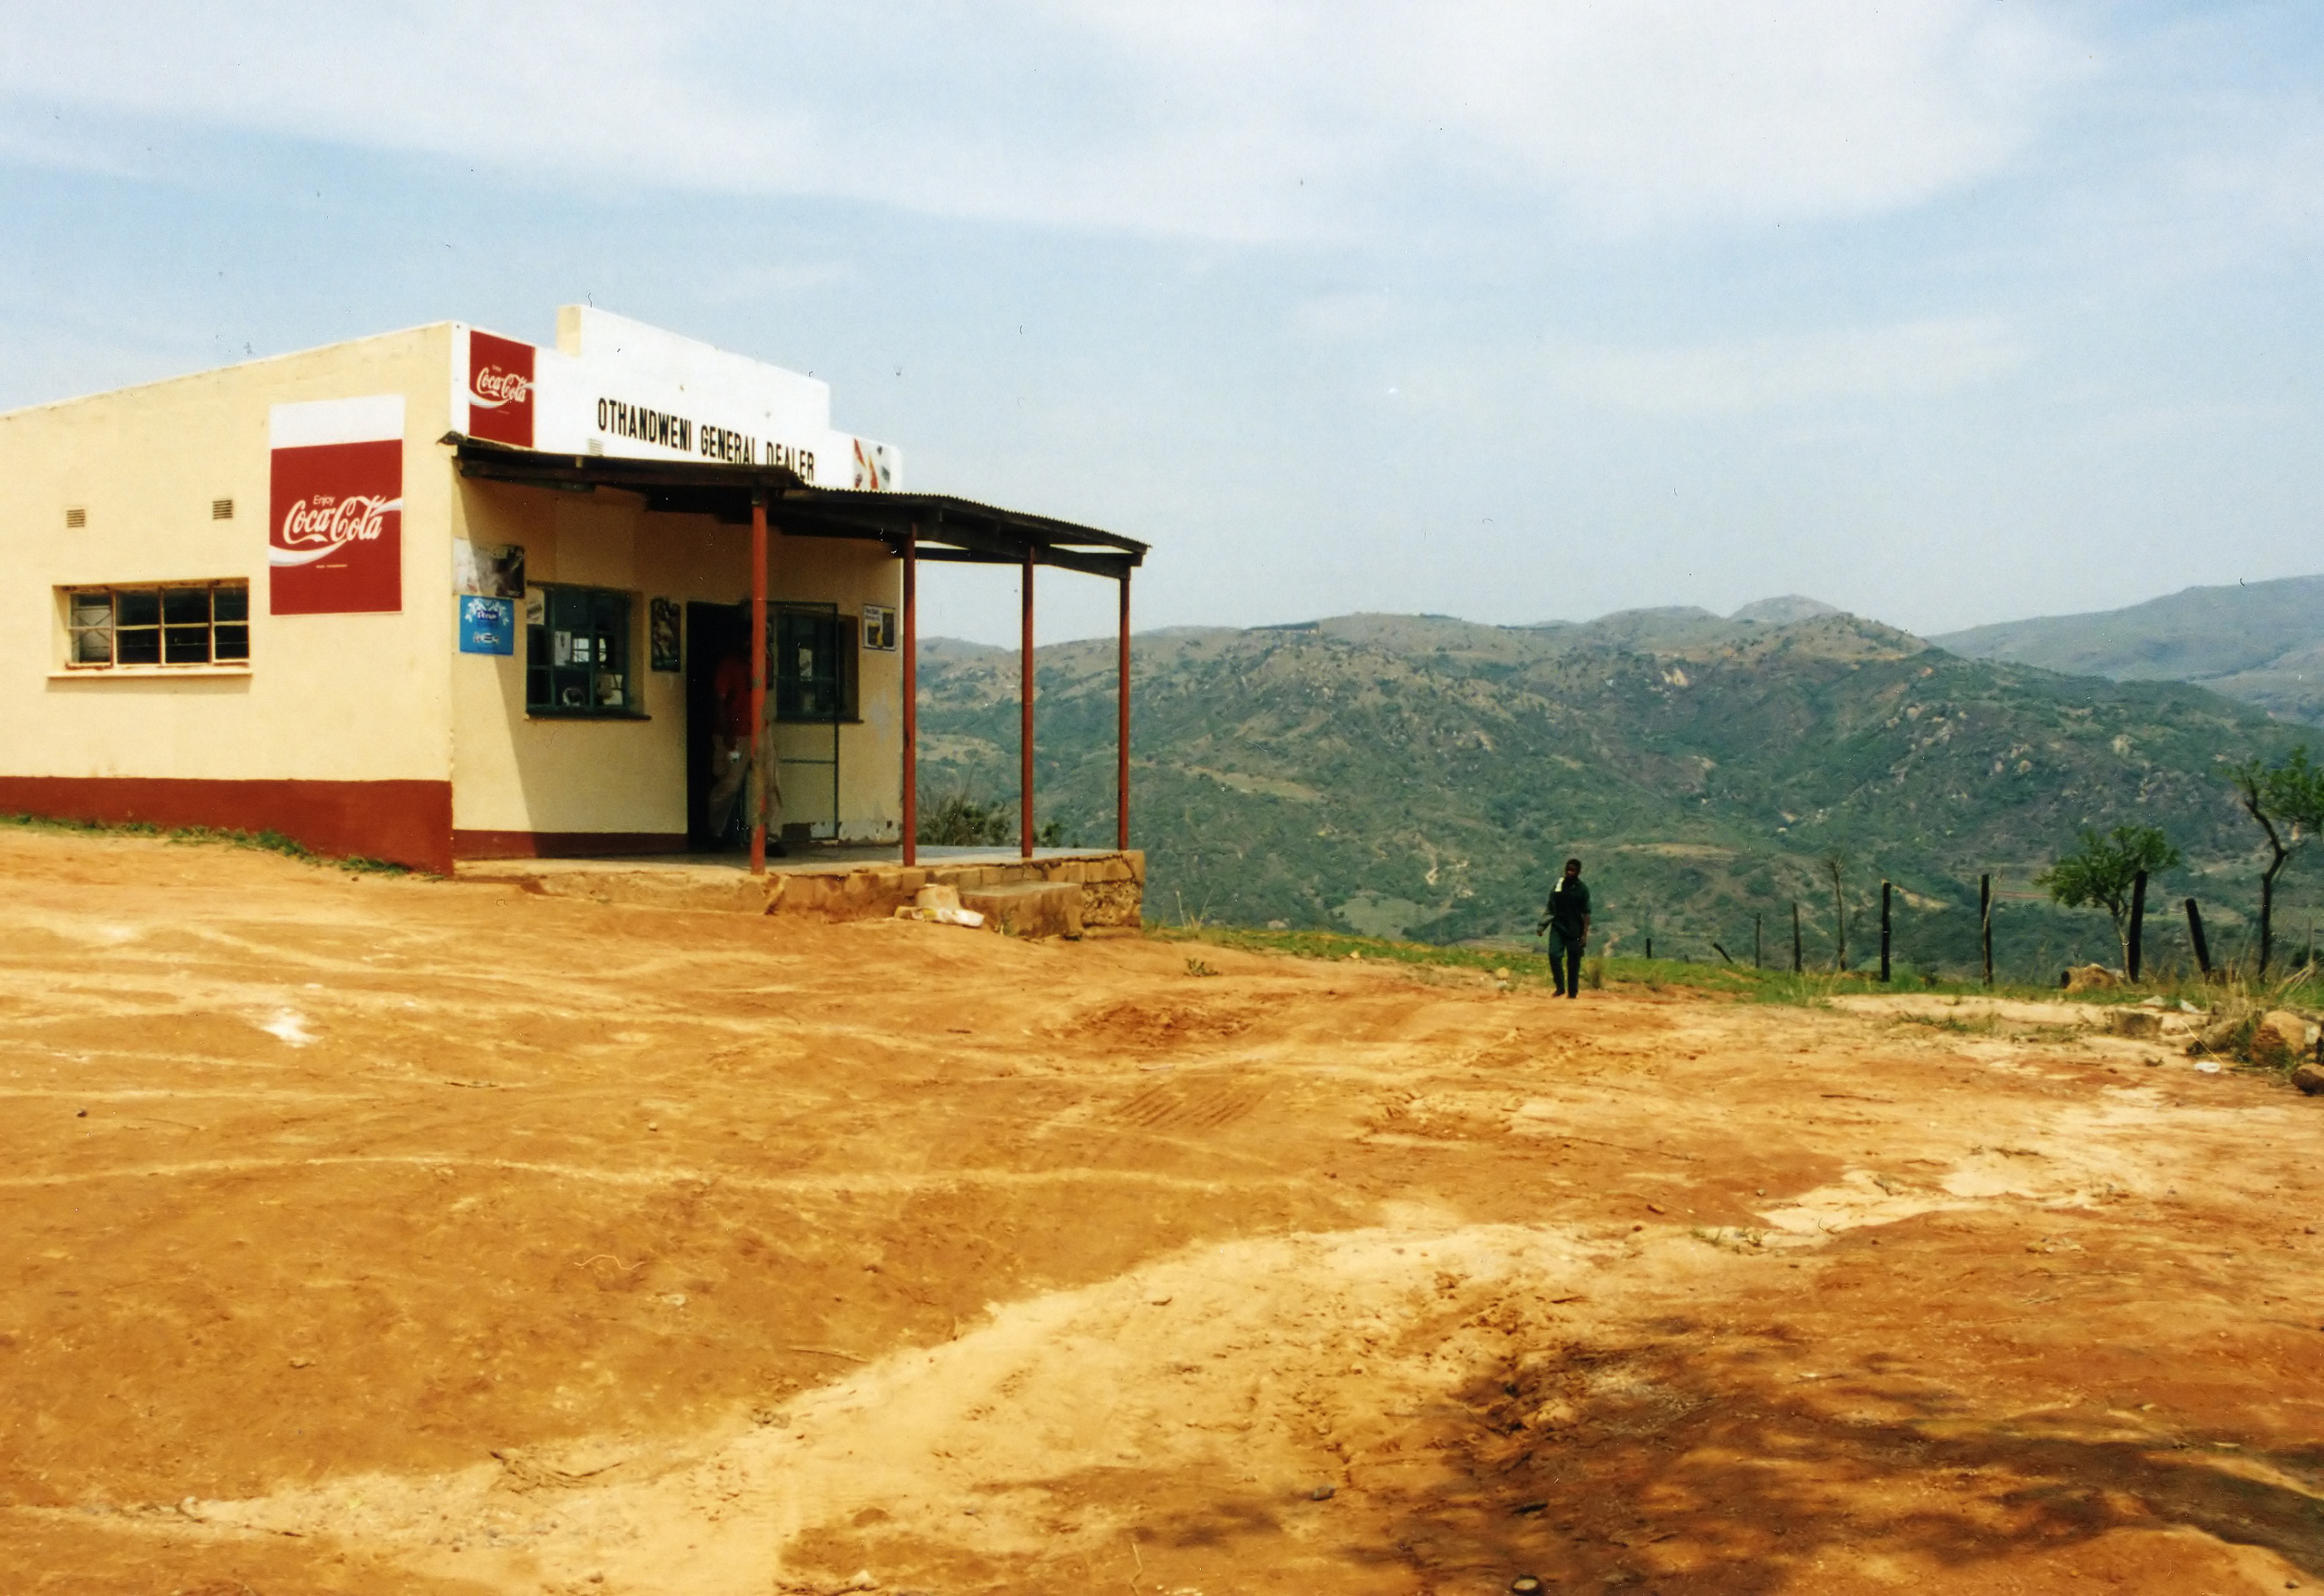
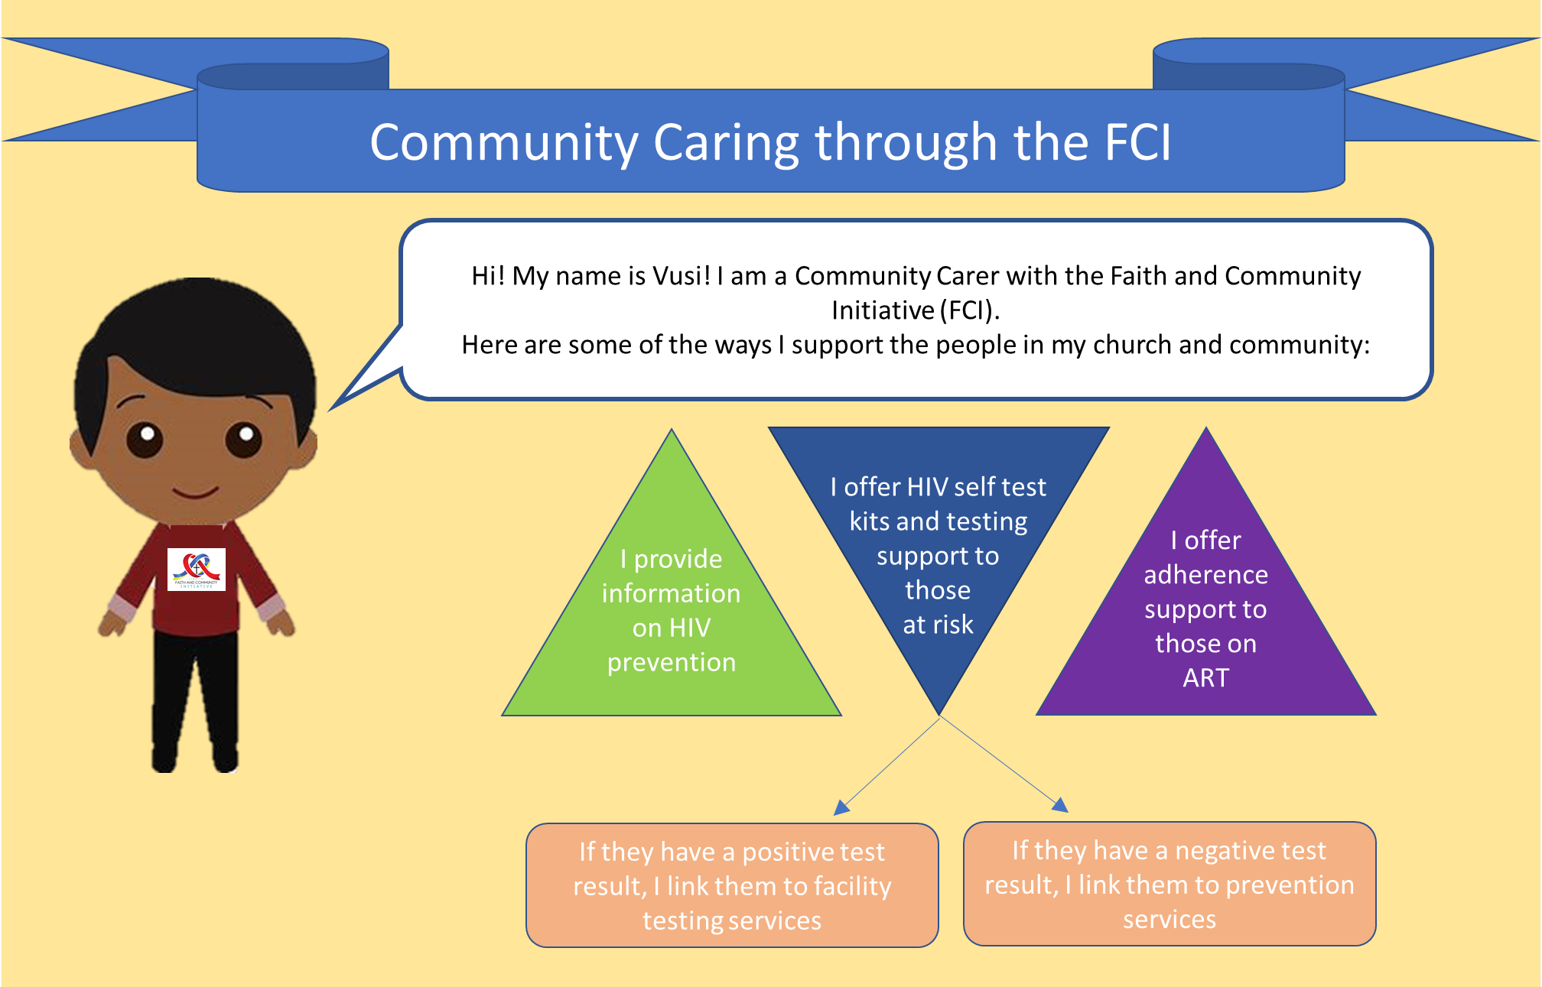
  An FCI Communications task team has been formed to develop materials in line with FCI guidance
  Ministry of Health prevention materials have been made available in electronic flyer format for Community Carer distribution on electronic platforms such as WhatsApp, Facebook, Instagram, etc.
  Messages of Hope have been adapted into small electronic flyers (to reduce data-costs) and keep the national conversations ongoing.
  Community Carers received e-flyers and guidance (and in some cases, where ongoing trainings occurred, on-site training) on how to keep themselves and their communities (particularly those living with, or at-risk of, HIV) safe from COVID-19 infection.
  Faith Leaders are to be contacted via phone, by implementing partners/subs, to discuss ways in which they can protect their communities from HIV, GBV and COVID during and after the lockdown.
Priority 1: Finding the Missing
1
COVID-19 Adaptations: Modified HIVST Distribution (1/2)
  Alternate models of HIVST distribution adopted in April by FCI TWG.
    responsive to MoH and PEPFAR guidance and need for PPE for FCI staff
    distribution models adapted to include:
      discreet commodity pick-up, support hours, small shop distribution, PSI’s pharmacy FCI HIVST network.
  A flyer describing these methods was circulated to IPs, to be sent to all community carers, along with a reminder of the goals of the FCI project.
3
Priority 2: Justice for Children
SUGGESTIONS ON HOW CARERS CAN HELP THEIR COMMUNITIES DURING THE COVID-19 LOCKDOWN
Learn and share information on how people can protect themselves from COVID-19. Minimize risk to yourself and other congregants by encouraging worship from home, regular handwashing and social distancing.
Send Messages of Hope and HIV prevention materials to congregants on different virtual platforms.
Be available on the phone, WhatsApp or other platform to provide prevention, testing or adherence support.
Communicate often with your church support partner to be aware of the resources available in your community for those experiencing any kind of abuse or insecurity, communicate these resources to the congregants you support.
Ensure people can receive HIVST kits in a way that reduces COVID-19 risk exposure, some options include:
  Make vouchers available for pharmacy pick-up of HIVSTs, share the list of participating pharmacies
  If possible, have set weekly hours at pre-determined location where people can pick up HIVSTs (using risk prevention measures such as social distancing and masks)
  Leave HIVSTs and IEC materials in a secure area (such as your church) for people to collect for themselves. Leave a sign with your name and number instructing people to message you with what they took.
  Make sure you have the contact info of anyone who received a HIVST, so you can link them to care based on their results.
Notes:
FCI priority 1 activities were paused in March during the national lockdown, in order to limit exposure to Faith Leaders, Community Carers and congregants. In response, several program modifications were made:

Slide 8
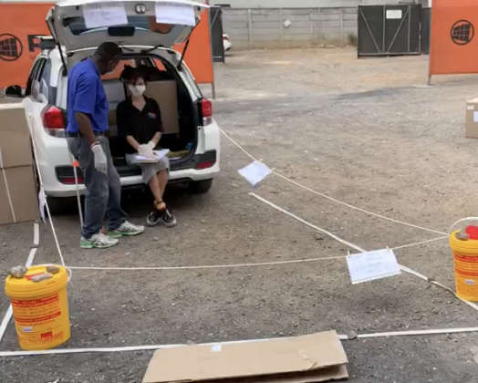

  An FCI Communications task team has been formed to develop materials in line with FCI guidance
  Ministry of Health prevention materials have been made available in electronic flyer format for Community Carer distribution on electronic platforms such as WhatsApp, Facebook, Instagram, etc.
  Messages of Hope have been adapted into small electronic flyers (to reduce data-costs) and keep the national conversations ongoing.
  Community Carers received e-flyers and guidance (and in some cases, where ongoing trainings occurred, on-site training) on how to keep themselves and their communities (particularly those living with, or at-risk of, HIV) safe from COVID-19 infection.
  Faith Leaders are to be contacted via phone, by implementing partners/subs, to discuss ways in which they can protect their communities from HIV, GBV and COVID during and after the lockdown.
FCI priority 1 activities were paused in March during the national lockdown, in order to limit exposure to Faith Leaders, Community Carers and congregants. In response, several program modifications were made:
Priority 1: Finding the Missing
1
A conscious shift towards electronic delivery of FCI materials and prevention IEC materials
Priority 1: Finding the Missing
1
Incorporation and delivery of COVID-19 prevention materials
COVID-19 Adaptations: Modified HIVST Distribution (2/2)
SUGGESTIONS ON HOW CARERS CAN HELP THEIR COMMUNITIES DURING THE COVID-19 LOCKDOWN
Learn and share information on how people can protect themselves from COVID-19. Minimize risk to yourself and other congregants by encouraging worship from home, regular handwashing and social distancing.
Send Messages of Hope and HIV prevention materials to congregants on different virtual platforms.
Be available on the phone, WhatsApp or other platform to provide prevention, testing or adherence support.
Communicate often with your church support partner to be aware of the resources available in your community for those experiencing any kind of abuse or insecurity, communicate these resources to the congregants you support.
Ensure people can receive HIVST kits in a way that reduces COVID-19 risk exposure, some options include:
  Make vouchers available for pharmacy pick-up of HIVSTs, share the list of participating pharmacies
  If possible, have set weekly hours at pre-determined location where people can pick up HIVSTs (using risk prevention measures such as social distancing and masks)
  Leave HIVSTs and IEC materials in a secure area (such as your church) for people to collect for themselves. Leave a sign with your name and number instructing people to message you with what they took.
  Make sure you have the contact info of anyone who received a HIVST, so you can link them to care based on their results.
  Alternate models of HIVST distribution for Community Carers were presented in the April FCI TWG. The presentation included a review of MoH and PEPFAR guidance, the need for PPE for FCI staff, distribution models that Community Carers could utilize, including: discreet commodity pick-up, support hours, small shop distribution, utilization of PSI’s pharmacy FCI HIVST distribution network.
  A flyer describing these methods was circulated to IPs, to be sent to all of their respective community carers, along with a reminder of the goals of the FCI project.
3
Priority 2: Justice for Children
3
Priority 2: Justice for Children

Slide 9
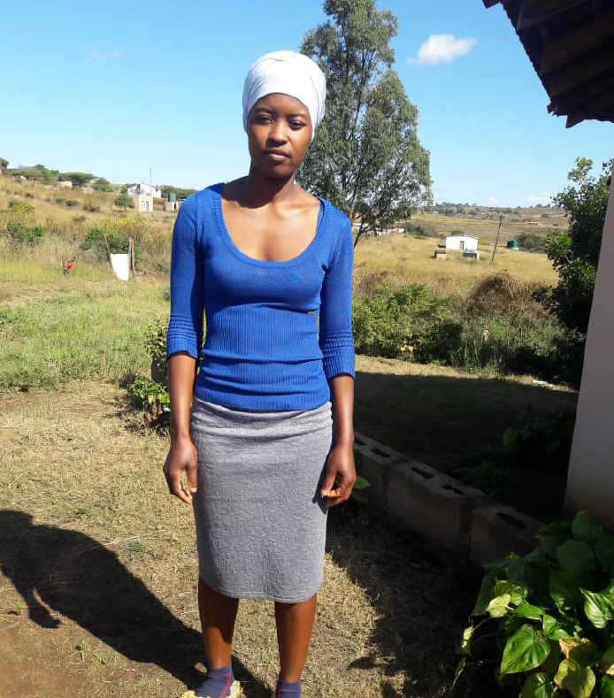
FCI Success Stories
N. G., a 26 year-old church caregiver says:
“Following the training, I have been able to deliver messages of hope to my fellow congregants, especially on treatment adherence….. Those who didn’t know their HIV status requested self-test kits which I have duly distributed to them”.
Result: four men screened HIV positive, were referred/confirmed, and initiated treatment.
Nelisiwe Gumbi. Community Carer from
Emseni Church in Zion, Nsingizini Chiefdom, Hosea Inkhundla

Slide 10

THANK YOU
SIYABONGA

